Slide 1
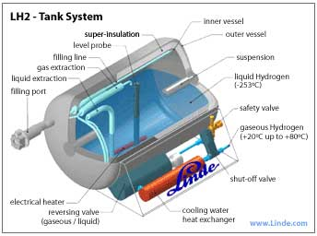
Hydrogen fuel cells
Operates like a battery, but reactants are added continuously
2H₂ + O₂ → energy + 2H₂O

Slide 2
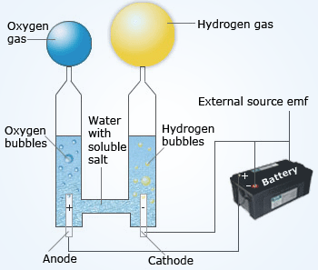
Need supply of hydrogen
Burn natural gas to extract hydrogen (CO2 released)
Electrolysis: electric current splits water into hydrogen and oxygen
New ways: photosynthetic algae/bacteria?

Slide 3
Benefits
80% efficient
No emissions

Slide 4
Drawbacks
How to obtain hydrogen without expending more energy than harnessing
Distribution network needs to be in place
Vehicles and tanks are in more danger of fire and explosions

