Slide 1
6.2 Global Energy Consumption

Slide 2
Units
Basic unit of energy: Joule (J)
1 gigajoule (GJ) = 1 billion joules = energy in 30L of gasoline
1 exajoule (EJ) = 1 billion GJ
1 Quad (only in US) = 1 quadrillion (10¹⁵) Btu (British thermal units) = 1.055 EJ

Slide 3
Dimensional Analysis = Yay!
In 2011, total world energy consumption was approximately 521 quads per year. How many GJ is that per person every month? SHOW SETUP!
GJ/person*month
10⁹ GJ x 1.055 EJ x 521 quads x 1 year x 1 year
1 EJ 1 quad 1 year 12 months 7 billion people
6.5435 GJ/person*month

Slide 4
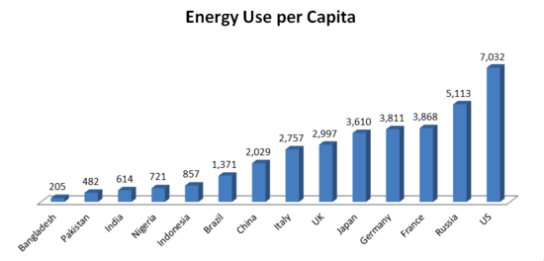
Put in the blank spots:
Bangladesh
US
France
Brazil
Japan

Slide 5
Developed and Developing countries
Commercial energy sources are bought and sold (oil, coal, natural gas)
Subsistence energy sources are gathered by individuals for their own immediate needs (straw, sticks, animal dung)

Slide 6
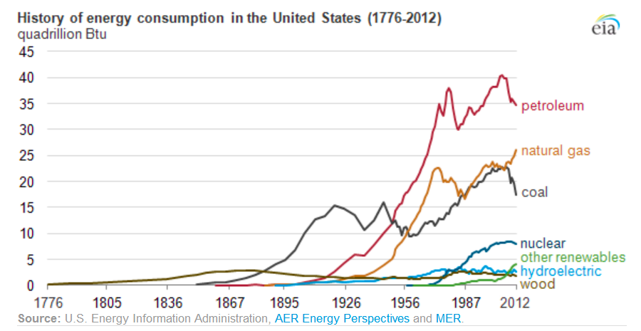
As industrialization increases, energy use increases and sources of energy change

Slide 7
Patterns of energy use
The predominant energy source until 1875 →
At that point, it became →
Did not begin until 1950 →
The 1970s saw a dramatic dip in →
The top three sources today are →
Since 2000, there has been an increase in →
WHY? (hint:
Wood
Coal
Nuclear
Oil
Oil, natural gas, coal
Natural gas
Increased availability due to the new technology of fracking

Slide 8
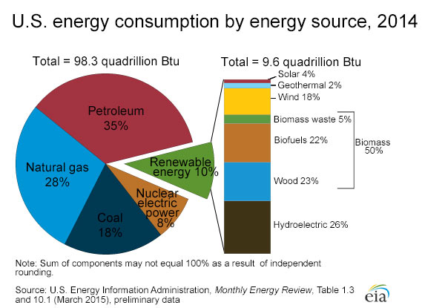

Slide 9
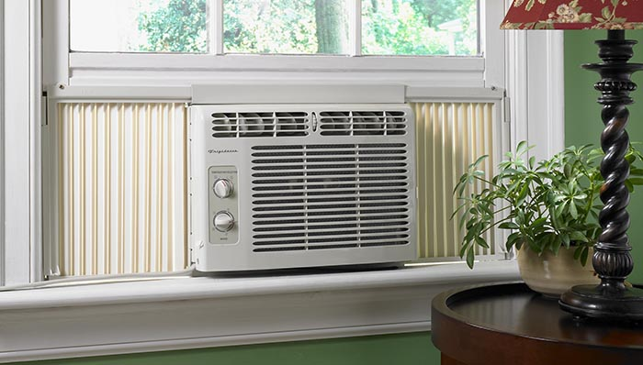
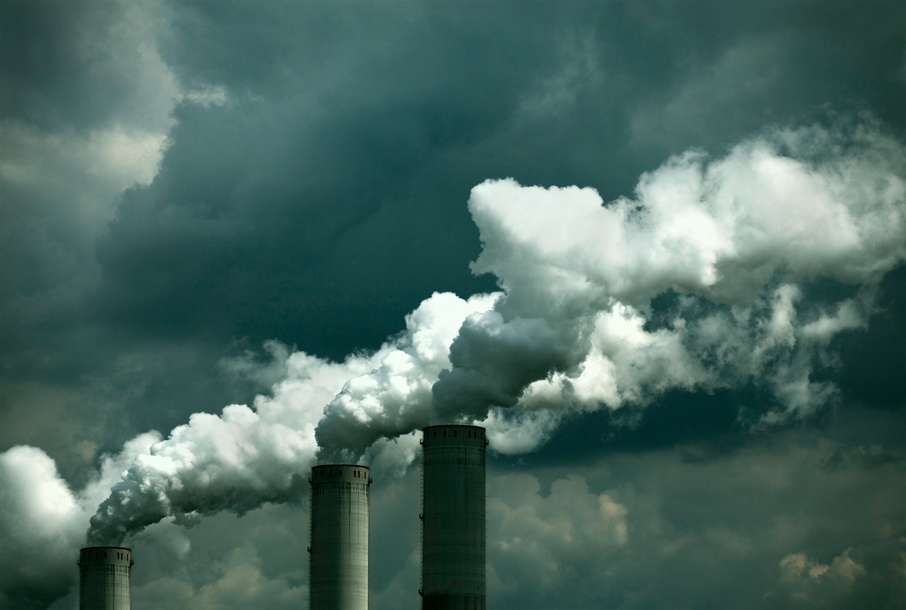
Energy use varies regionally and seasonally
Midwest/SE → coal for electricity
West/NE → nuclear/natural gas/hydroelectric
Highly populated → less coal
WHY?
North uses more energy in winter
WHY?
South uses more energy in summer
WHY?
Air pollution
Heating
Air conditioning

Slide 10
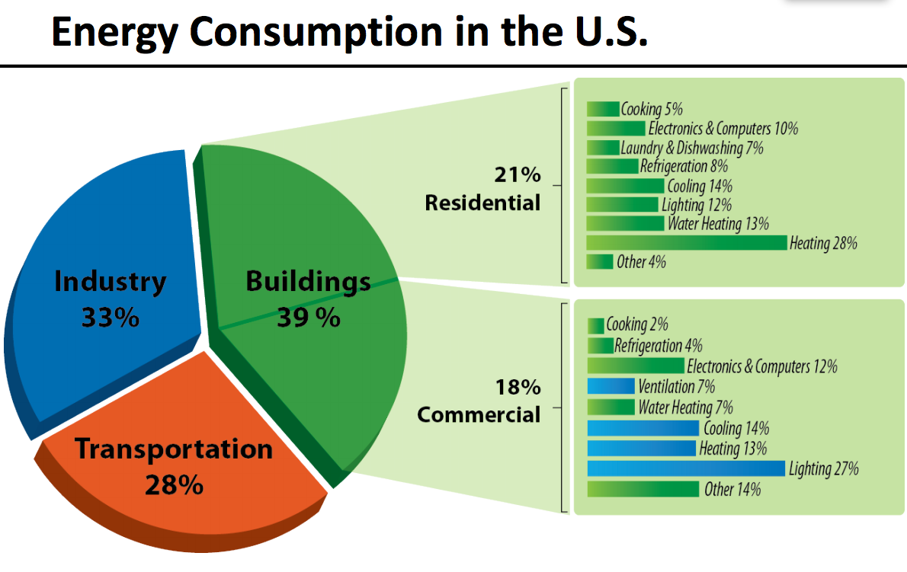

Slide 11
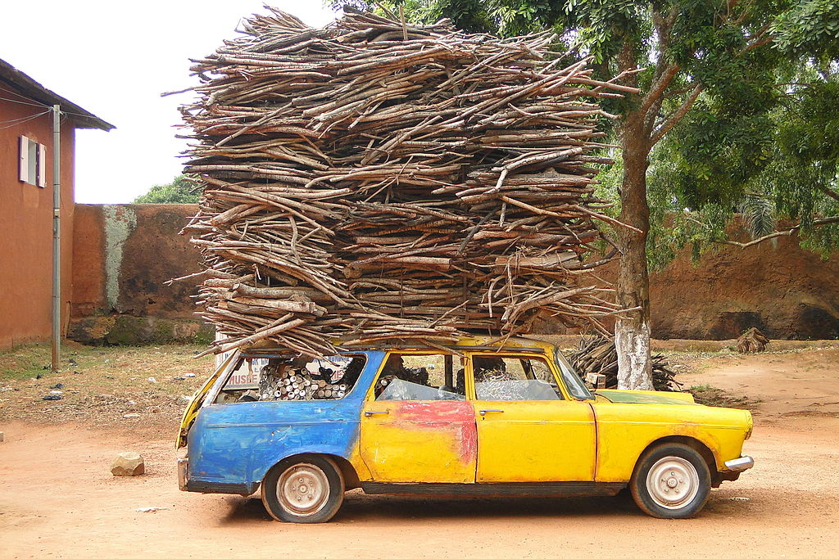
Why do we use gas or diesel for our cars instead of coal or firewood?
Energy-to-mass ratio: smaller volume needed
Starts quickly, can be shut off quickly

Slide 12
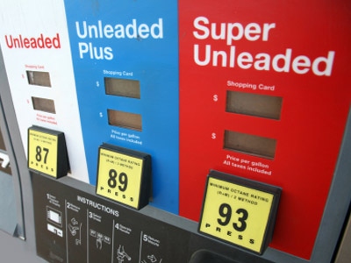
So why not use gasoline for everything?
High amounts of air pollution per joule of energy released
Requires large amount of processing/refining→ $$$$

