Slide 1
6.8 Solar Energy

Slide 2
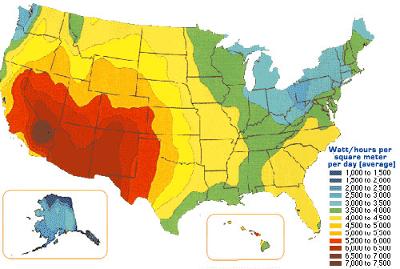
Go back to your world map to annotate!

Slide 3
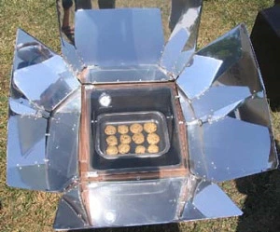
Passive solar heating
South-facing windows
Dark roofs
Solar ovens

Slide 4
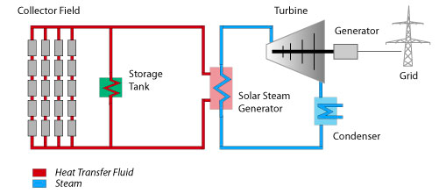
Active solar technologies
Solar water heating systems
Photovoltaic systems
Concentrating Solar Thermal Electricity Generation—CST systems
Uses lenses and mirrors to focus sunlight
Evaporates water to steam, turns turbine

Slide 5
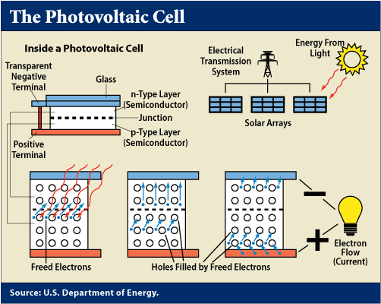
The sunlight’s energy activates and releases electrons from thin layers of semiconducting material (like silicon)
Generates a low-voltage electric current

Slide 6
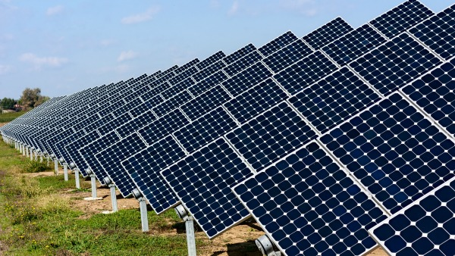
Benefits
No emissions during operation
Can produce electricity during peak demand (air conditioning)
Economically feasible (5-20 payback, then nearly free)

Slide 7
Drawbacks
PV panels expensive to manufacture and install
With less solar radiation, payback can take longer
Manufacturing of panels requires energy and water and can release toxic metals and chemicals

