Slide 1
Pretest

Slide 2
March 3, 2016
Warm Up
How many atoms are there of each element in the following chemical formulas?
MgBr₂
3 NH₄Cl
5 Mg(OH)₂
Fun Fact of the Day:
The most common isotope of hydrogen is protium, with is 1 proton and 0 neutrons.
What are We Doin’ Today?
Warm up
Notes/Videos on Parts of an Equation
Notes/Videos on Balancing Equations
Announcements/Reminders:

Slide 3
Intro Video
What can chemical reactions do??
https://www.youtube.com/watch?v=UkBhW8Kj3r8

Slide 4
Review: Chemical Formulas
5 (NH₄)₂SO₄
Subscript:
The small # after an element symbol that represents the # of atoms for that element.
Coefficient:
The large # in front of a chemical formula that represents the # of that molecule.
Circle all subscripts on your example equation!
Square all coefficients on your example equation!

Slide 5
Chemical Equations
C₇H₆O₃ + 7 O₂ → 7 CO₂ + 3 H₂O
Reactants:
The substances that react in a chemical reaction
On the left side of the equation
Products:
The substances produced by a chemical reaction
On the right side of the equation
Label the reactants on your example equation.
Label the products on your example equation.

Slide 6
Reaction Condition Symbols
 | “Yields” or “Produces”
 | Reversible reaction
 | Heat is required
Chemical | Catalyst needed;
(s) | Solid state; Precipitate
(l) | Liquid state
(g) | Gaseous state
(aq) | Aqueous solution;
Products reform original reactants
Speeds up a reaction without permanently changing itself
Compound dissolved in water

Slide 7
Review: Evidence of Chemical Change
Precipitate:
A solid that is produced as a result of a chemical reaction
Color Change
Bubbles
Heat Change
Odor Change

Slide 8
Energy for Reactions
https://www.youtube.com/watch?v=66kuhJkQCVM
With a partner:
Identify the symbol is used to show energy is needed for a reaction.
Compare and contrast the two experiments using iron.
Predict why energy is released in the reaction of hydrogen gas and oxygen gas.

Slide 9
Law of Conservation of Mass

Slide 10
Law of Conservation of Mass
Mass cannot be created or destroyed in a chemical reaction.
Mass of Reactants
Mass of Products

Slide 11
History!!
Antoine Lavoisier (French) described the law of conservation of mass (or the principle of mass/matter conservation) as a fundamental principle of physics in 1789.
An important idea in ancient Greek philosophy was that "Nothing comes from nothing”, so that what exists now has always existed: no new matter can come into existence where there was none before.

Slide 12
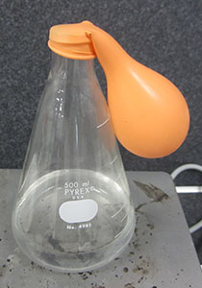
Demo: Law of Conservation of Mass
What is an “open” system?
What is a “closed” system?
Demo!

Slide 13
Star Stuff Law of Conservation of Mass
https://www.youtube.com/watch?v=2S6e11NBwiw

Slide 14
Balancing Chemical Equations
Predict why it is necessary to balance a chemical equation.
If reactions occurred unbalanced, what could happen to the world? The universe?

Slide 15
Balancing Chemical Equations

Slide 16
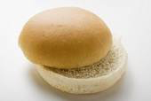
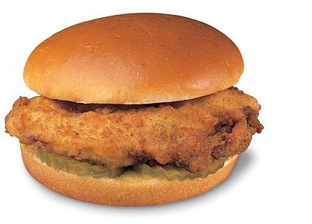
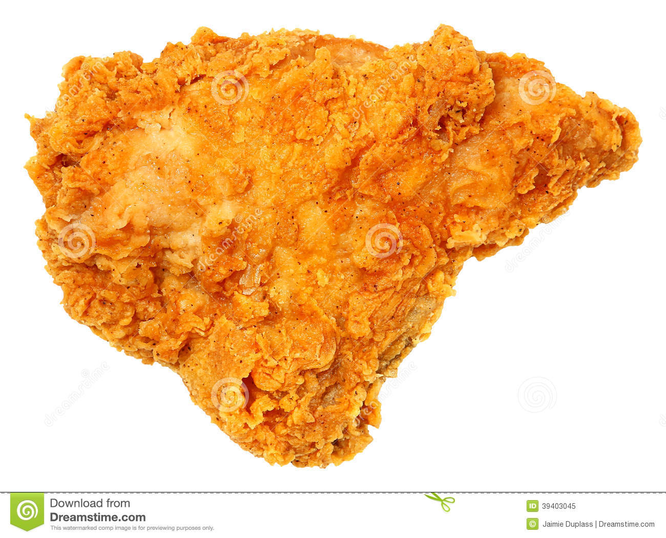
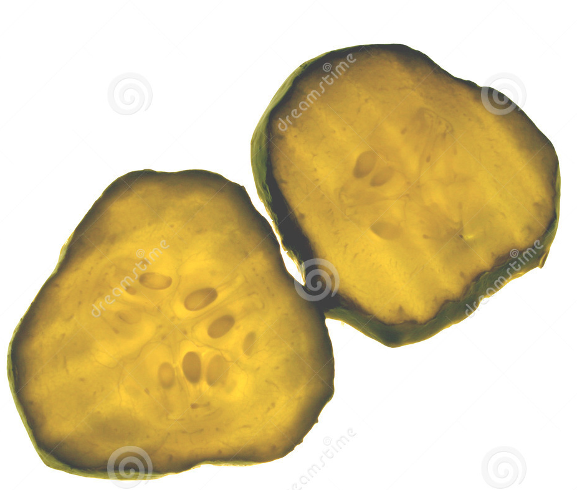
2 Buns + 1 Piece of Chicken + 2 Pickles → 1 Chickfila Sandwhich

Slide 17
Balancing Chemical Equations
H₂ + O₂ → H₂O
H- 2 | H- 2
O- 2 | O- 1
Count the number of each type of atom on each side.

Slide 18
Balancing Chemical Equations
H₂ + O₂ → H₂O
H- 2 | H- 2
O- 2 | O- 1
Change the COEFFICIENTS until there are equal numbers of atoms on each side.

Slide 19
Balancing Chemical Equations
2 H₂ + O₂ → 2 H₂O
H- 4 | H- 4
O- 2 | O- 2
Double check the amount of each type of atom.

Slide 20
What if it’s harder?
Mg(OH)₂ + HCl → MgCl₂ + HOH
Solve in this order:
Balance the METALS
Balance the NONMETALS (except O and H)
Balance O and H.

Slide 21
What if it’s harder?
Mg(OH)₂ + 2 HCl → MgCl₂ + 2 HOH
Solve in this order:
Balance the METALS
Balance the NONMETALS (except O and H)
Balance O and H.

Slide 22
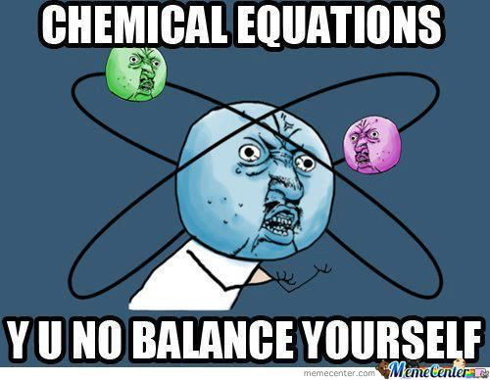

Slide 23
Practice:
Level 1: Zn + HCl → ZnCl₂ + H₂
Level 2: Fe₂S₃ + HCl → FeCl₃ + H₂S
Level 3: C₅H₁₂ + O₂ → H₂O + CO₂
Solve in this order:
Balance the METALS
Balance the NONMETALS (except H and O)
Balance H and O.

Slide 24
Practice:
Level 1: 1 Zn + 2 HCl → 1 ZnCl₂ + 2 H₂
Level 2: Fe₂S₃ + HCl → FeCl₃ + H₂S
Level 3: C₅H₁₂ + O₂ → H₂O + CO₂
Solve in this order:
Balance the METALS
Balance the NONMETALS (except H and O)
Balance H and O.

Slide 25
Practice:
Level 1: 1 Zn + 2 HCl → 1 ZnCl₂ + 2 H₂
Level 2: 1 Fe₂S₃ + 6 HCl → 2 FeCl₃ + 3 H₂S
Level 3: C₅H₁₂ + O₂ → H₂O + CO₂
Solve in this order:
Balance the METALS
Balance the NONMETALS (except H and O)
Balance H and O.

Slide 26
Practice:
Level 1: 1 Zn + 2 HCl → 1 ZnCl₂ + 2 H₂
Level 2: 1 Fe₂S₃ + 6 HCl → 2 FeCl₃ + 3 H₂S
Level 3: 1 C₅H₁₂ + 8 O₂ → 6 H₂O + 5 CO₂
Solve in this order:
Balance the METALS
Balance the NONMETALS (except H and O)
Balance H and O.

Slide 27
I Got It!
Work on next page of homework packet quietly.
Help me!
I got stuck on the Strugglebus…
https://www.youtube.com/watch?v=oDVswHfZJzY

Slide 28
March 4, 2016
Warm Up
Write 2-4 instances describing where you have observed the Law of Conservation of Mass in your life.
Fun Fact of the Day:
The hardest chemical in your body is your tooth enamel.
What are We Doin’ Today?
Warm up
Notes on Balancing Equations
PhET Lab
Announcements/Reminders:
Test on 2/12

Slide 29
Computer Lab
Start with “PhET” side
Minimum 15 problems
5 Level 1, 5 Level 2, 5 Level 3
It’s Elemental! Balancing Act
Minimum of 20 problems
5 Beginner, 10 Intermediate, 5 Advanced
If you finish, come get signed off my teacher and you may play one of the two games listed on your paper.

Slide 30
March 7, 2016
Warm Up
Balance:
Fe + H₂O → Fe₃O₄+ H₂
Na₂SO₄+ CaCl₂ → CaSO₄+ NaCl
Fun Fact of the Day:
The ethylene gas produced by ripening fruit, ripens other fruit and vegetables.
What are We Doin’ Today?
Warm up
Announcements/Reminders:
Turn in Lab if completed
Turn in Packet
Test on Friday!

Slide 31
Classifying Chemical Reactions
5 Major Types of Reactions
Synthesis
Decomposition
Single Replacement
Double Replacement
Combustion

Slide 32
Synthesis
A + B → AB
Synthesis Reaction: two or more substances combine to form a new compound.

Slide 33
Synthesis
A + B → AB
Synthesis Reaction: two or more substances combine to form a new compound.
Could be many forms: Anything that combines together to form a more complex compound.
AB + C → ABC
A + B + C → ABC

Slide 34
Synthesis
A + B → AB
Synthesis Reaction: two or more substances combine to form a new compound.
Not always needed!
Example:
2 Mg + O₂ → 2 MgO
2 Mg + O₂ → 2 MgO

Slide 35
Decomposition
AB → A + B
I’m so much better off without him…
I’m so much better off without her…

Slide 36
Decomposition
AB → A + B
Decomposition Reaction: A single compound breaks down to form two or more simpler substances.
Could be many forms: Anything that breaks apart a more complex molecule.
ABC → AB + C
ABC → A + B + C

Slide 37
Decomposition
AB → A + B
Decomposition Reaction: A single compound breaks down to form two or more simpler substances.
Not always needed!
Example:
2 H₂O₂→ 2 H₂O + O₂
KI

Slide 38
Mercury (II) thiocyanate decomposition
https://www.youtube.com/watch?v=PC3o2KgQstA
8:52- 10:00

Slide 39
Single Replacement
AB + C → AC + B
Prom at 7 pm.
Prom at 11 pm.

Slide 40
Single Replacement
AB + C → AC + B
AB + C → CB + A
Single Replacement: One atom or ion displaces another atom or ion from a compound.
Also known as “Single Displacement”
Example:
3 CuCl₂ + 2 Al → 2 AlCl₃ + 3 Cu

Slide 41
Double Replacement
AB + CD → AD + CB
Prom at 7 pm.
Prom at 11 pm.

Slide 42
Double Replacement
AB + CD → AD + CB
Double Replacement: Two compounds exchange atoms or ions to form two new compounds.
Also known as “Double Displacement”
Example:
Pb(NO₃)₂ + 2 KI→ PbI₂ + 2 KNO₃

Slide 43
Combustion
C_{x}H_{y} + O₂ → CO₂ + H₂O
BOOM!
+ Hurt Feelings
Gossip…

Slide 44
Combustion
C_{x}H_{y} + O₂ → CO₂ + H₂O
C_{x}H_{y}O_{z} + O₂ → CO₂ + H₂O
Combustion Reaction: The oxidation of a hydrocarbon, in which heat is released.
Example:
C₂H₆O+ 3 O₂ → 2 CO₂ + 3 H₂O

Slide 45
Project
Introduce project…
By Wednesday, you need to have a plan.

Slide 46
March 8, 2016
Warm Up
Balance and Classify:
N₂ + H₂ → NH₃
Fe₂O₃ + H₂ → Fe + H₂O
Fun Fact of the Day:
The only letter that doesn’t appear on the Periodic Table of Elements is J.
What are We Doin’ Today?
Warm up
Single Replacement and Double Replacement Labs
Announcements/Reminders:
Test on Friday!

Slide 47
March 8, 2016
Warm Up
Balance and Classify:
N₂ + 3 H₂ → 2 NH₃
Fe₂O₃ + 3 H₂ → 2 Fe + 3 H₂O
Fun Fact of the Day:
The only letter that doesn’t appear on the Periodic Table of Elements is J.
What are We Doin’ Today?
Warm up
Single Replacement and Double Replacement Labs
Announcements/Reminders:
Test on Friday!

Slide 48
Lab
What information to present for the lab?

Slide 49
March 9, 2016
Warm Up
Fill out “Project Plan” cards.
Fun Fact of the Day:
The human body contains enough carbon to produce graphite for about 9,000 pencils.
What are We Doin’ Today?
Warm up
Review
Project Workday
Announcements/Reminders:
Test on Friday!
Almost There Tomorrow!

Slide 50
March 10, 2016
Warm Up
Fun Fact of the Day:
Bee stings are acidic while wasp stings are alkaline.
What are We Doin’ Today?
Warm up
Questions?
Almost There
Announcements/Reminders:
Test tomorrow!
All classwork due tomorrow.

Slide 51
What’s Due??
fds

Slide 52
March 11, 2016
TURN IN:
In this order…
…
Fun Fact of the Day:
Mosquitoes like the scent of estrogen, thus women get bitten more often than men do.
What are We Doin’ Today?
Test
Announcements/Reminders:
Project Due Monday

