Slide 1
AP Testing Guide Highlights
Sprayberry HS
May 2020

Slide 2
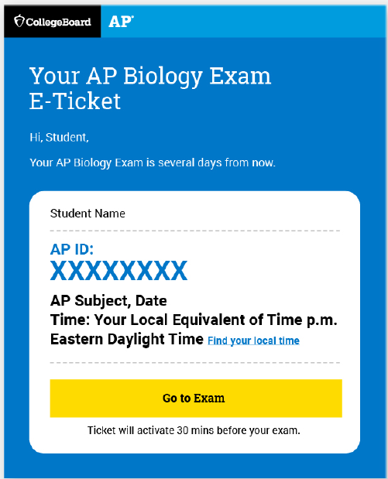
Exam E-Ticket

Slide 3
What you need to know:
You will receive your e-ticket two days before each exam
You will receive an e-ticket for each exam you are taking.
Access your e-ticket in your student account on My AP: myap.collegeboard.org if you do not receive it through email.
If you share your ticket, you may lose your chance to test
Save your e-ticket email, you may need it to request a June make-up
If you do not want to test, or you are testing later, DO NOT USE THE TICKET

Slide 4
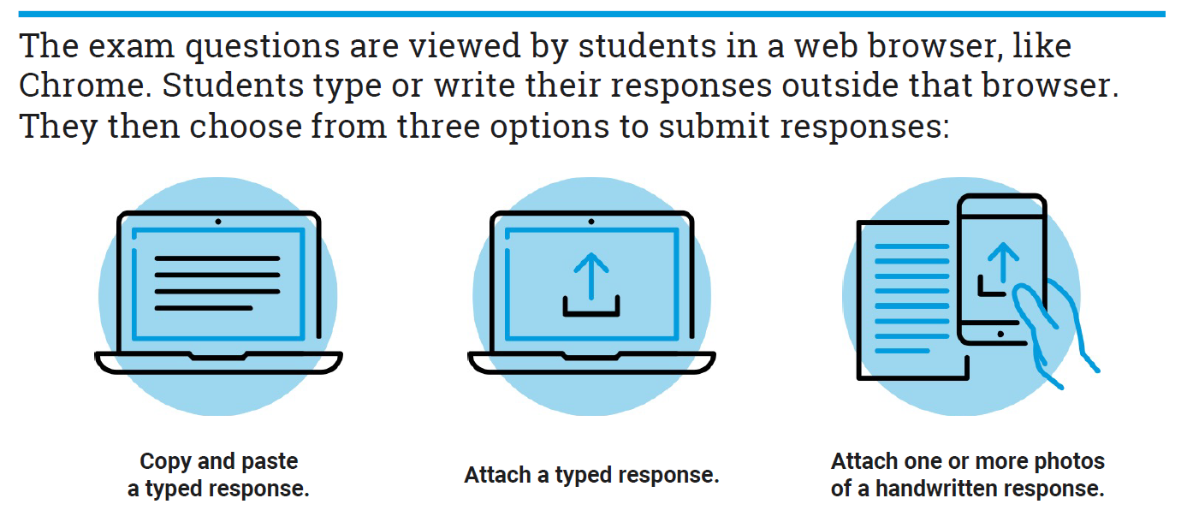
Submitting Your Answer/s

Slide 5
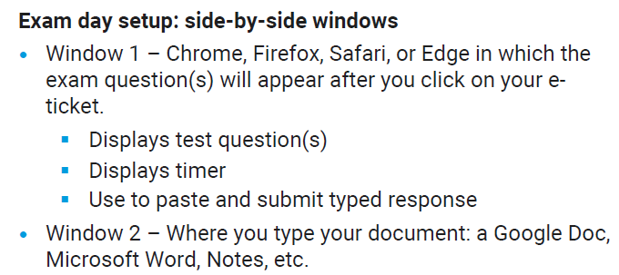
Option One: Copy-and-Paste a Typed Response
Type your response in Google Docs, Microsoft Word, Notes, or similar app. Do not include images and save your work often
Type your AP ID and initials at the top of the response
When the timer has 5 minutes remaining, copy-and-paste your response into the space indicated, and click Submit.

Slide 6
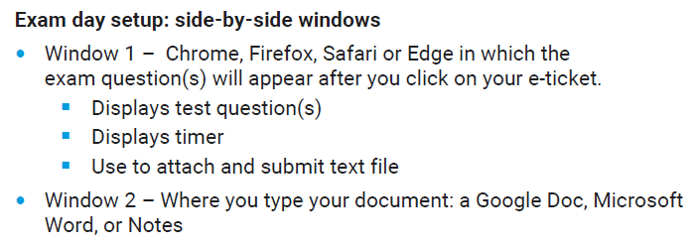
Option Two: Attach a Document
Type your response in Google Docs, Microsoft Word, Notes, or similar app. Don’t include images, and save your work often.
Save your document in one of these accepted file formats:
.doc
.docx
.pdf
.txt
odt
Type your AP ID and initials at the top of the response
When the timer has 5 minutes remaining, attach your response and click Submit
If your exam has two questions, you must create, save, attach, and submit two separate documents, one for each question.

Slide 7
Option Three: Attach Photos of Handwritten Response
Write your AP ID, initials, and page number at the top of EACH page of the response
Write your response clearly with dark pen or pencil
When the timer has 5 minutes remaining, take a photo of your response in vertical orientation (not landscape)
One page per photo, If your response is longer than one page, you’ss need to attach multiple photos (max of 5 photos per test) before clicking submit
Make sure to attach all of your pages before you click Submit
Acceptable file formats:
.png
.jpg
.jpeg

Slide 8
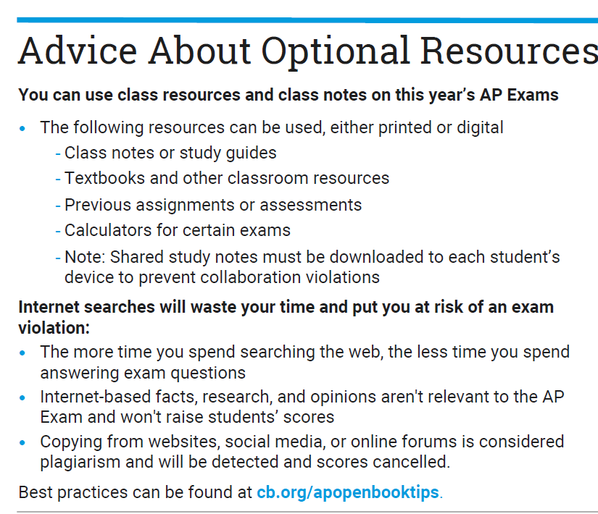
Preparing for Test Day
Important Steps to Take

Slide 9
Review Your Contact Information
Sign into My AP: myap.collegeboard.org
Confirm your email address:
In Subscriptions, confirm that you’ve checked the box to receive updates from College Board
Then, create a new contact with the email address collegeboard@e.collegeboard.org in your address book or safe sender list
Don’t worry – if you still can’t get emails from AP, your e-ticket will also be posted in your My AP account

Slide 10
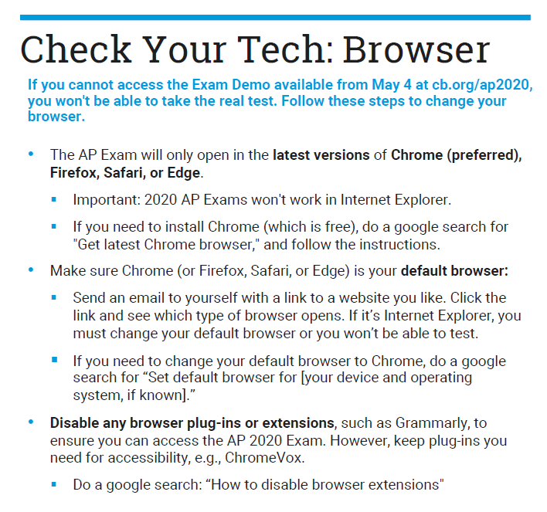
Check your Tech
Check that you have the appropriate device for your exam and how you’re planning to create your response
You won’t need the lockdown browser
If you have Grammarly plug-in on your computer, you’ll need to remove it to test

Slide 11
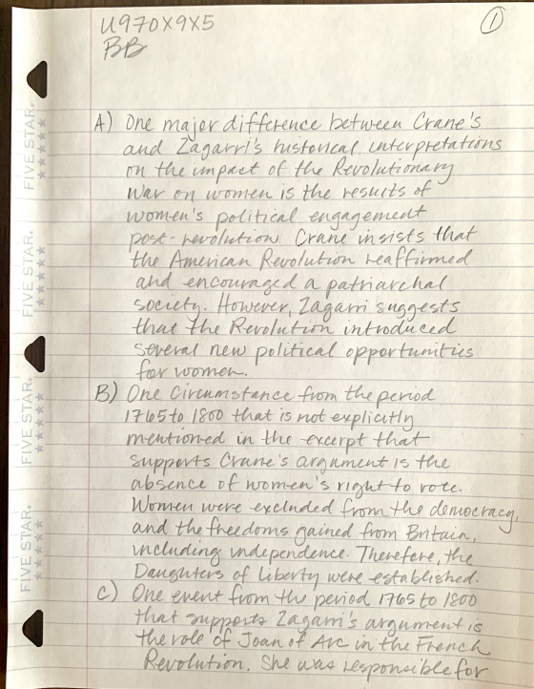
Prepare Your Document or Paper
Before test day, prepare your docs by typing your AP ID and initials at the top
Before test day, prepare your paper (name, AP ID, initials, page number)
Remember, some exams require two responses. Those responses have to be on separate documents

Slide 12
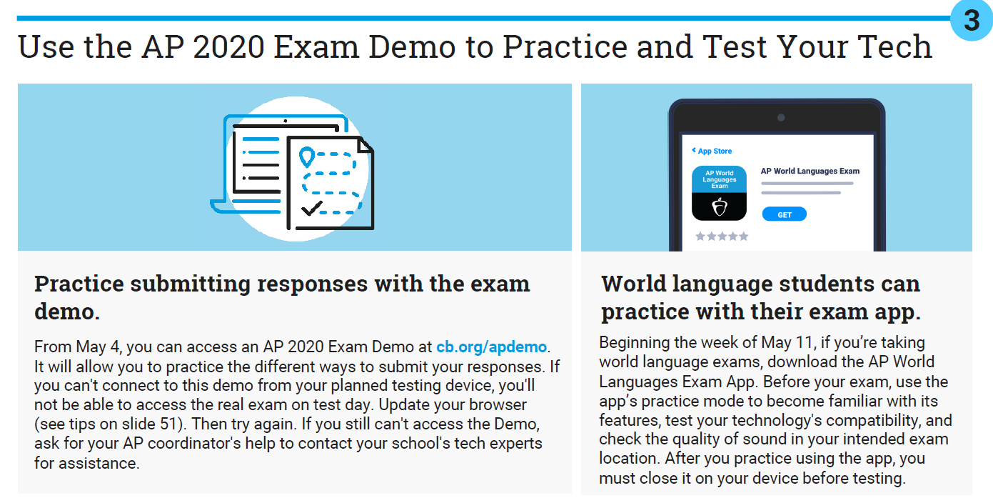
Use the AP 2020 Exam Demo – May 4th cb.org/apdemo

Slide 13
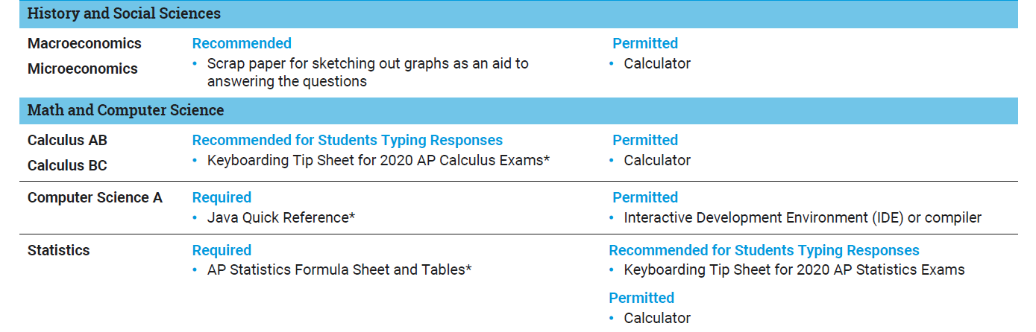

Slide 14
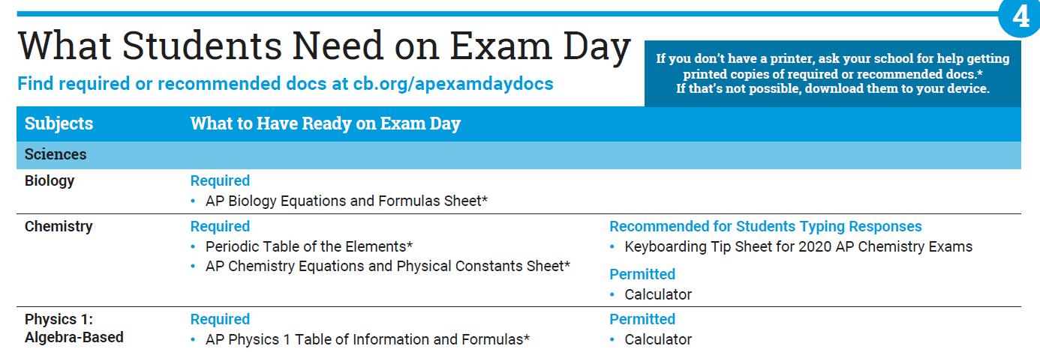

Slide 15
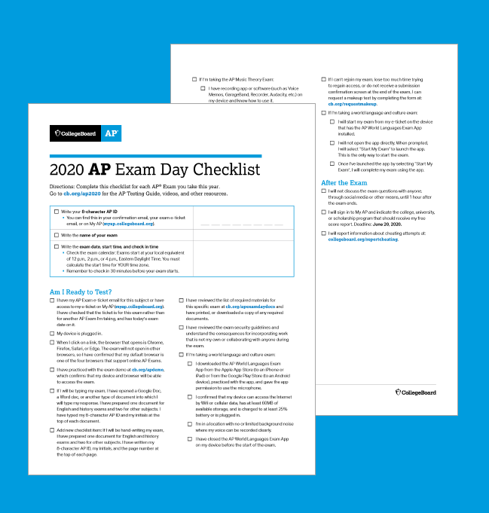
Complete your AP Exam Day Checklist for each exam
Download the checklist at cb.org/apchecklist

Slide 16
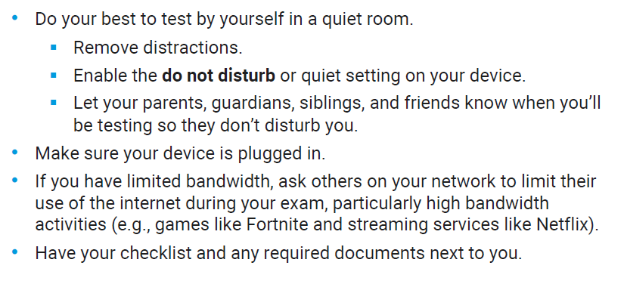
Exam Day
Testing Environment

Slide 17
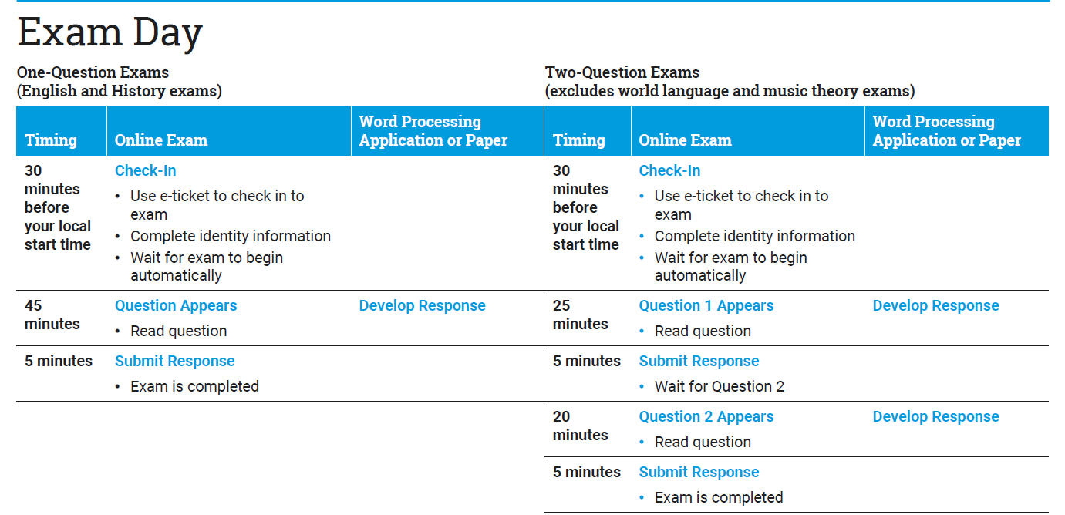

Slide 18
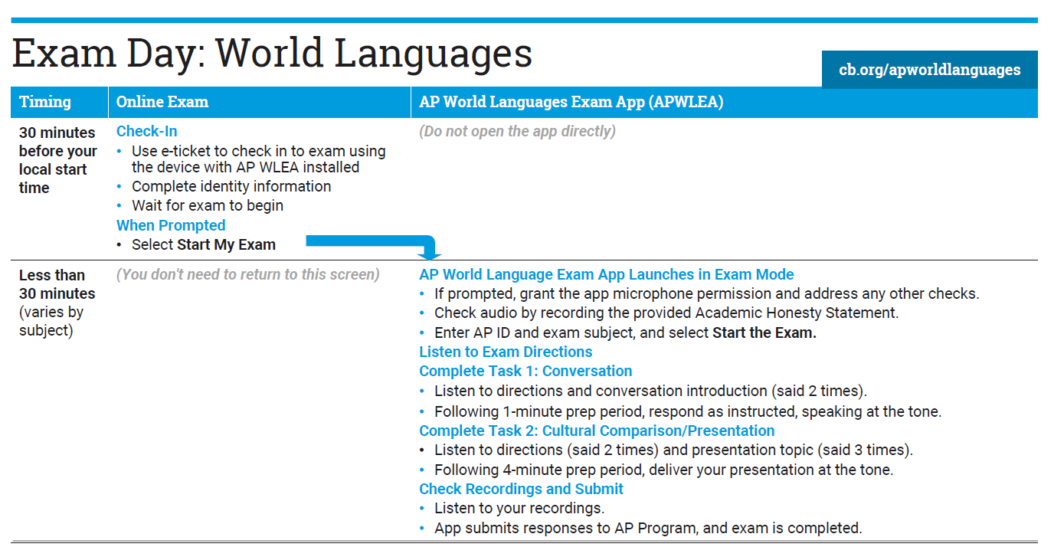

Slide 19
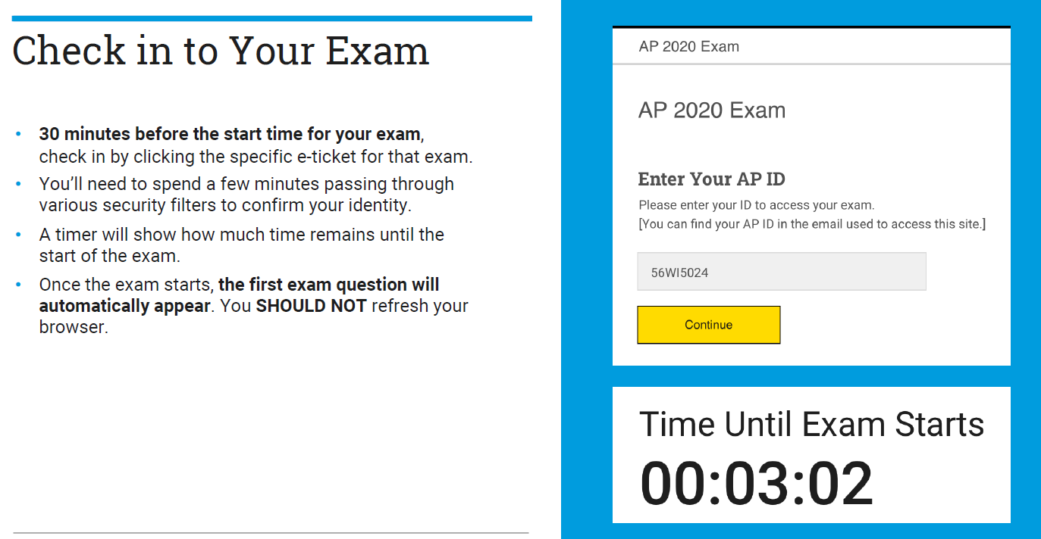

Slide 20
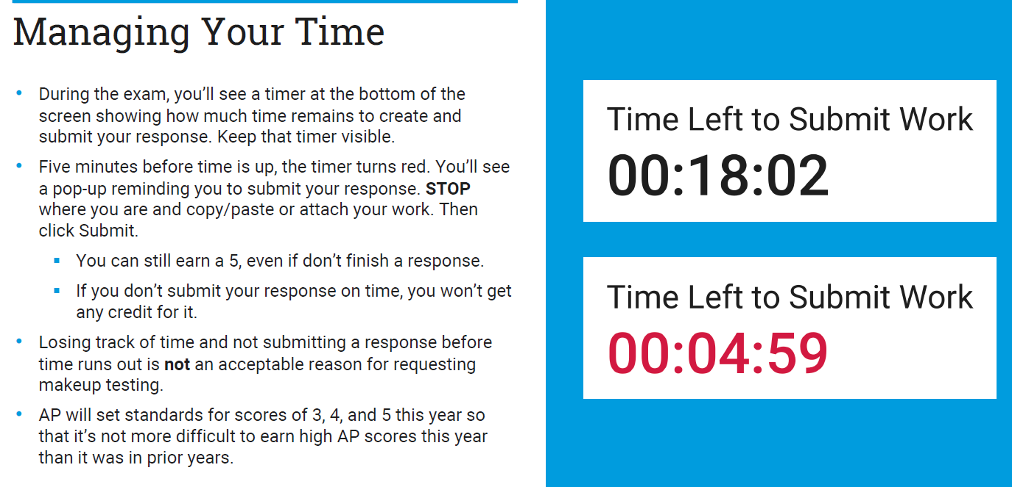

Slide 21
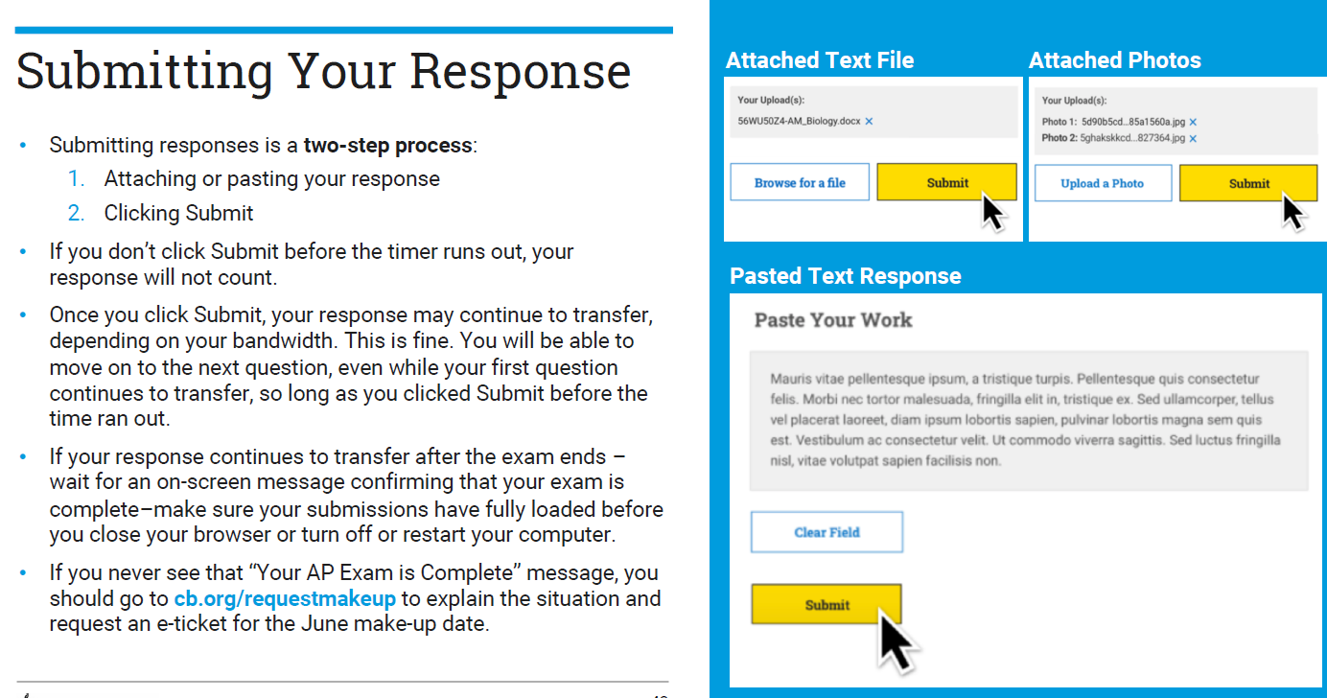

Slide 22
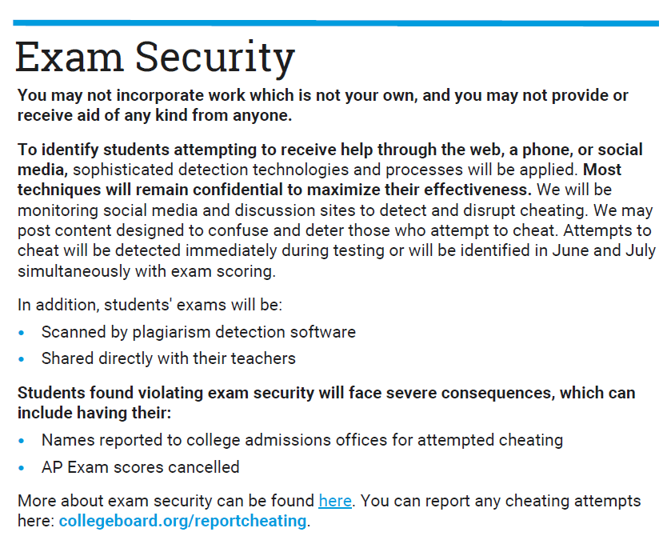
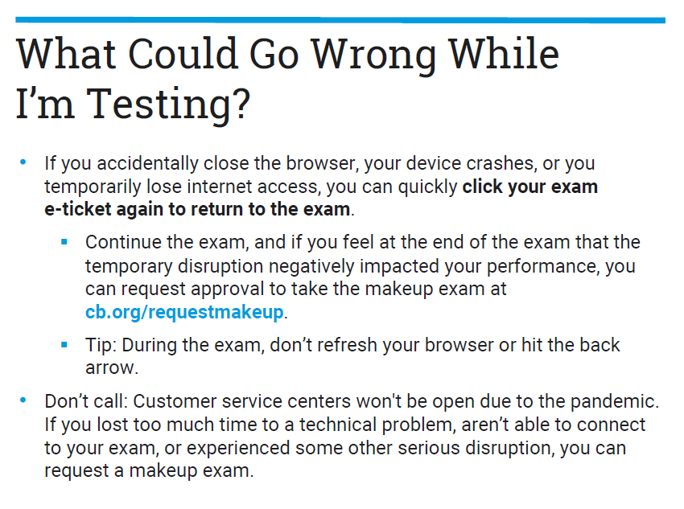
Important Information

Slide 23
Additional Information
World Language Exams, Testing Accommodations, Requesting a Make-Up Exam, and Scores

Slide 24
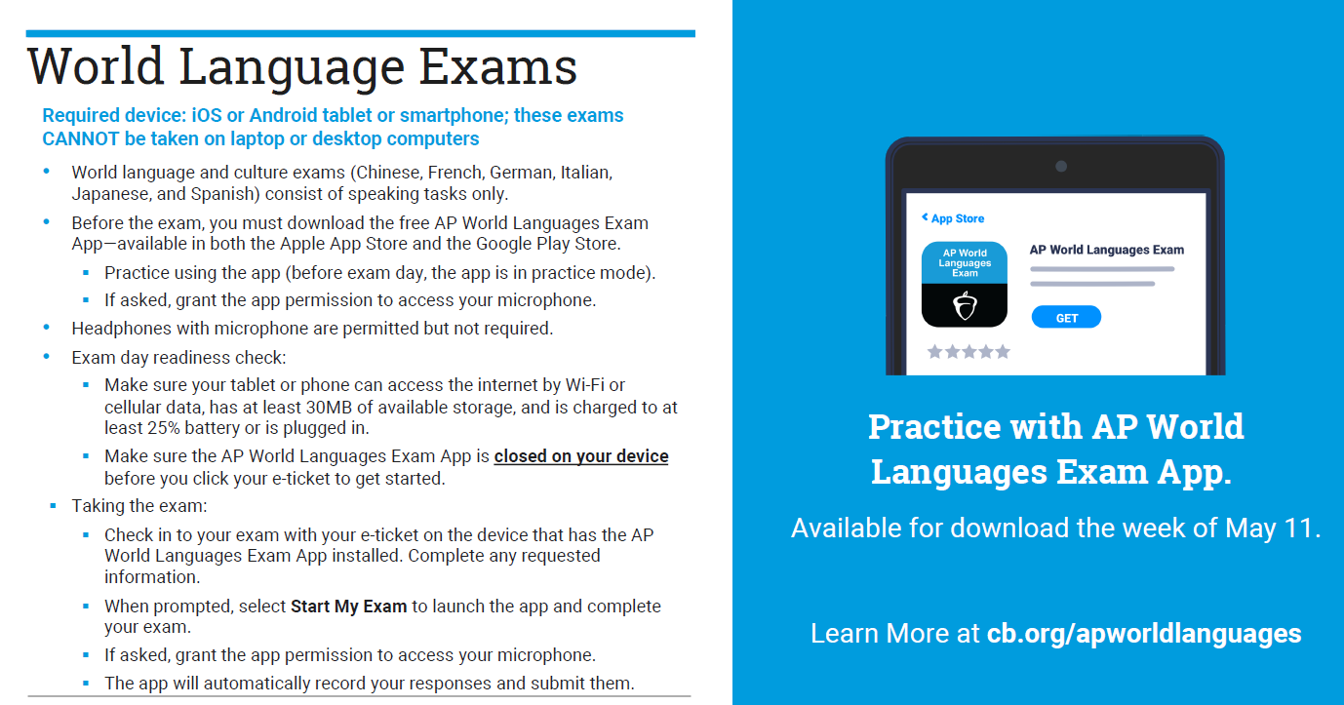

Slide 25
Additional Links
Testing with Accommodations: cb.org/ap2020accommodations
Requesting a Makeup Exam: cb.org/requestmakeup

Slide 26
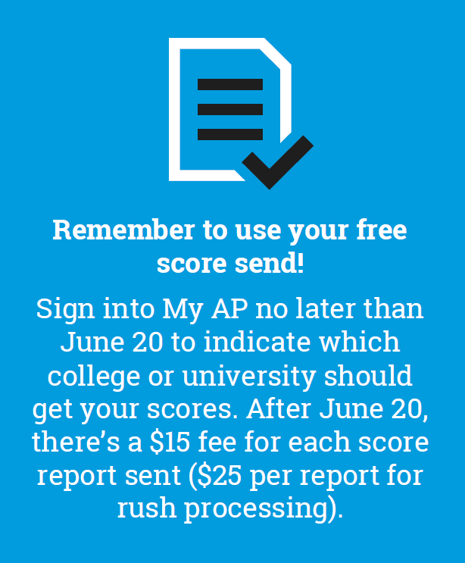
Scores
Expect score releases around July 15

