Slide 1
Casts and impressions

Slide 2
Types of impressions
Patent Impressions- Visible, two dimensional impressions produced as an object moves through soil, dust, paint, blood, or other fine particles
Latent impressions- hidden to the eye, but can be visualized through the use of special dusting and electrostatic techniques or chemical developers.
Plastic impressions- Three dimensional imprints. Can be left in soft materials such as snow, mud, soil, or soap.

Slide 3
Shoe impressions
Can obtain information about the persons involved at a crime scene using shoe and tire impressions.
Size- size of person’s food
Depth- weight of person
Type- Job or personality

Slide 4
Databases
Databases contain the names of specific manufacturers and tread patterns used to identify different types of shoes.
The number of manufacturers that use the same generic sole patterns complicates shoe pattern identification.
Recall that merely matching footwear is CLASS EVIDENCE

Slide 5
Shoe Wear Patterns
Although two different people may purchase the same type of shoes, the wear pattern on the shoes will appear different.
Toe or heel walking
Body weight
If the person walks straight ahead or tends to walk with toes pointed inward or outward.
The shape of the foot and the wearers activities
The surface in which they usually walk
Unique holes, cuts, or debris that may become embedded in the shoe

Slide 6
Gait and tracks
Gait= walking habits. In an asymmetrical gait, one foot may be angled differently or one may make a deeper impression than another.
Limp or injury
Carrying Heavy Objects
Walking or Running
Number of People at a Crime Scene
Entrance and Exit to a Crime Scene

Slide 7
Collection of Impressions
Take photographs before they are touched or altered.
Fill the camera’s viewfinder with the impression
Take photographs with the lens perpendicular to the impression to reduce distortion
Take multiple photographs
If using a digital camera, check your photographs for clarity and retake when necessary.
Place an identifying label and a rule in position with the impression being sure to focus on impression and not ruler.
Use oblique lighting when possible. Sunlight can produce glare.
If flash is needed keep it 3-4 feet away from print.
If impression is faint, spray it with a light coat of color contrasting solution.

Slide 8
Lifting latent impressions
Luminol used on bloody footprints
Dusting of the latent print, similar to dusting for fingerprints
Electrostatic Dusting and Lifting works by applying an electrostatic charge on a piece of lifting film.
Gel Lifting is a layer of thick gel sandwiched between paper backing and plastic cover sheet. Not sticky, so can be used on paper.

Slide 9
Casting Plastic impressions
A three dimensional impression, such as a shoeprint in mud or snow is called a cast.
If in sand or dirt, Plaster of Paris is used.
If in snow, dental stone because it doesn’t heat up and hardens faster.

Slide 10
Foot length and shoe size

Slide 11
Tire Treads and Impression
Tread pattern and measurements to identify the type of tire and perhaps the make and model of a car.
Nature of the impression to determine how the vehicle was driven.

Slide 12
The anatomy of a tire
Tire tread surface is divided into ridges (elevated regions) and grooves (indentations)
The purpose of grooves is to channel water away and provide traction as the surface area makes contact with the road.

Slide 13
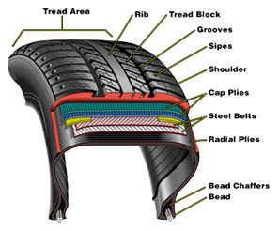

Slide 14
Identifying a vehicle
Every make and model of a vehicle has its own track width and wheelbase measurements.

Slide 15
Identifying a vehicle

Slide 16
Track width and Wheelbase
Track width= measured from the center of each tire to the center of the opposite tire. Note that the front and rear track width measurements may differ.
Wheelbase= the distance between the center of the front axle and the center of the rear axle. Measurements should be taken to the nearest millimeter.

Slide 17
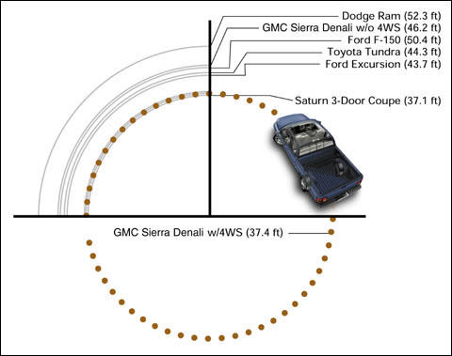
Turning Diameter
Turning Diameter= the measure of how tight a circle can be driven by a vehicle.

Slide 18
Establishing Car Movements from Tire Marks
Vegetation disturbed as a vehicle entered or left a road
Debris patterns cast off by a moving vehicle
Splash patterns created as a vehicle moved through a puddle of water or some other substance or from a wet to dry pavement.
Substance transfer, such as oil leakage from vehicle to pavement or soil. (The drips would be farther apart as the vehicle accelerates).
Tire marks on the pavement or ground.

Slide 19
Accident Reconstruction
Skid Marks
When someone breaks suddenly and locks the wheels
Provides Evidence of the Distance Breaks were Applied
Calculation of velocity can be made from skid marks

Slide 20
Yaw Marks
Produced when a vehicle travels in a curved path faster than the vehicle can handle skids sideways.
Tires and road surface melt from extreme temperatures.
Audible squeal and often smoke occurs.

Slide 21
Tire Scrubs
Produced by Damage or overloaded tire or tires during or immediately after impact.
Usually curved, irregular in width
May have striations that look like stripes
Determine an area of impact

Slide 22
Dental Impressions
Bite marks left behind at times
Individual Evidence due to:
Number, size, coloration, alignment, unique fillings, crowns, caps, the distance between teeth, and overall condition

Slide 23
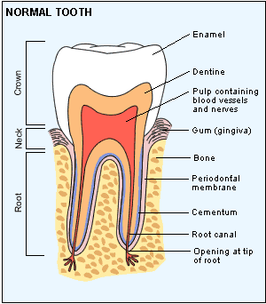
Structure of Teeth

Slide 24
The development of Teeth
20 primary baby teeth follows predictable pattern beginning in the first 7-12 months.
Primary teeth are replaced by 32 permanent adult teeth.
Wisdom teeth are the last to develop (ages 17-21)
The complete adult set includes 32 teeth including wisdom teeth.
Can help to estimate age.

Slide 25
Types of TeeTh
Incisors- 8 total in the very front. They cut food.
Canines- 4 total next to incisors. They cut and tear.
Premolars- 8 total next to canines.
Molars- 12 total. Used for grinding and chewing.
Dentition Pattern- The shape of a set of teeth

Slide 26
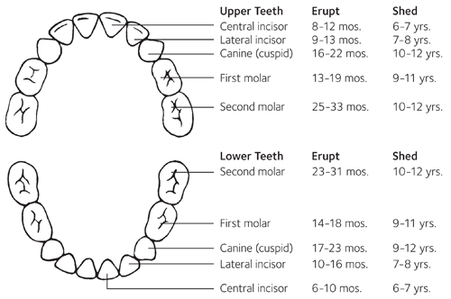

Slide 27
What is the study of Teeth Called?
Ondontology!!!

