Slide 1
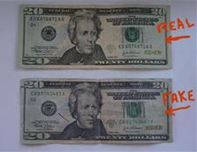
Counterfeiting
Forensic Science

Slide 2
Counterfeit Millionaire
http://www.youtube.com/watch?v=dJHEO1WvwKo 10 min

Slide 3
Counterfeit Currency
The Secret Service has worked with electronics and software makers to add security features to paper currency that makes forgery extremely difficult.
Scanning cannot reproduce these security features.
The first security feature is the feel of the paper.
Regular printer paper contains starch. Paper bills contain rag fiber instead of starch.

Slide 4
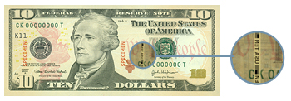
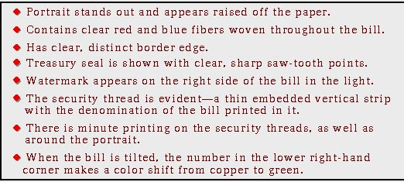
Verifying Authentic Currency
Some features found in the new series bills:

Slide 5
Verifying Authentic Currency
Some features found in the new series bills:

Slide 6
Portrait
The genuine portrait appears lifelike and stands out distinctly from the background. The counterfeit portrait is usually lifeless and flat. Details merge into the background which is often too dark or mottled.

Slide 7
Federal Reserve and Treasury Seals
On a genuine bill, the saw-tooth points of the Federal Reserve and Treasury seals are clear, distinct, and sharp. The counterfeit seals may have uneven, blunt, or broken saw-tooth points.

Slide 8
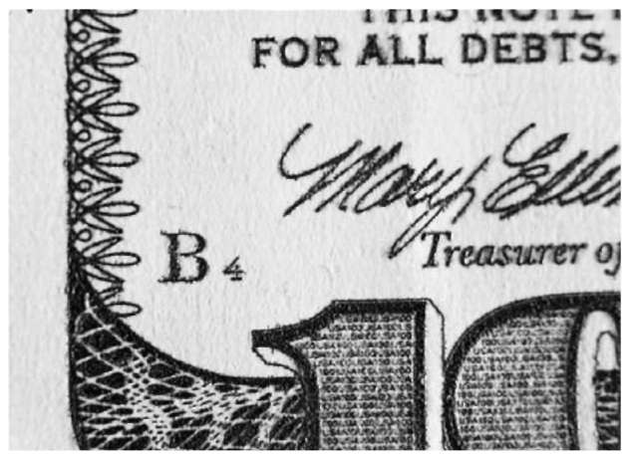
Microprinting

Slide 9
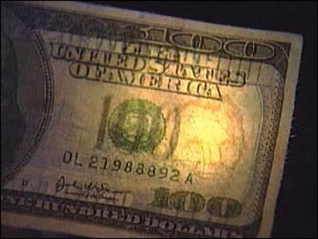
Watermarks

Slide 10
Border
The fine lines in the border of a genuine bill are clear and unbroken. On the counterfeit, the lines in the outer margin and scrollwork may be blurred and indistinct.

Slide 11
Serial Numbers
Genuine serial numbers have a distinctive style and are evenly spaced. The serial numbers are printed in the same ink color as the Treasury Seal. On a counterfeit, the serial numbers may differ in color or shade of ink from the Treasury seal. The numbers may not be uniformly spaced or aligned.

Slide 12
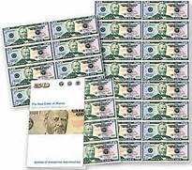
Paper
Genuine currency paper has tiny red and blue fibers embedded throughout. Often counterfeiters try to simulate these fibers by printing tiny red and blue lines on their paper.
Close inspection reveals, however, that on the counterfeit note the lines are printed on the surface, not embedded in the paper.
It is illegal to reproduce the distinctive paper used in the manufacturing of United States currency

Slide 13
Redesign of USA Currency
http://www.newmoney.gov/materials/download.htm

Slide 14
Counterfeit cash news report
http://www.youtube.com/watch?v=k77h5ljBJa0

Slide 15
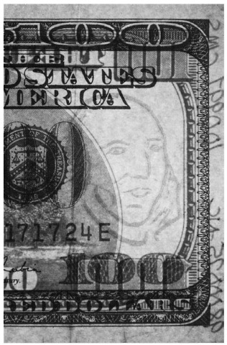
Beached Technique
Because of the unique characteristics of currency paper, many counterfeiters remove the ink (‘bleach’) in an attempt to create more deceptive counterfeit notes. The counterfeiter may use low-denomination genuine notes from the target country, bleach the paper, and print the image of a higher denomination.

Slide 16
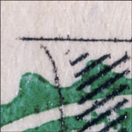
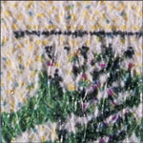
Ink Jet Technology
Ink Jet copiers/printers spray tiny droplets of ink from the printer head through a small gap of air onto the paper to form the image.
Genuine Ink Jet

Slide 17
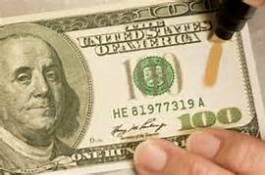
Counterfeit ID pens
Counterfeit detection pens contain iodine that will react with wood- or starch-based paper (like common copier paper). The iodine will not react to cotton-fiber paper. A streak is made on the bill with the pen, and if it is genuine, the mark will be yellow or clear. If counterfeit, the streak will be black or dark.

