Slide 1
Crime Scene Investigation
Forensic Science

Slide 2
Crime Scene Team
Police Officers (First Responders)
Usually first at scene
Secure Scene
District Attorney (possibly)
Sometimes present to determine if a search warrant is needed for crime-scene investigators
Crime-Scene Investigators
Document crime scene in detail and collect evidence
Recorders, sketch artists, photographers, evidence collectors
Medical Examiners (Also known as coroners)
May be present to determine the cause of death if a homicide or “possible” homicide occurred.
Detectives
Look for leads
Interview witnesses
Converse with CSI’s about evidence
Forensic Specialists
Certain crime scenes may call for experts in certain areas to be on scene
Example - entomologists

Slide 3
7 S’s of Crime Scene Investigation
Securing the Scene
Responsibility of first-responding police officer (first responder)
First Responder = First person @ crime scene
others may assist as they arrive
Safety of all individuals is FIRST priority
Preservation of evidence is SECOND priority
Tape off the area
Restrict all unauthorized persons from entering
Transfer, loss, or contamination of evidence can occur if the area is left unsecured
Log kept of all those that visit crime scene
Forensic experts (besides CSI) may be called in under certain circumstances

Slide 4
7 S’s of Crime Scene Investigation
Separating the Witnesses
Witnesses should not be allowed to talk to each other
Otherwise could lead to collusion
Witnesses working together to create a story
Accounts of witnesses will be compared later
Are accounts the same or different
Do accounts match up with FORENSIC EVIDENCE?
The following questions should be asked
When did the crime occur?
Who called in the crime?
Who is the victim?
Can the perpetrator be identified?
What did you see happen?
Where were you when you observed the crime/crime scene?

Slide 5
7 S’s of Crime Scene Investigation
Scanning the Scene
Determination of Primary Crime Scene and Secondary Crime Scene
Primary Crime Scene = location where initial crime took place
Example- Robbery site of a bank or store
Secondary Crime Scene = location other than primary crime scene where evidence may be found
Example- Home of a suspect in robbery
Determine where photos should be taken
Overall and up close of evidence

Slide 6
7 S’s of Crime Scene Investigation
Seeing (photographing) the Scene
Photos of overall crime scene from several angles
Initial
Close up photos of evidence (including bodies) with and without a measuring ruler
After crime scene has been searched and evidence marked
Triangulation of stationary objects should be included in photos as reference points
Distance and location of evidence from stationary reference points
Example: location and distance of murder weapon from oak tree.

Slide 7
7 S’s of Crime Scene Investigation
Searching for Evidence-
crime scene should be walked and location evidence marked.
Grid
Linear
Quadrant or Zone
Spiral
Xxx
Xx
xx

Slide 8
7 S’s of Crime Scene Investigation
Securing and Collecting Evidence
ALL evidence needs to be properly packaged, sealed, and labeled
Protocol for packaging certain types of evidence exists to preserve evidence
Example- Most biological evidence must be place in breathable container so it can dry out (prevents mold)
Evidence then can be placed in paper bindle and then sealed in a plastic container or paper bag

Slide 9
7 S’s of Crime Scene Investigation
Sketching the Crime Scene
An accurate rough sketch of the crime scene is made, noting the position of the body (if any) and any other evidence
All objects (evidence) should be measured from two immovable landmarks (reference points)
Direction of “North” should be labeled on sketch
Includes other objects (doors, chairs, windows, furniture ect…)
A Final sketch should be made for possible presentation in court
Drawn to scale (example 1/4 inch = ? Feet)
Computer programs are available to create neater and nicer sketch for court proceedings

Slide 10
7 S’s of Crime Scene Investigation
Example of Sketch Format
Case number, date, location, and sketcher’s name should be included on rough and final sketch

Slide 11
7 S’s of Crime Scene Investigation
Securing & Collecting Evidence
Paper Bindle- a folded paper
used to hold trace evidence
Crease a clean paper and place evidence in the X position
Fold in the left and right sides, and then fold in the top and bottom
Put the bindle into a plastic or paper evidence bag affixing a seal over the opening
Write your name on the seal

Slide 12
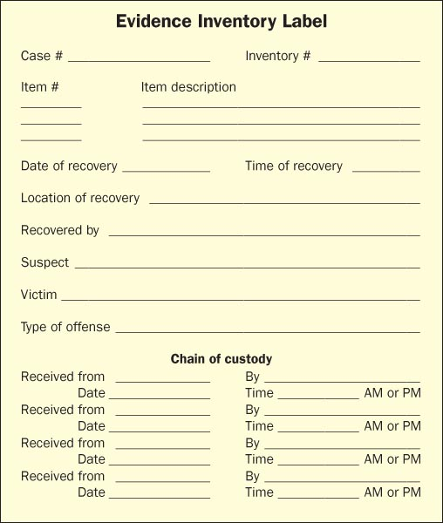
Example of Evidence Inventory Label
Include: Case #, Inventory #, Description of evidence

Slide 13
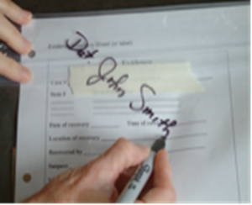
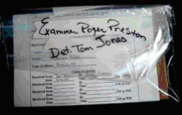
Maintaining Chain of Custody
Chain of Custody- the documented and unbroken transfer of evidence
Evidence should never be unattended
Document each time evidence opened
Bag the evidence Add identification Seal it Sign it across the sealed edge
Sign over to a lab technician Open bag on non-sealed edge
Return items to the evidence bag Seal evidence bag in another bag Sign the evidence log

Slide 14
Analysis of Evidence
Performed by forensic lab technicians
Usually very specialized
Example- DNA specialist, blood specialist ect…
Lab results can:
Show reliability of witness accounts
Establish the identity of suspects or victims
Show suspects to be innocent or link them with a scene or victim

Slide 15
Hypothesis Crime Scene Reconstruction
What happened?
From before crime was committed through the crime taking place, to after crime was committed.
Eyewitness testimony
Forensic evidence

Slide 16
Staged Crime Scene a unique problem
Examples
Arson
Suicide/Murder
Initially all death investigations should be considered homicide
Could wounds be self-inflicted?
Burglary
Does evidence match testimony and
behavior of witnesses?

