Slide 1
Fingerprints history and Analysis
8/31 Chapter 6

Slide 2
History
“Every human being carries with him from his cradle to his grave, certain physical marks which do not change their character, and by which he can always be identified– and that without shade of doubt or question. These marks are his signature, his physiological autograph so to speak, and this autograph cannot be counterfeited, nor can he disguise it or hide it away, nor can it become illegible by the wear and mutations of time.”
- Mark Twain
Pudd’nhead Wilson

Slide 3
History of fingerprints
- Used in Babylon (1792-1750 B.C.) when fingerprints were pressed into clay tablet contracts.
- Ink fingerprints used in Ancient China on all official documents.
1684- Dr. Nehemiah wrote a paper describing the patterns he saw on human hands under the microscope including the presence of ridges.
1788- Johann Christoph Andreas Mayer described that the arrangement of ridges never duplicated in two persons.
1823- Jan Evangelist Purkyn described 9 distinct fingerprint patterns.
1856- Sir William Herschel began collection of fingerprints and noticed they were not altered by age.
1879- Alphonse Bertillon created system for identification of criminals (Bertillonage) and 1902 he was credited with solving the first murder using fingerprints.
1891- Ivan Juan Vucetich improved fingerprint collection by collecting all 10 prints.
1896- Sir Edmund Richard Henry created ten card.

Slide 4
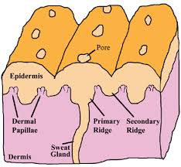
What are Fingerprints?

Slide 5
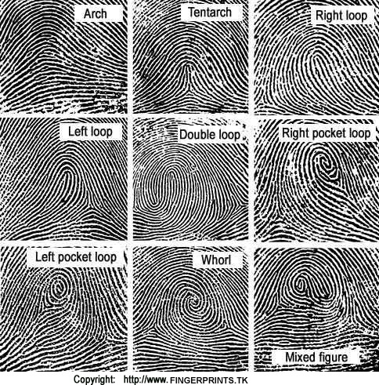
Characteristics of Fingerprints
- Loops, Whorls, and Arches

Slide 6
Percentages
Whorl- 30%
Arches- 5%
Loops- 65%

Slide 7
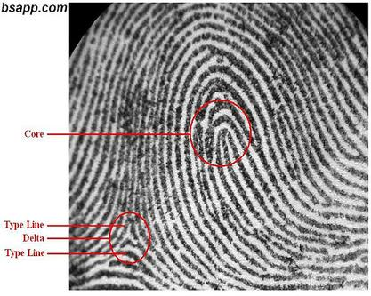
Core, ridge count, delta

Slide 8
Ridge Patterns
- Also called minutiae
- 150 individual ridge characteristics on the average fingerprint.

Slide 9
Types of fingerprints
- Patent Fingerprints: visible prints are left on a smooth surface when blood, ink, or some other liquid comes in contact with hands.
- Plastic fingerprints: actual indentations left in some soft material such as clay, putty, or wax.
- Latent fingerprints: hidden prints. Caused by the transfer of oils and other body secretions onto a surface. They can be made visible with powders.

Slide 10
Can fingerprints be altered or disguised?
-American Public Enemy Number 1 in 1930s, John Dillinger, put acid on his fingertips to change their appearance.
-Learned this from pineapple farmers in cuba. Acids in plant and rough handling dissolved fingerprints.
-Their fingerprints grew back. Thus, he was unable to destroy his.

Slide 11
How reliable are fingerprints?
- Fingerprints themselves are flawless, but humans are not.

Slide 12
How are fingerprints analyzed?
- Not done in seconds like on TV.
- Up to 3 months of careful searching.

Slide 13
How are latent fingerprints collected?
- Latent fingerprints are not visible, but techniques can bring them out.
- Dusting surfaces such as drinking glasses, the faucets on bathroom sinks, telephones, and the like with a fine carbon powder can make it visible. Tape is then used to lift and preserve the fingerprint. These are placed on evidence sheets.

Slide 14
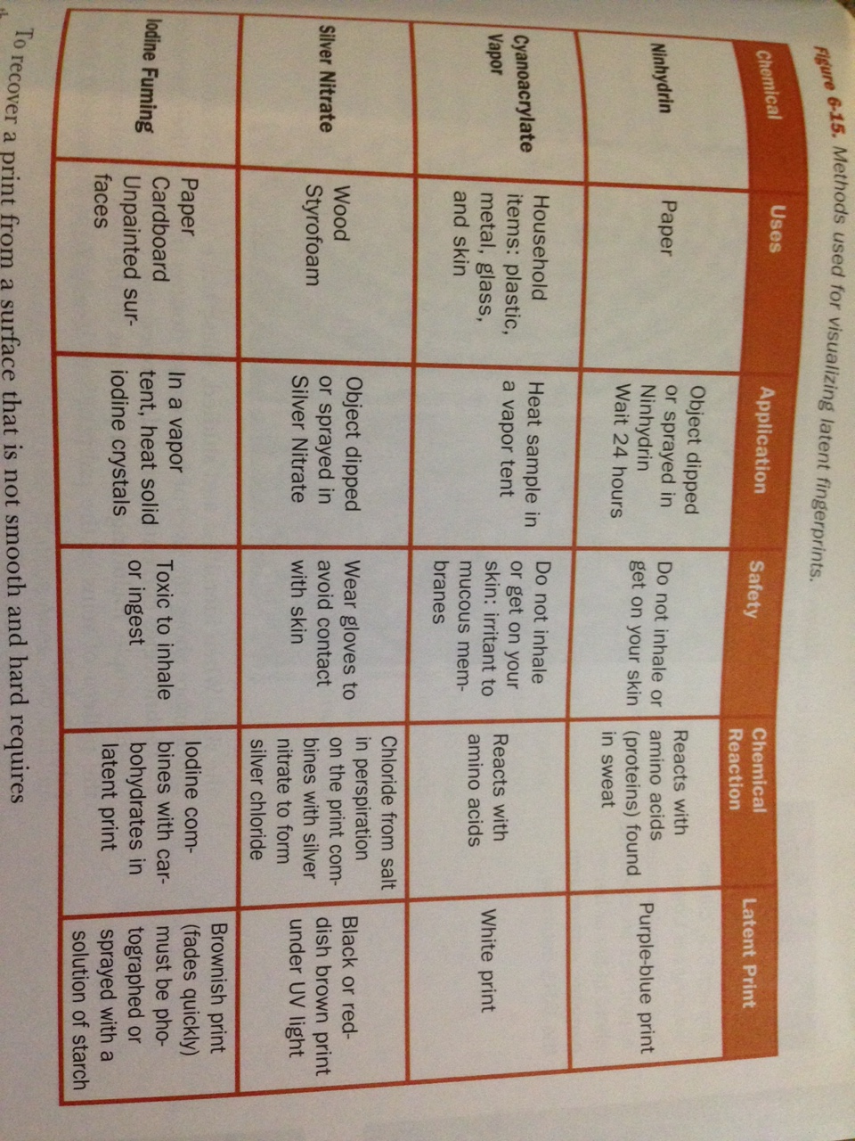
Types of fingerprint analysis

Slide 15
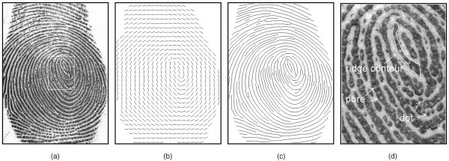
Future of Fingerprinting
- Digital Image will highlight pores along the ridges.

