Slide 1
Forensic Anthropology What We Learn From Bones
Miss Jones
2015

Slide 2
BONE BASICS

Slide 3
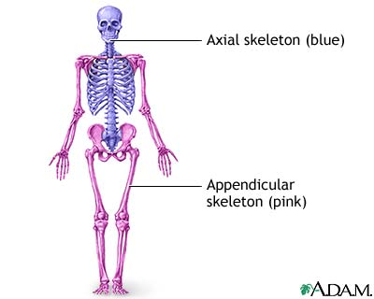
The Human Skeleton
Adults Have 206 Bones
Babies Have 450 Bones
Bones fuse as we develop
Axial Skeleton
Skull, vertebral column,
and rib cage
Appendicular Skeleton
Pelvis, arms, legs, ect…

Slide 4
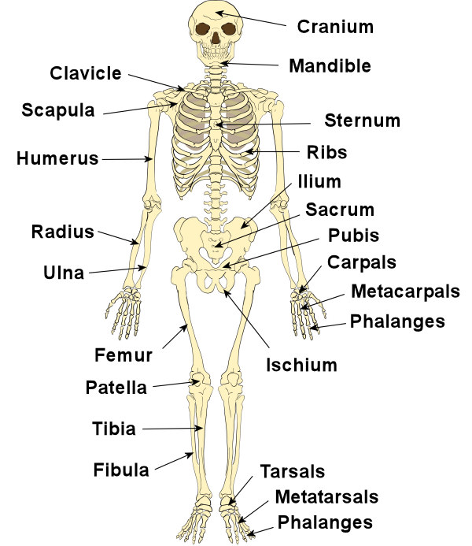
Major Bones of Body
KNOW BONES ON DIAGRAM
Name, location, spelling
Sacrum
At end of vertebral column
Coccyx at end = tail bone
Pelvis =
Ileum
Ishium
Pubis (pubic bones)

Slide 5
Development of Bone
Osteoblast cells (osteocytes)—specialize cells where bones originate.
Skeleton starts out as cartilage
Ossification—osteoblast cells (osteocytes) migrate to the center of cartilage areas and deposit minerals such as CALCIUM PHOSHATE that give bone strength and rigidity.
Starts to turn to bone after a few weeks of in utero development
At 8 weeks a skeleton is visible with x-ray
Process continues throughout lifetime.
Life Cycle of Bone- bone is deposited, breaks down, and is replaced
Osteoclasts—the 2nd type of bone cell, specialized to dissolve bone
Osteoblasts – replace bone that is destroyed by osteoclasts

Slide 6
Interesting Fact
The skeleton has completely replaced itself every 10 yrs

Slide 7
COMPARE AND CONTRAST
Osteoblasts (osteocytes) and Osteoclasts

Slide 8
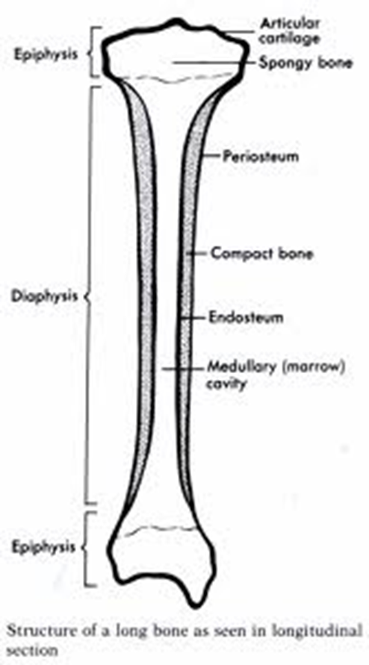
Structure of Long Bones
Periosteum
Protective membrane or covering
Contains blood vessels and nerves
keeps bones moist
Aids in recovery from injury
Epiphysis-
the ends of the bone
Epipyseal (growth) plates located here
Cartilaginous areas
Close during stages of life a filled with bone
Diaphysis-
the shaft or long middle portion of bone
Spongy Bone
NOT ACTUALLY SPONGY
More porous, located in/on epiphysis
Compact Bone
Stronger bone of diaphysis
Contains cavity
Medullary cavity
Contains bone marrow
Where blood cells are produced

Slide 9
RECALL AND SHARE
PERIOSTEUM
EPIPHYSIS
DIAPHYSIS
SPONGY BONE
COMPACT BONE
MEDULLARY CAVITY

Slide 10
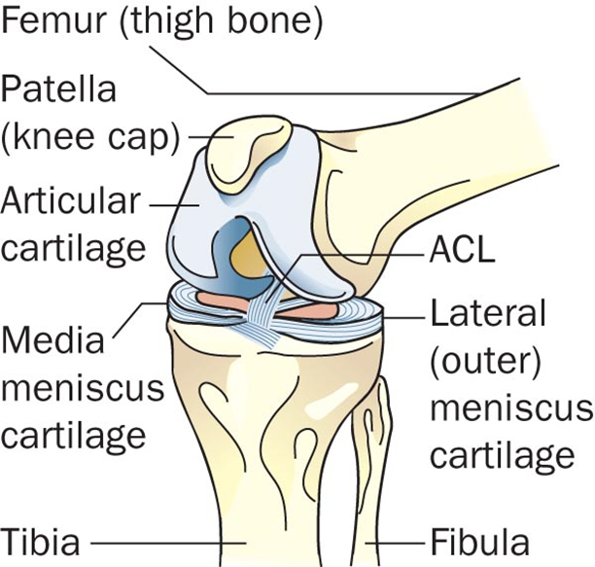
What Protects the Ends of Bones?
Articular cartilage—wraps the ends of bones for protection and prevents scraping
Think chicken wing
Does not regenerate
Age
Injury

Slide 11
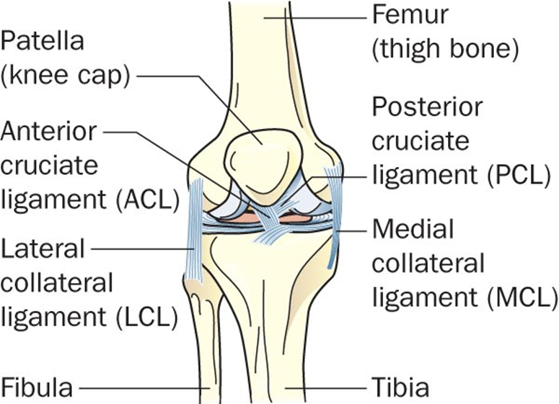
What Connects Bones?
ligaments—bands of connective tissues that connect two or more bones together

Slide 12
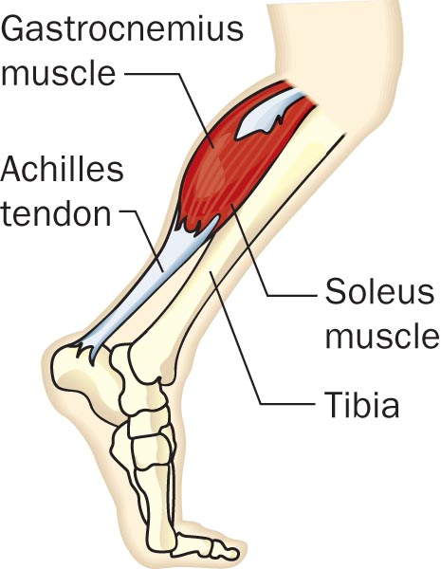
How Do Bones Move?
Muscles attach to Bones to cause movement
tendons—connect muscle to bone

Slide 13
Time to Process
Describe the role of cartilage (articular), ligaments, and tendons in the skeletal system

Slide 14
Forensic Anthropology
Studies the identifying characteristics of the remains of an individual
SKELETON
So what can a skeleton tells us?
Sex
Height
Race/Ethnicity
Physical Health and/or History of Disease
Identification
Dental Records
Mitochondrial DNA
What Happened?

Slide 15
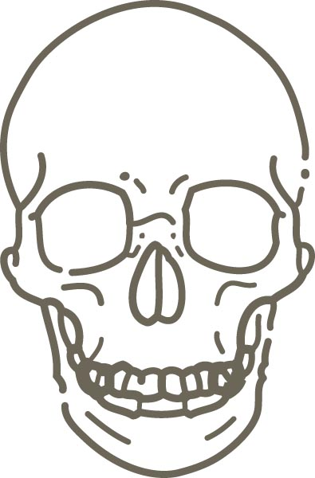
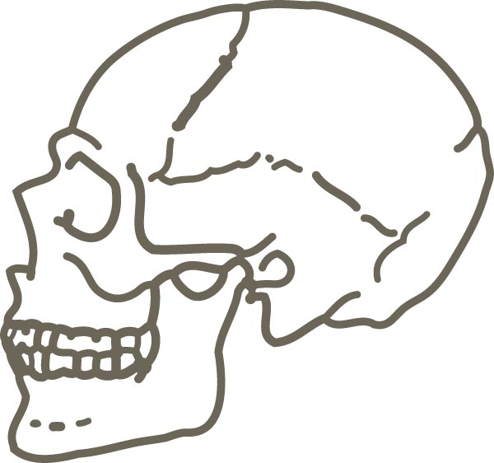
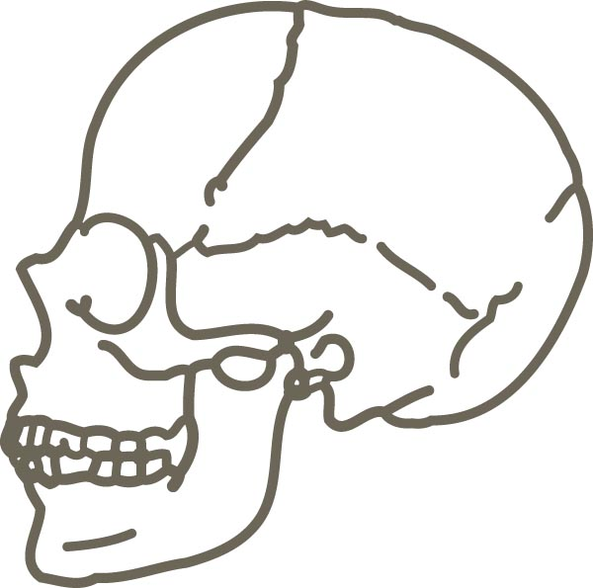

Slide 16
Distinguishing Males From Females OVERALL SKELETON
Female Skeleton
Smoother
Less “knobby”
Male Skeleton
Thicker
Rougher
Quite Bumpy (why?)
Male hormones = more muscle development
Surface of bone where tendons attach is thicker

Slide 17
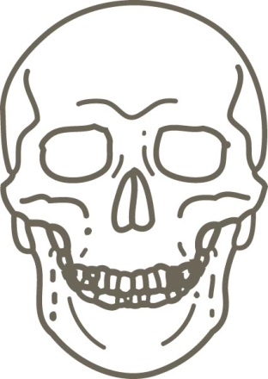
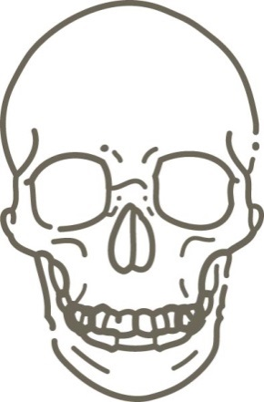
Sex Determination SKULL
Male Characteristics | Trait | Female Characteristics
More square | Shape of eye | More rounded
More square | Mandible shape from underside | More V-shaped
Thick and larger | Upper brow ridge | Thin and smaller

Slide 18
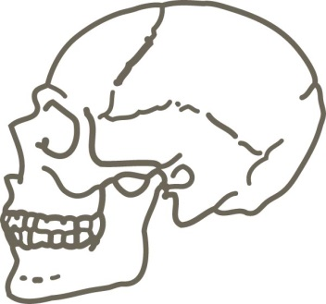
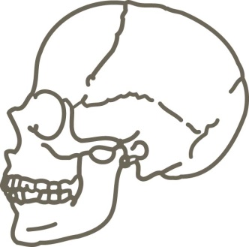
Sex Determination SKULL
Male Characteristics | Trait | Female Characteristics
Present | Occipital protuberance | Absent
Low and sloping | Frontal bone | Higher and more rounded
Rough and bumpy | Surface of skull | Smooth
Straight | Ramus of mandible | Slanting
Rough and bumpy | Nuchal crest | Smooth

Slide 19
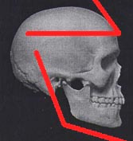
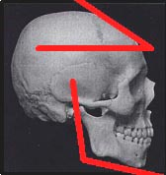
Sex Determination SKULL
Is the female skull smoother than the male’s?
Which frontal bone is lower and sloping?
Are the male’s eye orbits more circular?
Which jaw is more square, with an angle that is closer to 90º?

Slide 20
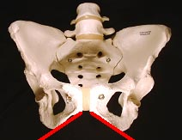
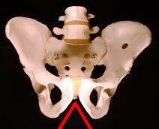
Sex Determination PELVIS
An easy method to determine gender
The surface of a woman’s pelvis can be scarred from pregnancy/child bearing
The sub pubic angle of the female pelvis is greater than 90º; the male’s, less
Pelvic cavity
Male heart shape, usually sacrum and coccyx visible
Female oval, usually only coccyx visible

Slide 21
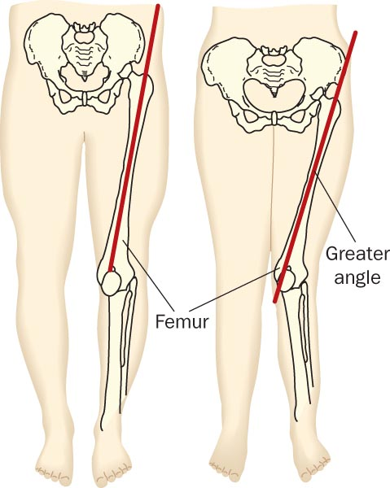
Sex Determination FEMUR
The male femur is thicker and joins the pelvis at a straighter angle than the female femur

Slide 22
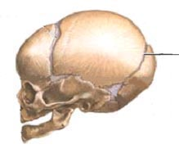
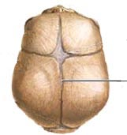
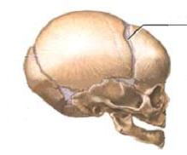
Age Determination SKULL
LAMBOIDAL SUTURE
Begins closing at age 21
Accelerates at age 26
Closed age 30
SAGITAL SUTURE
Closes by about age 32
CORONAL SUTURE
Closed at about age 50

Slide 23
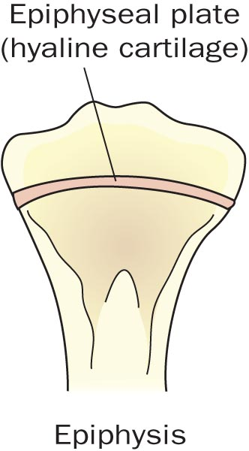
Age Determination LONG BONES
At birth—450+ bones in the skeleton
Adults— 206 bones
Epiphysis line—appears where cartilage is replaced by bone
When the cartilage is fully replaced, the line is no longer visible
This information can be used to approximate a skeleton’s age

Slide 26
Height Determination
Measurements of LONG BONES like the humerus and femur can be used to calculate a persons height
Involves calculations
Example
2.10 x (length of femur in cm) + 72.22 cm = height of person in cm.
+ or – 3.91 cm (about an 1 ½ inches)

Slide 27
Race Determination Race can be very hard to determine. WHY?
Shape of eye orbits
Caucasoid = rounded, somewhat square
Negroid = rectangular
Mongoloid = rounded, somewhat circular
Nasal Spine
Caucasoid = prominent spine
Negroid = very small spine
Mongoloid = somewhat prominent spine
Nasal Index
Caucasoid = <.48
Negroid = >.53
Mongoloid = .48-.53
Prognathism
Caucasoid = straight
Negroid = prognathic
Mongoloid = variable
Femur
Caucasoid = fingers fit under curvature
Negroid = fingers do not fit under curvature
Mongoloid = fingers fit under curvature

Slide 28
Identification
Dental records
Height
Right vs Left Handed
Facial Reconstruction

Slide 29
DNA and Identification
Bone contains little nuclear DNA but it does contain mitochondrial DNA
Nuclear DNA degenerates before mitochondrial DNA
Mitochondrial DNA is inherited only from the mother
Compare results with living relatives on the mother’s side of the family

Slide 30
Right vs Left Handed
Bones are usually more developed on the side that is used most
why?
Sometimes there may also be more deterioration.

Slide 31
History of Disease / Prior Surgeries
Scoliosis
Osteoporosis
Arthritis
Surgeries
Rods, plates ect..
Have id number

Slide 32
Skeletal Trauma / Cause of Death
Sharp Force Weapons, Blunt Force Trauma, Gunshots
All make distinct fracture patterns
Blunt force generally more widespread fractures and greater damage to bone than sharp objects

