Slide 1
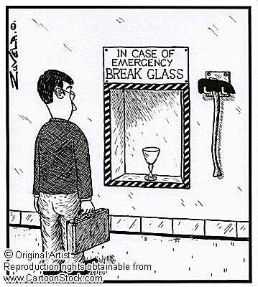
Chapter 4 Forensic Analysis of Glass

Slide 2


Case Study: Susan Nutt (1987)
At 9:30pm on a cloudy, dark night in February, 19-year-old Craig Elliott Kalani went for a walk in his neighborhood in northwest Oregon but never returned home. A hit-and-run driver killed him. Crime-scene investigators collected pieces of glass embedded in Craig’s jacket and other glass fragments found on the ground near his body.
Police searched for a vehicle that had damages consistent with a hit-and-run accident. They found a car with those types of damages that belonged to a woman named Susan Nutt. In order to connect Ms. Nutt and her car with the crime, the police had to match the glass from the crime scene to the glass in her car. The scientists found that windshield glass from the crime scene contained the same 22 chemical elements as those used to make the glass in Ms. Nutter’s car. The scientists considered both samples of glass to be a definite match.
The glass evidence helped convict Susan Nutt of failure to perform the duties of a driver for an injured person. She was sentenced to up to 5 years in and prison and 5 years’ probation.

Slide 3
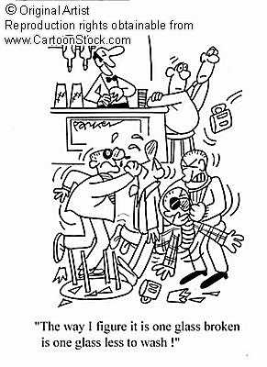
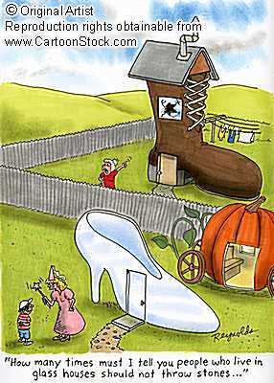
Glass Cartoons

Slide 4
Essential Questions to Answer
- How can understanding the chemical properties of matter help in solving a crime?
- How will density help solve a case?
How can comparing glass fragments lead to solving a crime?
What are some physical or chemical characteristics of glass that could help to distinguish one type of glass from another?

Slide 5
Objective
- Define and distinguish the physical and chemical properties of matter.

Slide 6
Physical vs. Chemical Properties
The forensic scientist must constantly determine those properties that give distinguishing characteristics to matter, giving it a unique identity.
Physical properties
  Weight, volume, color, boiling point, melting point
  Describe a substance without reference to any other substance
Chemical properties
  Behavior of a substance when it reacts or combines with another substance

Slide 7
Forensic Examination of Glass
Goals in examining glass evidence:
  Determine the types of glass at the scene
  Determine how the glass was fractured
  Use physical characteristics to classify it
  Individualize the glass to a source
Compare physical and chemical characteristics:
  Optical properties: color and refractive index
  Non-optical properties: striations from manufacturing, thickness, surface film or dirt, density
  Chemical properties: additives or trace elements

Slide 8
What is Glass?
Glass is an amorphous solid
→ does not have a rigid, ordered structure
1) Window and bottle glass
→ is made out of sand mixed with metal oxides
Physical properties: hard, elastic, brittle, non-conductor of electricity, density, refractive index, etc.
Chemical: resistant to all but fluorine and very strong bases.

Slide 9
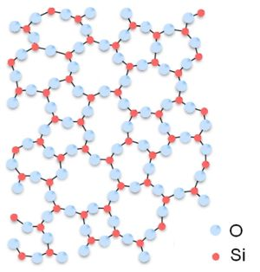
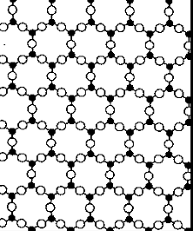
Amorphous vs. Crystalline Structure
Amorphous Structure: Glass
Crystalline Structure: Salt (NaCl)

Slide 10
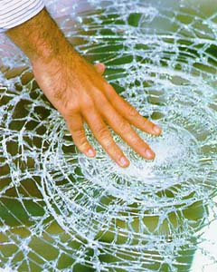
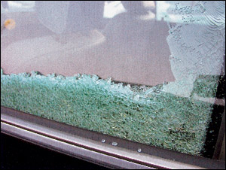
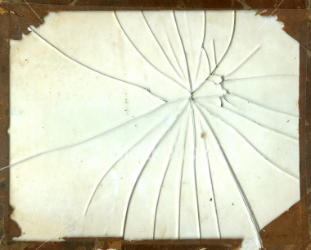
What Other Types of Glass Are There?
2) Laminated glass: used in windshields, two sheets of glass with plastic between them.
3) Tempered safety glass: used in car side windows and designed to break into tiny pieces

Slide 11
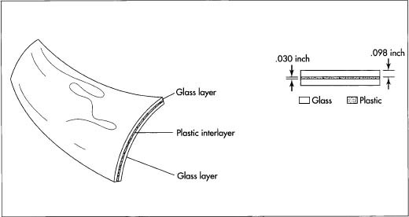
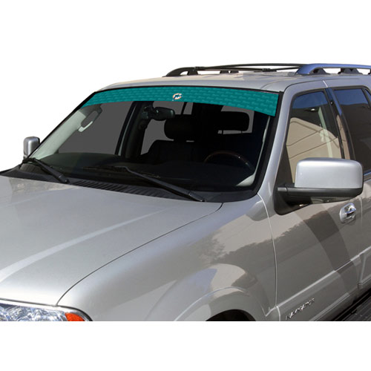
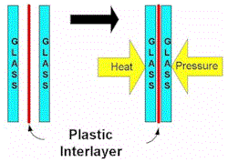
Laminated Glass: Car Front Windshields

Slide 12
Video
http://www.videojug.com/interview/csi-of-glass-and-light-2

Slide 13

Glass In Forensics
Used in solving automobile accidents, hit-and-runs, burglaries, and assaults
Glass is a type of transfer evidence
  Can be individualized or class
    → Only can individualize a glass fragment, if can fit it like puzzle piece to its source

Slide 14
Collection of Glass
If even the remotest possibility exists that glass fragments may be pieced together, every effort must be made to collect all the glass found.
When an individual fit is thought improbable, the evidence collector must submit all glass evidence found in the possession of the suspect along with a representative sample of broken glass remaining at the crime scene.

Slide 15
Collection of Glass
The glass fragments should be packaged in solid containers to avoid further breakage.
If the suspect’s shoes and/or clothing are to be examined for the presence of glass fragments, they should be individually wrapped in paper and transmitted to the laboratory.

Slide 16
Objective
- Understand how to examine glass to determine impact

Slide 17
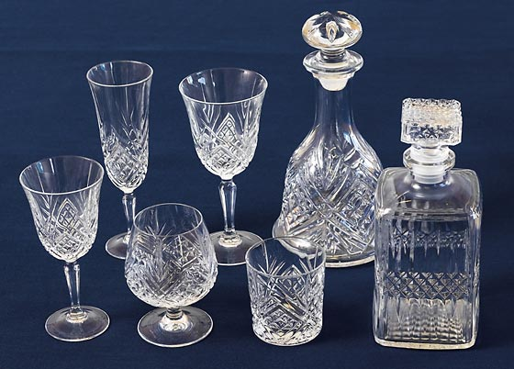
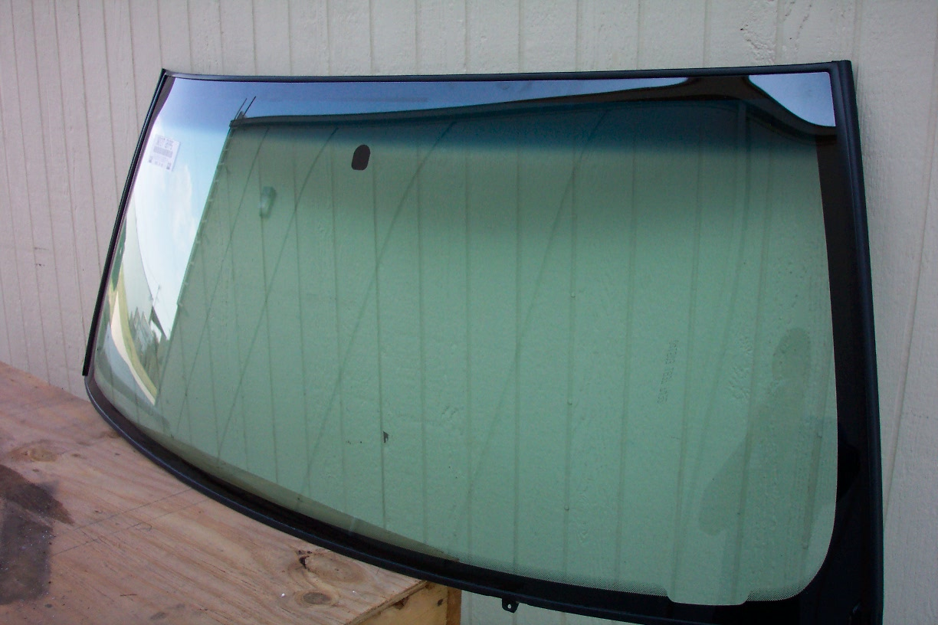
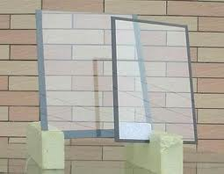
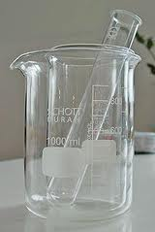
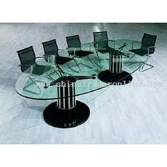
Glass Examples
Laminate
Lead crystal
Plate/window
Borosilicate
Tempered glass

Slide 18
Can glass be shattered with your voice?
http://www.youtube.com/watch?v=IZD8ffPwXRo

Slide 19
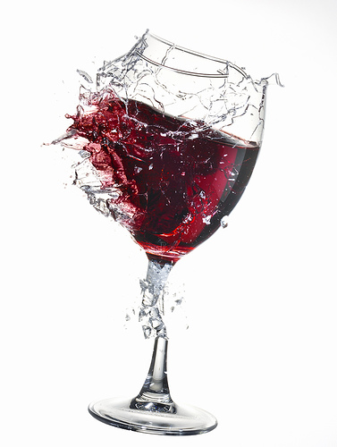
Glass Transfer Evidence
When glass objects are broken, glass flies backward from all parts of the object where cracks appear not just from point of impact.
This creates a shower of minute glass particles and a transfer of evidence.
Glass fragment comparison depends finding and measuring properties that will associate one glass fragment with another while eliminating other sources.

Slide 20
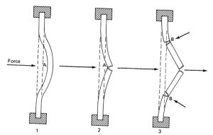
How Do Glass Windows Break?
Each force causes a deformation that may leave a visible mark or fracture the glass. This can be used to determine the direction and amount of force.
Glass acts initially as an elastic surface and bends away when a force is applied. When the force increases beyond its tensile strength, it cracks.

Slide 21
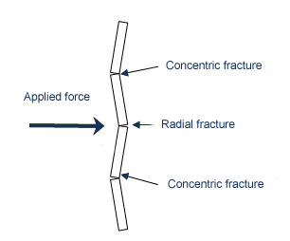
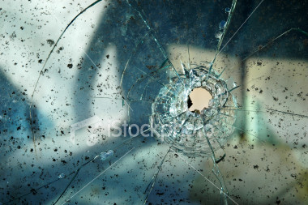
Glass In Forensics
Because of a lack of order and pattern, glass breaks in random patterns
An impact in glass produces two types of fractures
  Radial →(radiating out from the point of impact)
  Concentric →(forming circles around the impact)
radial
concentric

Slide 22
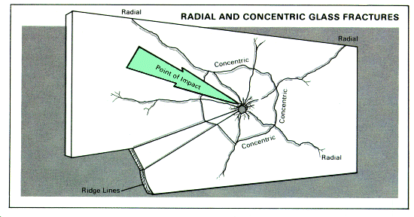
Radial and Concentric Glass Fractures

Slide 23
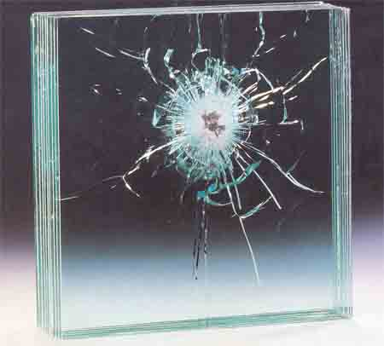
concentric
radial

Slide 24
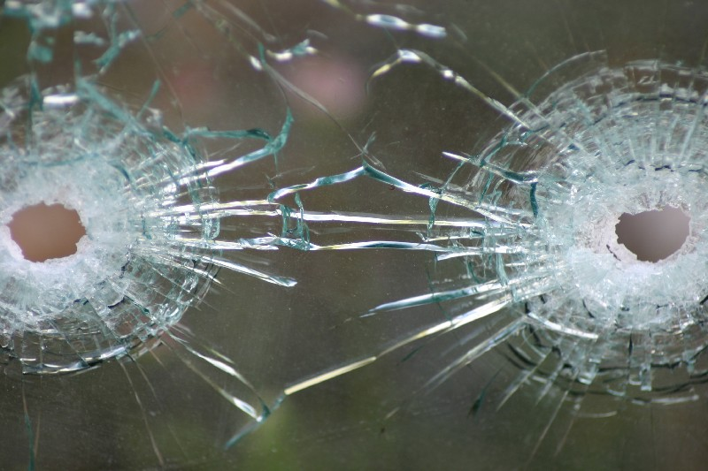
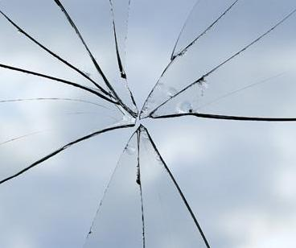
Projectile Patterns
Small projectiles passing through glass at a high velocity will produce characteristic patterns
  → Usually it is a crater with the largest portion on the face of the glass opposite from the impact
    A bullet will create an exit hole that is larger than entry hole
*important in determining the
direction of impact
Lower velocity impacts may not penetrate the glass but leave only a pit or crater on one side of the glass

Slide 25
Video
http://www.youtube.com/watch?v=qYUq0pJKOOw
4:00
http://www.youtube.com/watch?v=CZsREMZTTgU
Bullet Proof glass shooting
http://www.youtube.com/watch?v=mnj1D3uppTs

Slide 26
Which Bullet Hole Was First?
The sequence of impacts can be determined since crack propagation is stopped by earlier cracks.
In the figure above, which impact occurred first?

Slide 27
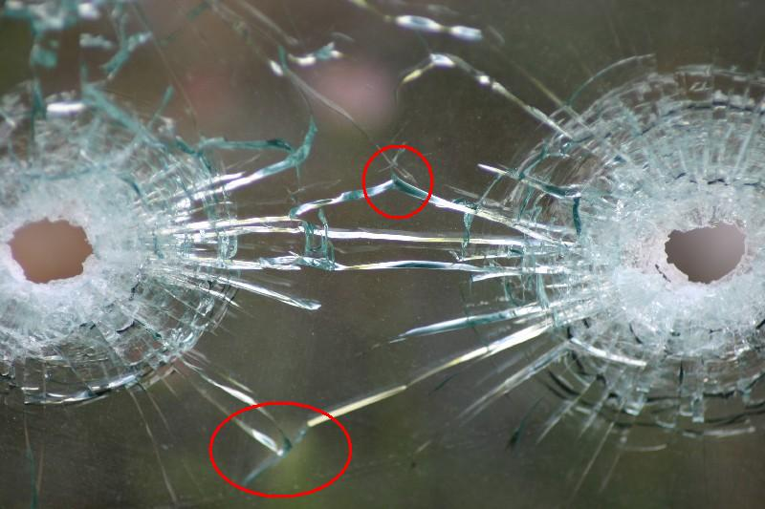
Order of Impact Example
This photo depicts two bullet holes in safety glass. Which hole was created first? How can you tell?
1st
2nd
The hole on the right was created first. Cracks radiating out from the hole will stop when they encounter another crack. Stress placed on the glass (causing it to crack) will be transferred along the existing crack rather than across it.

Slide 28
Order of Impact
Determining which bullet hole in glass was created first:
based on length of radial fractures
cracks radiating out from the hole will stop when they encounter another crack

Slide 29
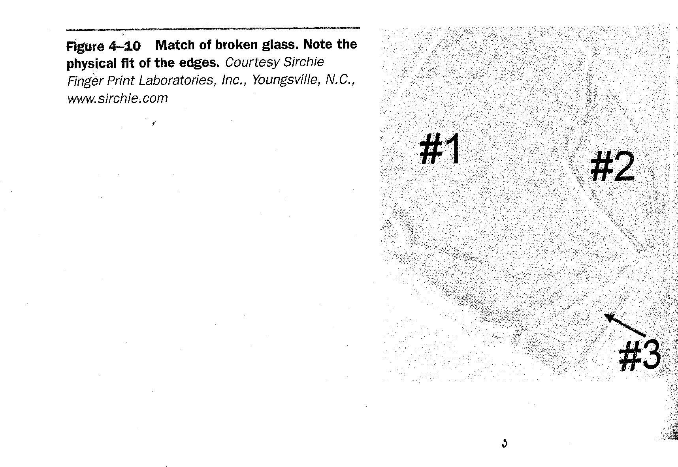
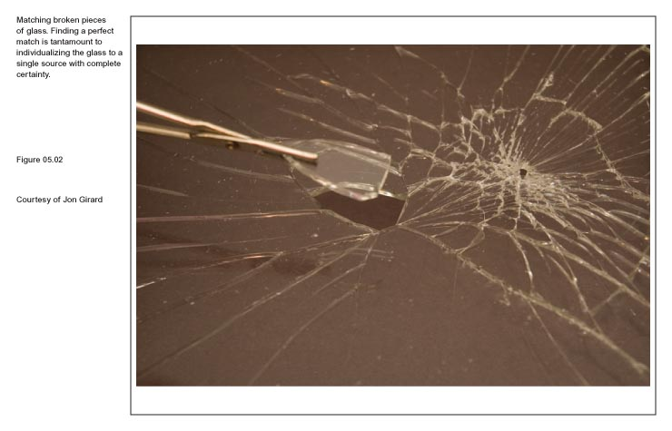
Putting it Back Together Again?
Examiners can fit together two or more pieces of glass that were broken from the same object.
Because glass is amorphous, no two glass objects will break the same way.

Slide 30
Glass Fragments
For the forensic scientist, the problem of glass comparison is one that depends on the need to find and measure those properties that will associate one glass fragment with another while minimizing or eliminating other sources.
To compare glass fragments, a forensic scientist evaluates two important physical properties: density and refractive index.

Slide 31
Density
Mass per unit volume
Density = mass
volume
Remains the same regardless of sample size
Characteristic property of substance
Can be used as an aid in identification

Slide 32
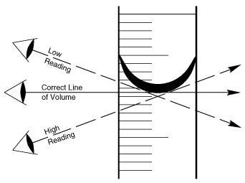
Graduated Cylinder - Meniscus

Slide 33
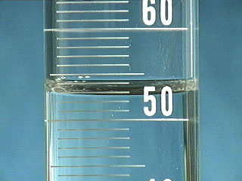

Slide 34
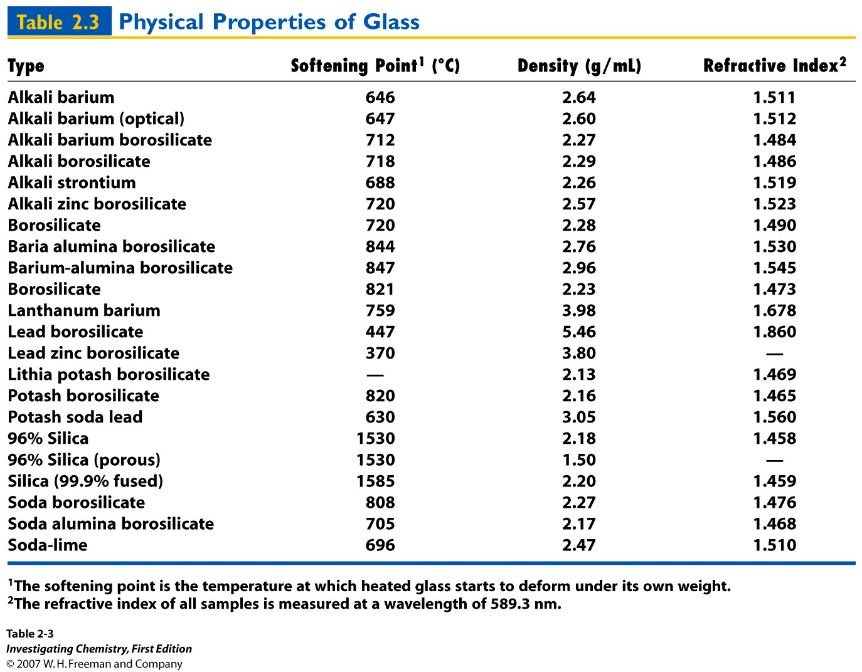
Quantitative Properties of Glass

Slide 35
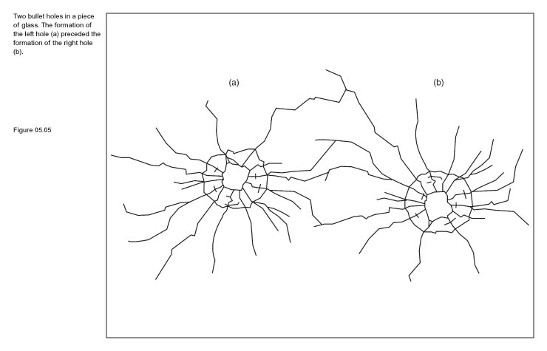

Learning Check
In the figure below & left, which impact occurred first?
In the figure above & right, from which side did the impact occur?

Slide 36
Why Measure Density?
Can be used as a screening technique with large numbers of fragments.
Useful in identifying multiple sources present in the known and/or questioned samples.
It is nondestructive and an intensive property (not dependant on sample mass).
Need to measure very precisely in parts per hundred or thousand or better.

Slide 37
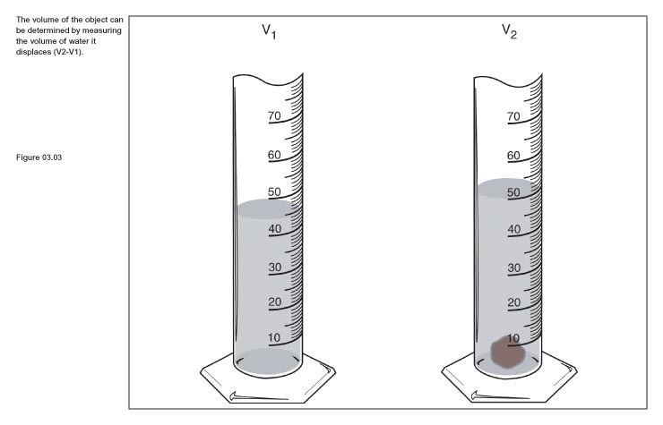
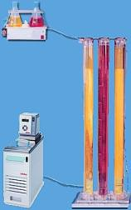
Glass Density
Density can be measured by:
  directly determining mass and volume (usually by water displacement)
  comparison by flotation
  comparison using a density gradient column
Density gradient column method:
  Fragments of different densities settle at different levels in the column of liquid of varying density.
  Technique is not accurate for fragments that are cracked or contain an inclusion.

Slide 38
Flotation Method
The glass can be compared to other relevant pieces of glass which will remain suspended, sink, or float.

Slide 39
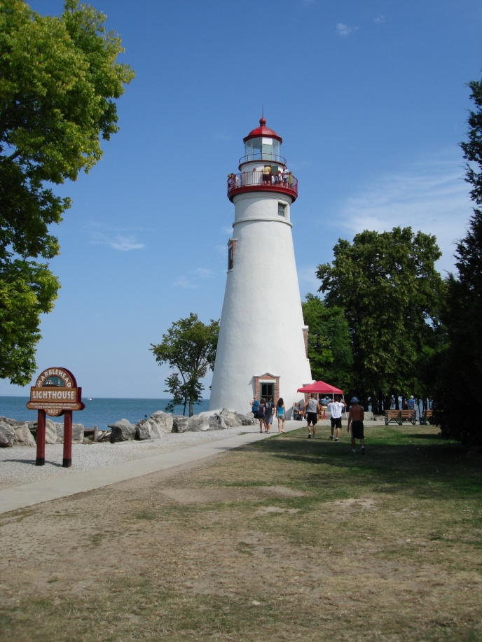
Speed Of Light
3.0 x 10⁸ m/s

Slide 40
What is light?
Two models describe the behavior of light.
  Light is described as a continuous wave traveling through space.
  Light is also described as a stream of discrete energy particles.
Particles are described as photons that release energy in the form of electrons
Chapter 4

Slide 41
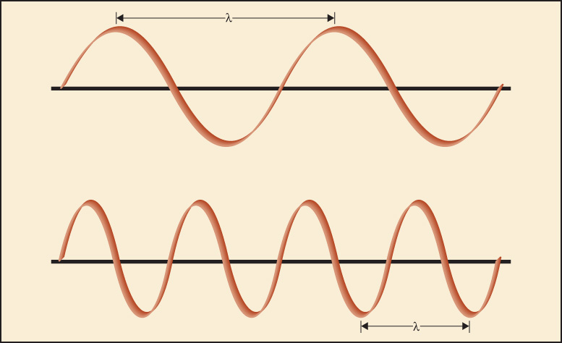
Theory of Light
Waves are described in terms such as:
  Wavelength, the distance between two successive crests (or one trough to the next trough).
  Frequency, the number of crests passing any one given point per unit of time.

Slide 42
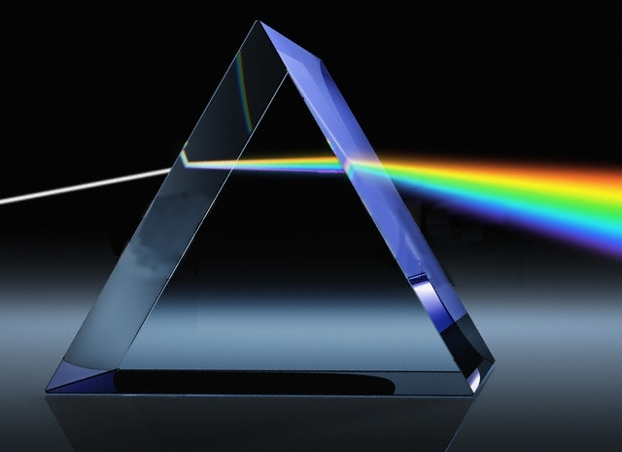
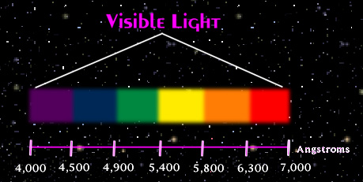
Visible Light
When white light passes though a prism, it is dispersed into a continuous spectrum of colors.
Visible light ranges in color from red to violet in the electromagnetic spectrum (ROYGBIV).

Slide 43
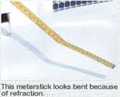
Physical Properties of Light
Light waves travel in air at a constant rate of speed (velocity) until they hit another substance.
Contact with another substance (like water or glass) causes the light wave to slow down, causing the ray of light to bend or refract.
Chapter 4

Slide 44
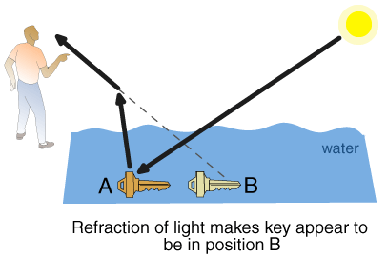
Question
What happens when you look at a key that is placed underwater from above water? Why?

Slide 45
Important Physical Properties
Refraction is the bending of light waves because of a change in velocity.

Slide 46
Refractive Index
→ A quantity that measures the bending of light as it travels from one medium into another
RI = velocity of light in a vacuum
velocity of light in medium
Always will be greater than 1.00
  Water has a refractive index of 1.33 (light travels 1.33 times faster in a vacuum than in water)

Slide 47

Refractive Index
→ The RI depends on the wavelength of light being used and the temperature of the material

Slide 48
Determining Refractive Index
Measured using a microscope equipped with a hot stage
  Glass is immersed in an oily material with a known refractive index
  Oil is slowly heated
    This changes the refractive index
  When glass is not seen in the oil, it has the same refractive index

Slide 49
Refractive Index By Immersion
2nd
A Becke line is present. It is a bright halo near the border of a particle that is immersed in the oil of a different refractive index.
1st
A glass particle is immersed in a liquid medium (silicone oil) which has a different refractive index compared to the glass
3rd
When the temperature of the oil changes, the Becke line disappears and : RI oil = RI glass.
The glass appears to disappear

Slide 50
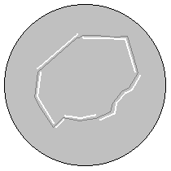
The Becke Line
→ The Becke Line is a line that appears as a halo if the refractive indexes of the glass and the material are different
  The Becke Line will disappear when the refractive indexes are the same

Slide 51
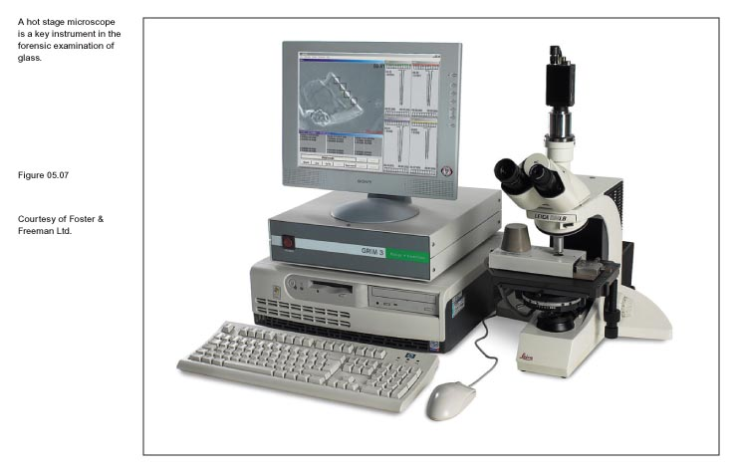
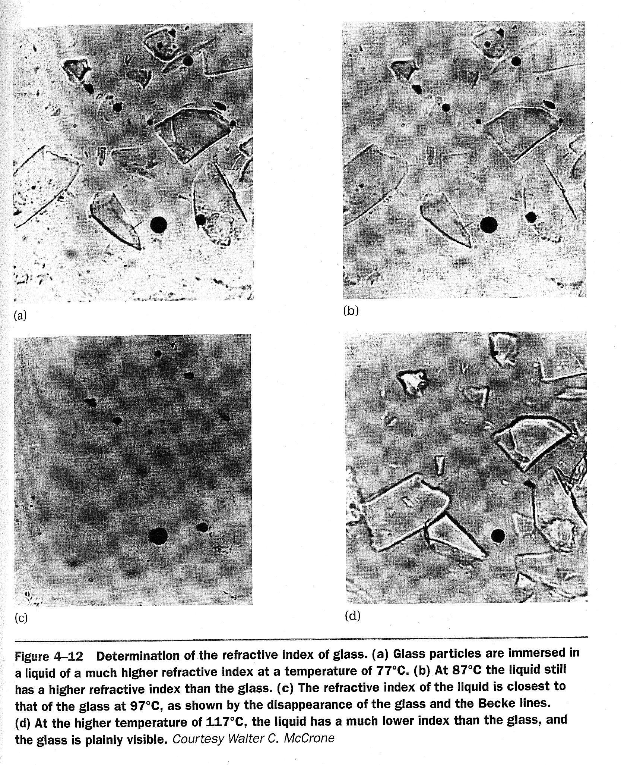
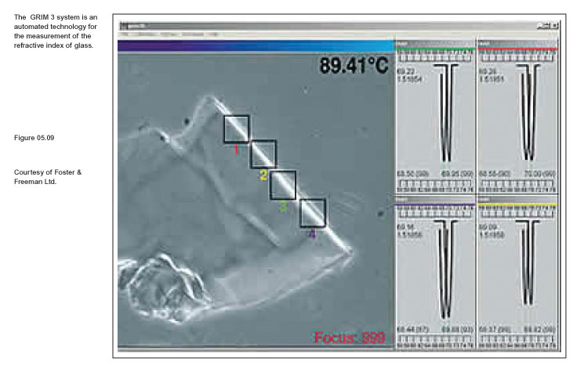
Refractive Index By Immersion

Slide 52
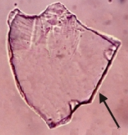
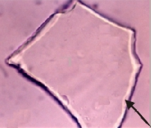
Becke Lines from Glass
Becke line on outside
Becke line on inside
RI of glass (1.525) > RI of medium (1.6)
RI of glass (1.525 < RI of medium (1.34)

Slide 53
Refractive Index
Liquid | RI | Glass | RI
Water | 1.333 | Vitreous silica | 1.458
Olive oil | 1.467 | Headlight | 1.47-1.49
Glycerin | 1.473 | Window | 1.51-1.52
Castor oil | 1.82 | Bottle | 1.51-1.52
Clove oil | 1.543 | Optical | 1.52-1.53
Bromobenzene | 1.560 | Quartz | 1.544-1.553
Bromoform | 1.597 | Lead | 1.56-1.61
Cinnamon oil | 1.619 | Diamond | 2.419

Slide 54
Quantitative Properties of Glass

Slide 55
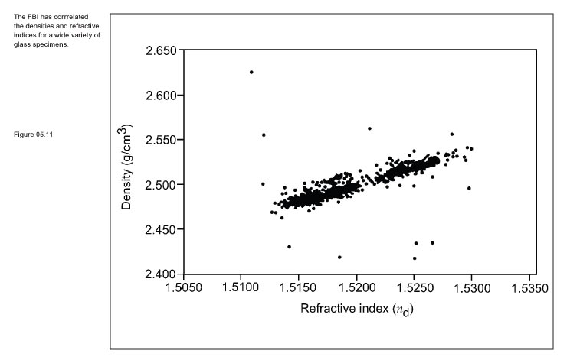
FBI Refractive Index vs Density Data
The FBI has compiled density and refractive index data for glass from around the world.
The FBI has identified a relationship between their refractive indices and densities for 1400 glass specimens that is better at classification.

Slide 56
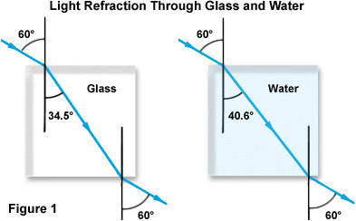
Snell’s Law
N=1.52
N=1.33
The higher the n, the more the light bends

Slide 57
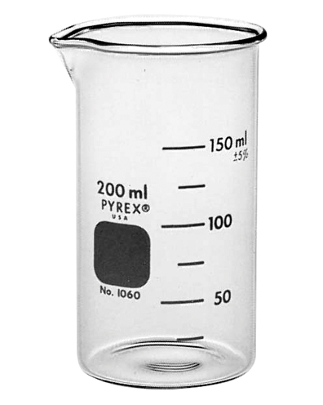
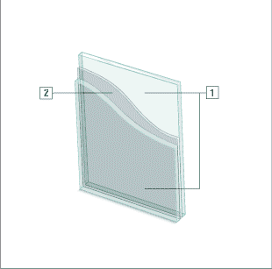
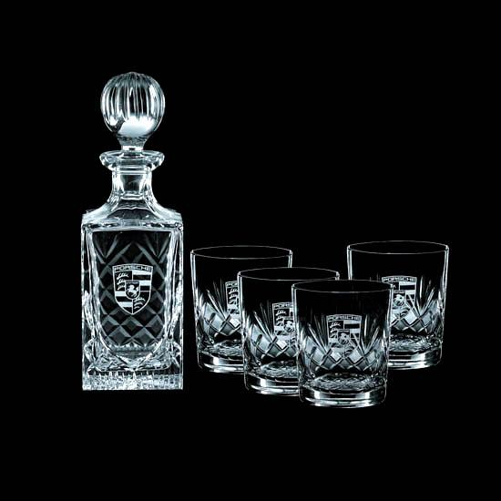
Learning Check
Which unique chemical component would be found in each type of glass shown below?
(beaker) (windshield) (crystal)
2. Use “Table 2.3” to determine if lead borosilicate glass can be distinguished from borosilicate glass by density, refractive index, or both.

