Slide 1
Hair

Slide 2
Hair Analysis
Can be used to match a suspect with a crime scene
Can be microscopically analyzed for similarity
Comparisons continue to improve as forensic techniques improve

Slide 3
Part 1 Hair Background
Grows from a collection of cells called a follicle
The hair shaft is composed of three parts:
1. cuticle – outside covering of hair
shaft, can look like overlapping
roof shingles

Slide 4
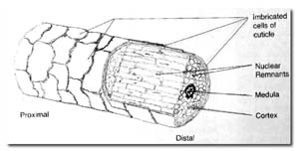
Cortex – inside the cuticle, a pigmented layer
Medulla – runs down the center of the hair
shaft

Slide 5
Hair texture can vary considerably depending upon the ratio of cuticle to medulla

Slide 6
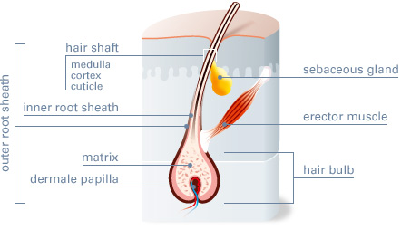
The Structure of Hair

Slide 7
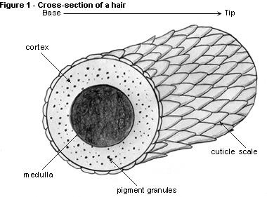
The Structure of Hair

Slide 9
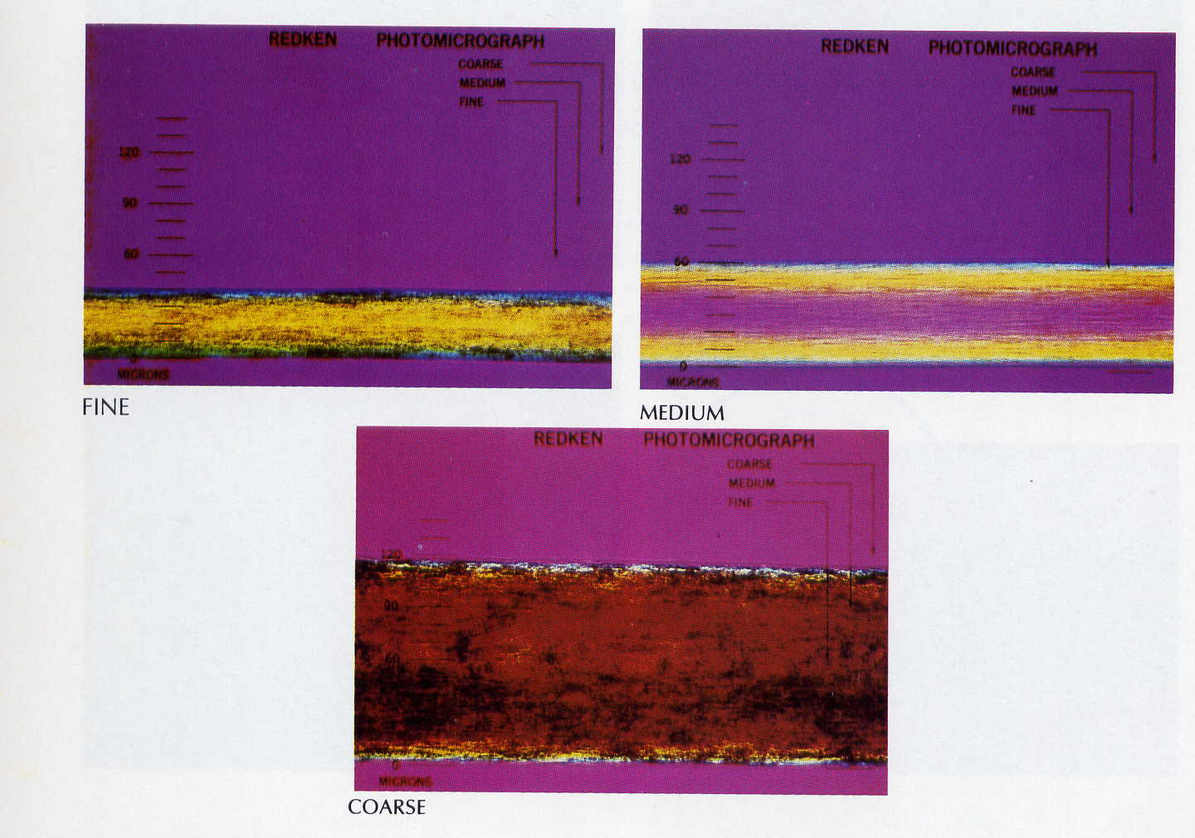

Slide 10
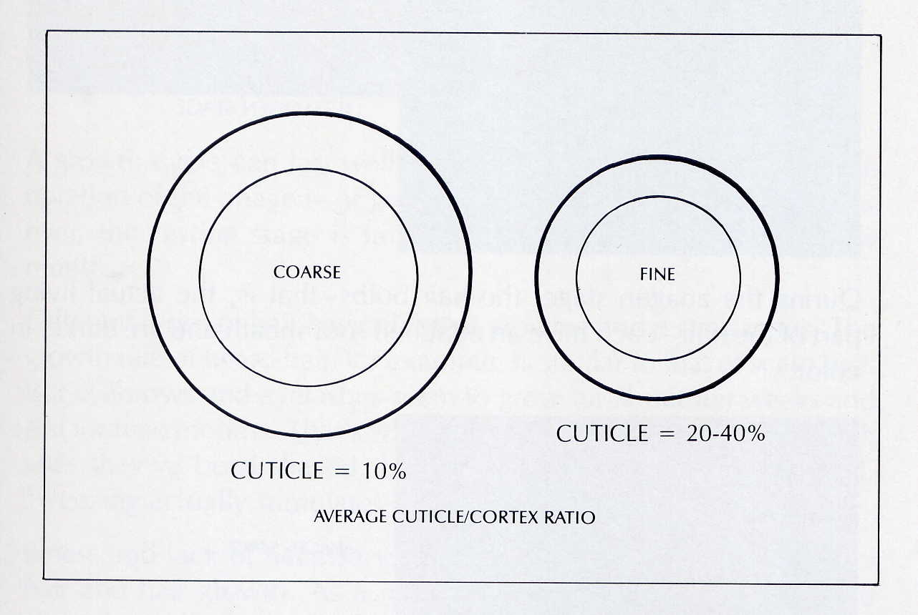

Slide 11
Cross-Sections
Hair can vary in shape, length, diameter, texture, and color.
The cross-sections can be circular, triangular, irregular, or flattened, which influences the curl of the hair.
Dog layers can have one fine coat and one coarse coat.

Slide 12
Color
Depends on distribution of pigment granules.

Slide 13
Hair from Different Parts of the Body
Head Hair
Eyebrows/Eye Lashes
Beard and Mustache Hair
Underarm Hair
Auxiliary or Body Hair
Pubic Hair

Slide 14
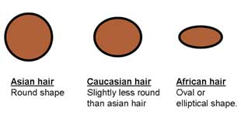
HEAD HAIR
Cross-Section is circular or elliptical

Slide 15
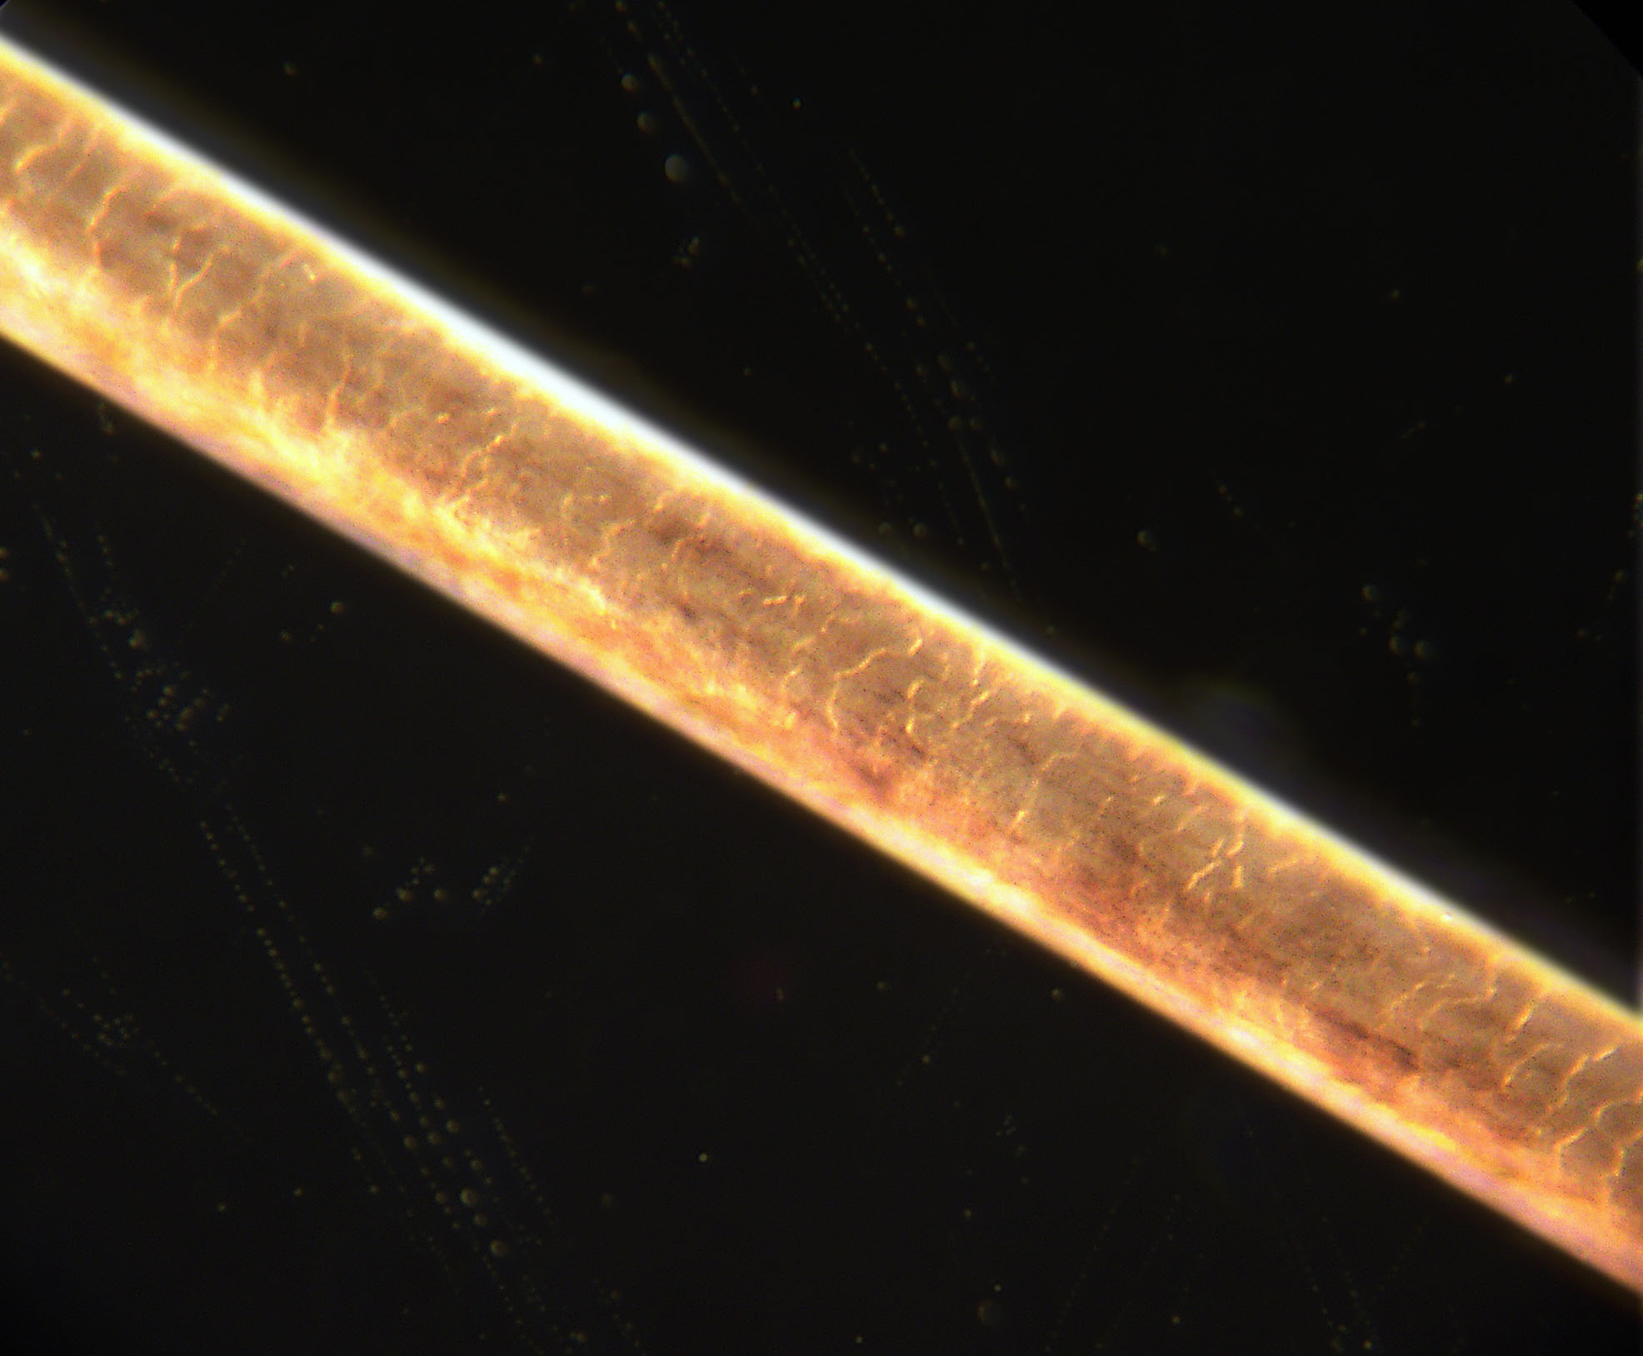
EYEBROW HAIR
Cross-Section is circular, but has tapering ends

Slide 16
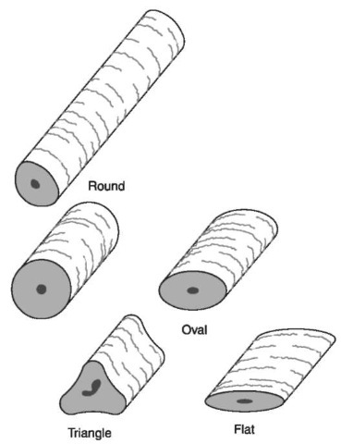
BEARD HAIR
Beard: Thick and Triangular Cross-Section

Slide 17
BODY HAIR and PUBIC HAIR
Oval or Triangle, depending on the shaving routines of individual.

Slide 18
HAIR GROWTH
Antagen Stage
  80-90% of all hair. Active growth around follicle.
Catagen Stage
  Hair changes (Turning Grey)
Telogen Stage
  Hair follicle is dormant or resting and hairs easily fall out.

Slide 19
TREATED HAIR
Bleaching removes pigment granule.
When hair is dyed, the hair shaft (Cuticle and Cortex) changes color.

Slide 20
Racial Differences

Slide 21
Animal Hair
Ovoid Bodies- clumps of pigment
Animal hair can change color abruptly

Slide 22
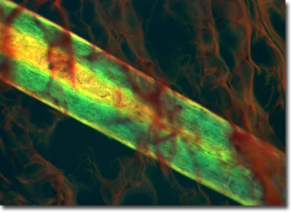
MICROSCOPY
Length, color, curliness
Pattern of Medulla
Florescence of Dyes

Slide 23
TESTING FOR SUBSTANCES
Lead, Arsenic, Drugs
Organic solvent breaks down hair over time. Scientists can often develop a timeline.
If hair is forcibly removed, it has follicular tag. DNA Testing.

