Slide 1
Carrying Capacity
No population can grow indefinitely due to limiting factors such as…?
Light
Water
Space
Competition
Predation
Disease

Slide 2
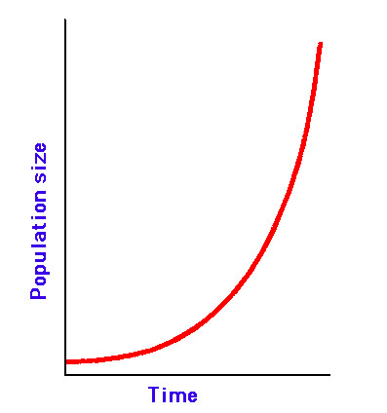
Intrinsic rate of increase (r)
Rate of population growth with unlimited resources

Slide 3
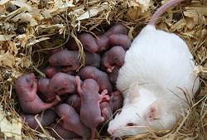
4 Characteristics of Rapidly Growing Populations
Timing of reproduction? →
Early in life

Slide 4
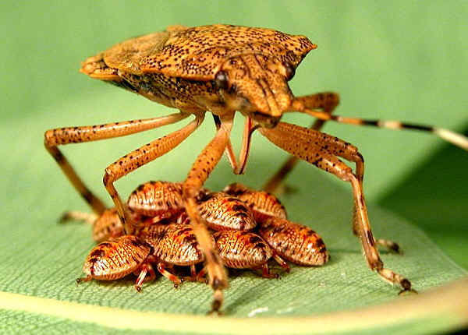
4 Characteristics of Rapidly Growing Populations
2. Amount of time between generations? →
Short generation time

Slide 5
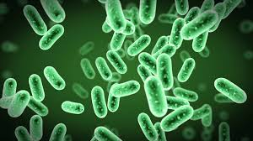
4 Characteristics of Rapidly Growing Populations
3. Length of reproductive lives? →
Long; can reproduce many times

Slide 6
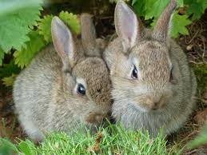
4 Characteristics of Rapidly Growing Populations
4. # of offspring? (FECUNDITY)
→ Many offspring (high fecundity)

Slide 7
Carrying Capacity (K)
Determined by biotic potential = maximum reproductive rate of a population in ideal conditions (capacity for growth)
and
environmental resistance (factors that limit growth)
As population reaches carrying capacity, growth rate decreases because resources become more scarce, among other factors
What happens to mortality?
What happens to fecundity?

Slide 8
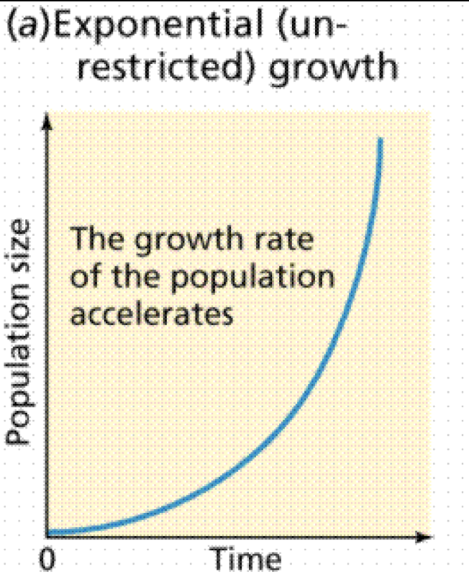
J-curve: Exponential Growth
In real-life situations, cannot last indefinitely!

Slide 9
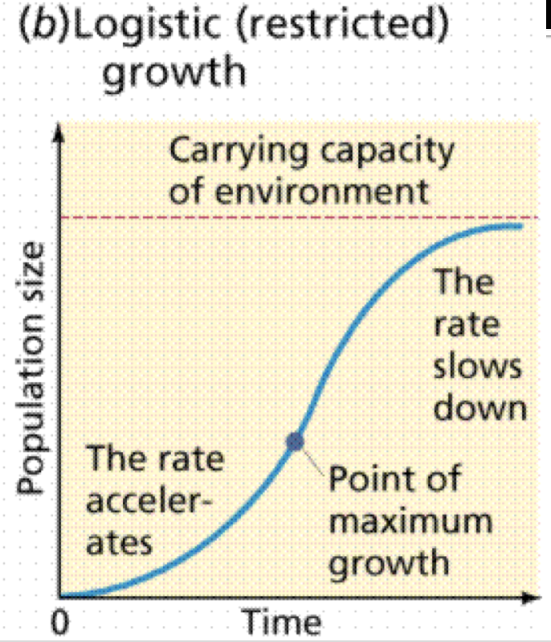
S-curve (sigmoid)—logistic growth
Notice it is exponential for the first part and then becomes S –shaped as limiting factors take effect

Slide 10
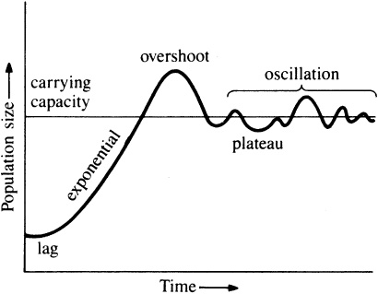
Dieback

Slide 11
Exponential Growth Equation
The Drama Correlation Law
N_{t} = N_{o} e^{rt}

Slide 12
N₀ = Initial population size
r = rate of growth
e = a constant (2.7)
t = amount of time
N_{t} = Final population size
This is also how you calculate compound interest

Slide 13
Consider a population of mice that has an initial population size of 20 individuals. The intrinsic rate of growth for mice is r=0.2 (or 20%), meaning each mouse produces a net increase of 0.2 mice each year. Predict the size of the mouse population 5 years from now.

Slide 14
N_{t} = N_{o} e^{rt}
N_{t} = (20) (2.7^{(0.2)(5)})
N_{t} = (20) (2.7¹)
N_{t} = 54.4 mice

Slide 15
N_{t} = N_{o} e^{rt}
N_{t} = (20) (2.7^{(0.2)(10)})
N_{t} = (20) (2.7²)
N_{t} = (20) (7.4)
N_{t} = 147.8 mice

Slide 16
N_{t} = N_{o} e^{rt}
N_{t} = (20) (2.7^{(0.2)(20)})
N_{t} = (20) (2.7⁴)
N_{t} = 1092 mice

Slide 17
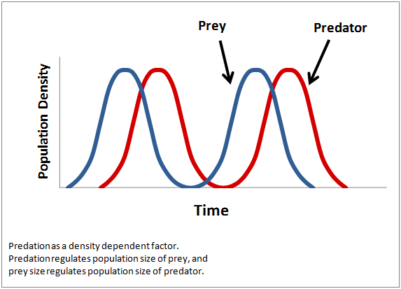
Density Dependent Factors
Will change intensity depending on the density of the population
Competition
Predation
Diseases
Parasitism

Slide 18
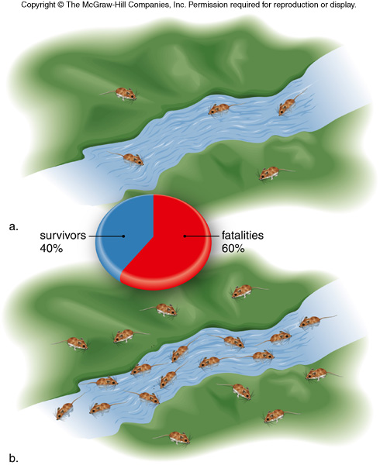
Density Independence
Will have the same intensity depending on the density of the population
Natural: Floods, hurricanes, fire
Anthropogenic: Pollution, habitat destruction

Slide 19
Video: Texas Mosquito Mystery Crash Course #2 (11:52
www.youtube.com/watch?v=RBOsqmBQBQk

Slide 20
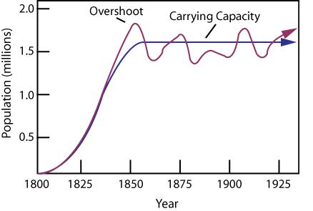
4 Types of Population Fluctuations
Stable—fluctuates slightly above and below carrying capacity
Tropical Rainforest—temps/rainfall stay steady

Slide 21
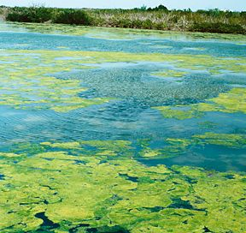
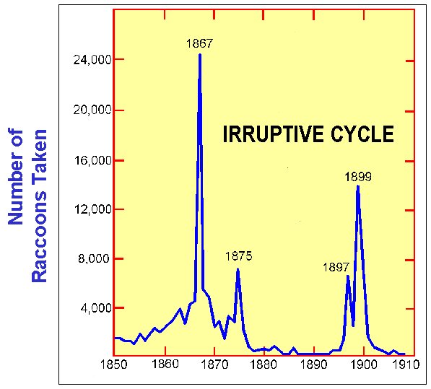
2. Irrupt—Usually stable, but sometimes explodes and then crashes
Algae, insects—due to seasonal changes, nutrient availability

Slide 22
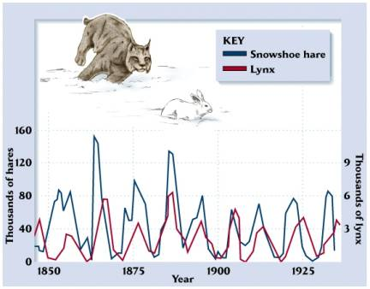
3. Cyclic—Rise and fall in predictable pattern
Predator/prey
Video—Lynx and hare “epic hunting chase” 2:53 https://www.youtube.com/watch?v=swiSMSWgbKE

Slide 23
4. Irregular—no recurring pattern
Chaos in the system, or just not yet understood?

