Slide 1
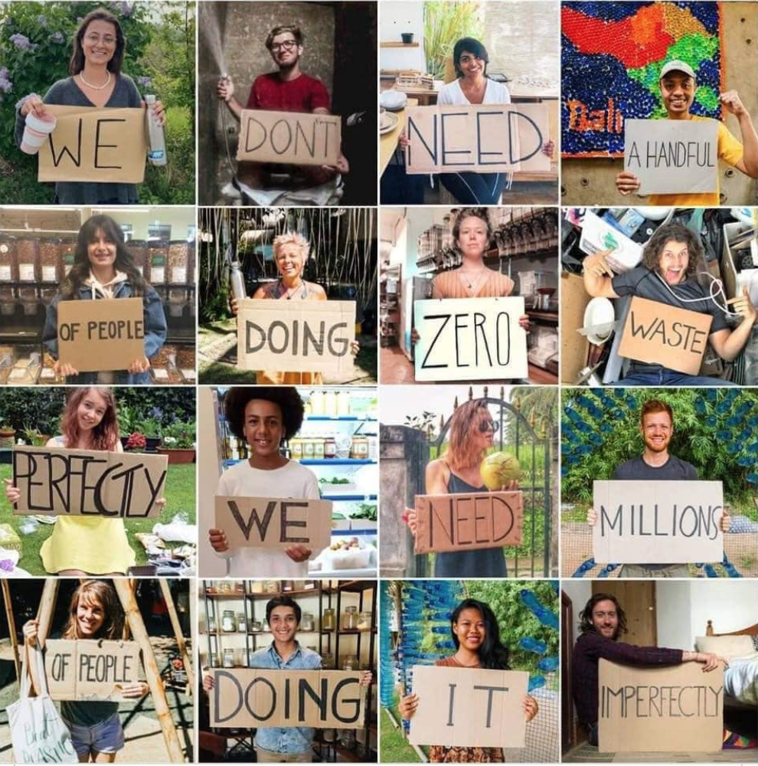

Slide 2
Better, not perfect?
Does this apply to individual choices, or systemic change?
Or both, or neither?

Slide 4
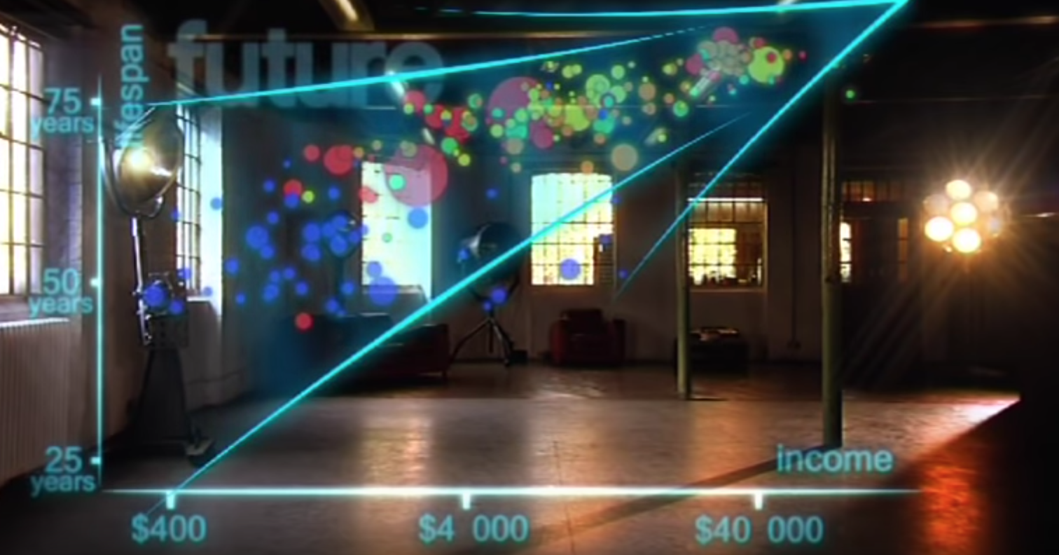
Discuss Hans Rosling’s video with your neighbor. Consider the statement he made at the end:
“We have become an entirely new converging world. I see a clear trend into the future, with aid, trade, green technology and peace, It’s fully possible that everyone can make it to the Healthy/Wealthy Corner!”
Do you agree?

Slide 6
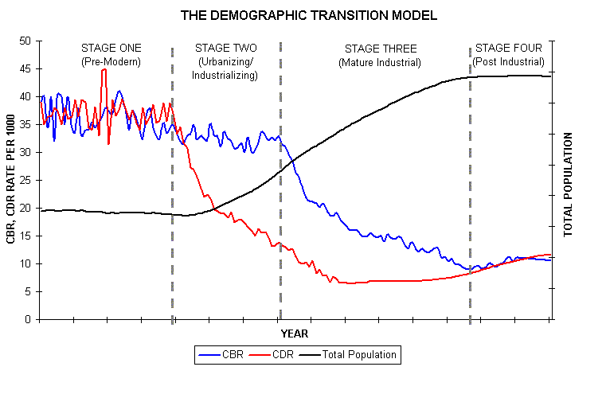
Stage ONE: No/Slow Growth
CBR = CDR
Short life expectancy, high infant mortality
Disease, lack of health care, poor sanitation
US/Europe: before late 18th
Almost no countries now in Stage 1
Notes:
Scientific method steps, biomes, characteristics of life, steps to the nitrogen or water cycle

Slide 7
Stage TWO: Rapid Growth
Death rates decline
Improved health care, access to water & food, vaccinations
Fertility rates remain high
Imbalance
US early 19th, India now

Slide 8
Stage THREE: Stable Growth
Economy/Education improves
Family income up, #births declines
More birth control availability
CBR lowers to = CDR again

Slide 9
Stage FOUR: Declining Growth
CBR < CDR
High affluence/economic development
More elderly
Govt may encourage immigration or $$ incentives to have more children

Slide 11
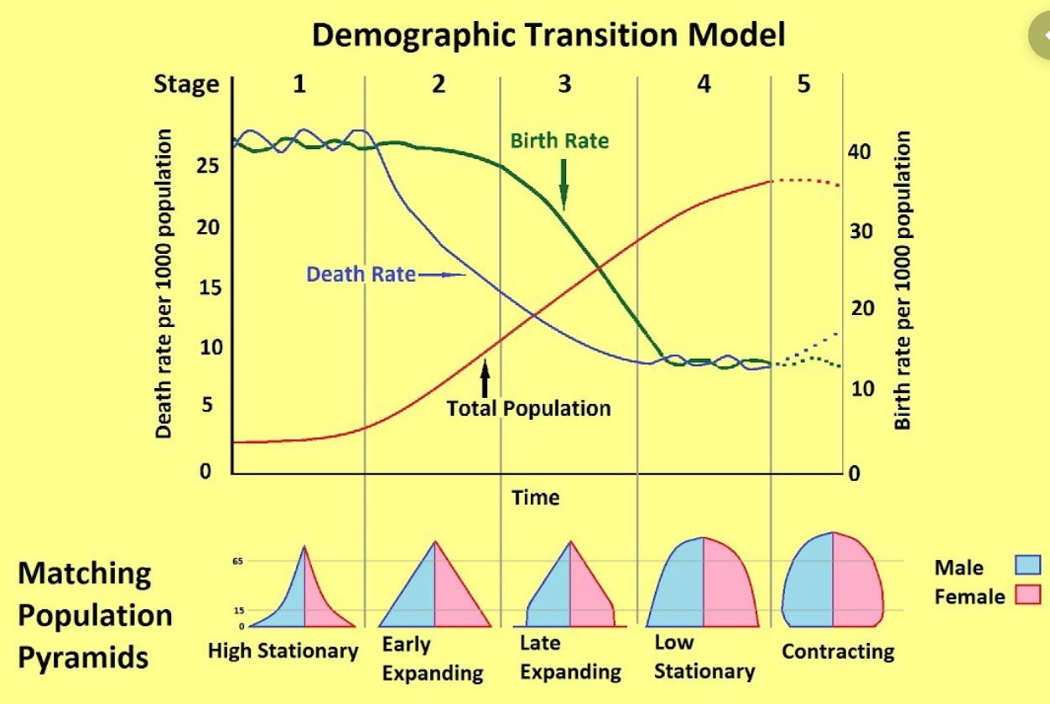

Slide 13
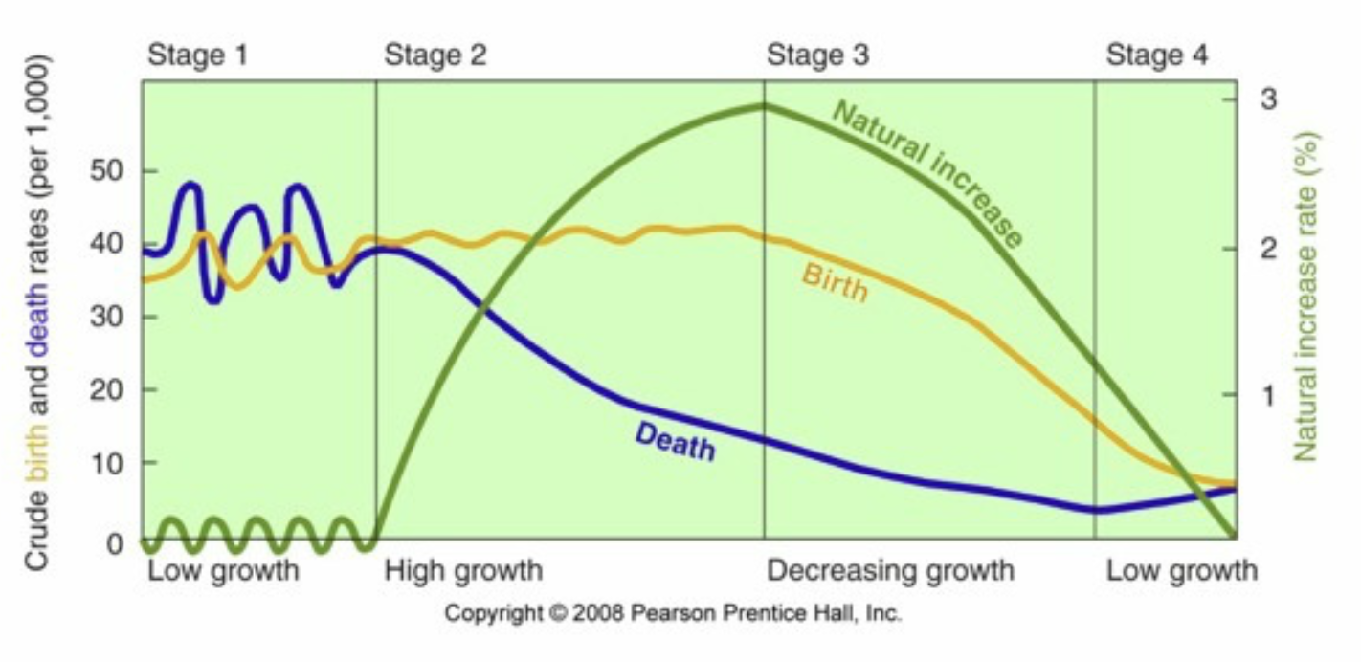

Slide 14
Card Sort
Find the cards labeled Pre-Industrial, Transitional, Industrial and Post-Industrial and make them the top of your columns
Match the characteristics to the correct stage. There are this many for each one:
Pre-Industrial = 5
Transitional = 5
Industrial = 4
Post-Industrial = 6
When you’re done call me over and I’ll give you the completed table to paste in your packet on p. 24

Slide 15
Case Studies
Follow the instructions on your case study sheet.
Individual reading and notes = 3 min
Get in groups (number in upper right)
Present your country individually = 1 min
Group discusses and agrees on stage = 1 min
Repeat for each person

Slide 16
Stage I =
South Sudan (B)
Stage II = Afghanistan (D)
Stage III =
Morocco (A)
Stage IV = Argentina (E)
Stage V =
Germany (C)

Slide 18
Affluence
More resources used per person
HOWEVER…
More wealth (higher GDP) can lead to environmental improvements and increased efficiency

Slide 19
Technology
Destructive: New toxic chemicals, increased resource extraction, manufactured “needs”
Beneficial: Green solutions that increase efficiency and lower impact (hybrid car)

