Slide 1
PPT 4.4 Earth’s Atmosphere

Slide 2
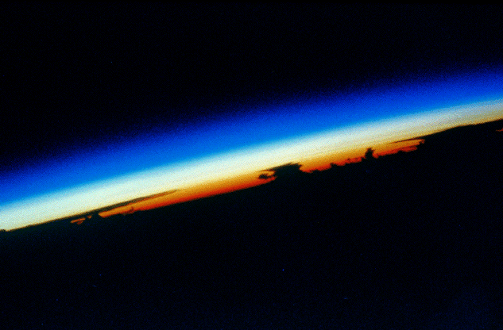
What is the Structure of the Earth’s Atmosphere?

Slide 4
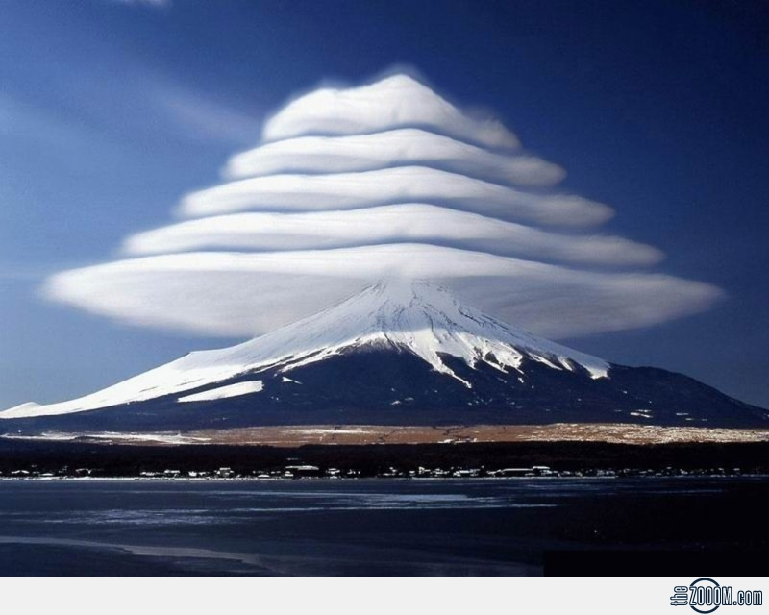

Slide 6
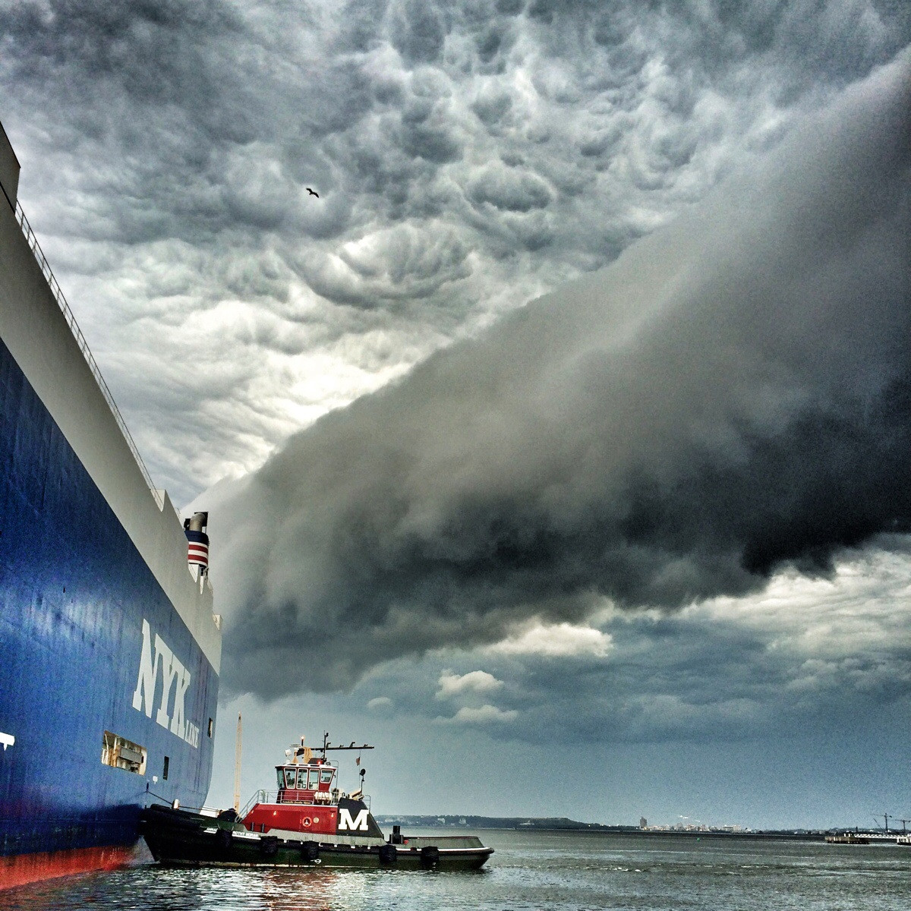

Slide 7
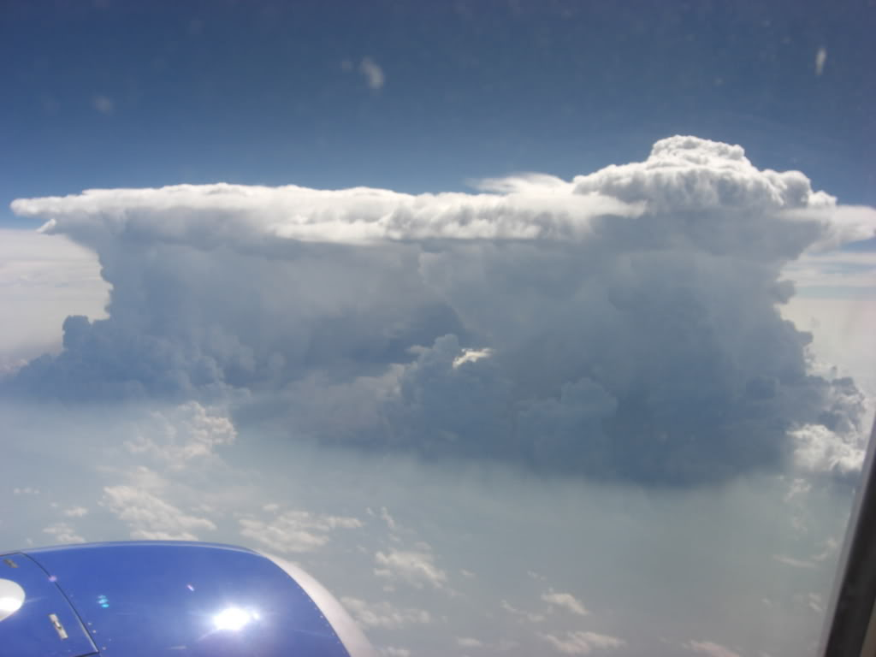

Slide 8
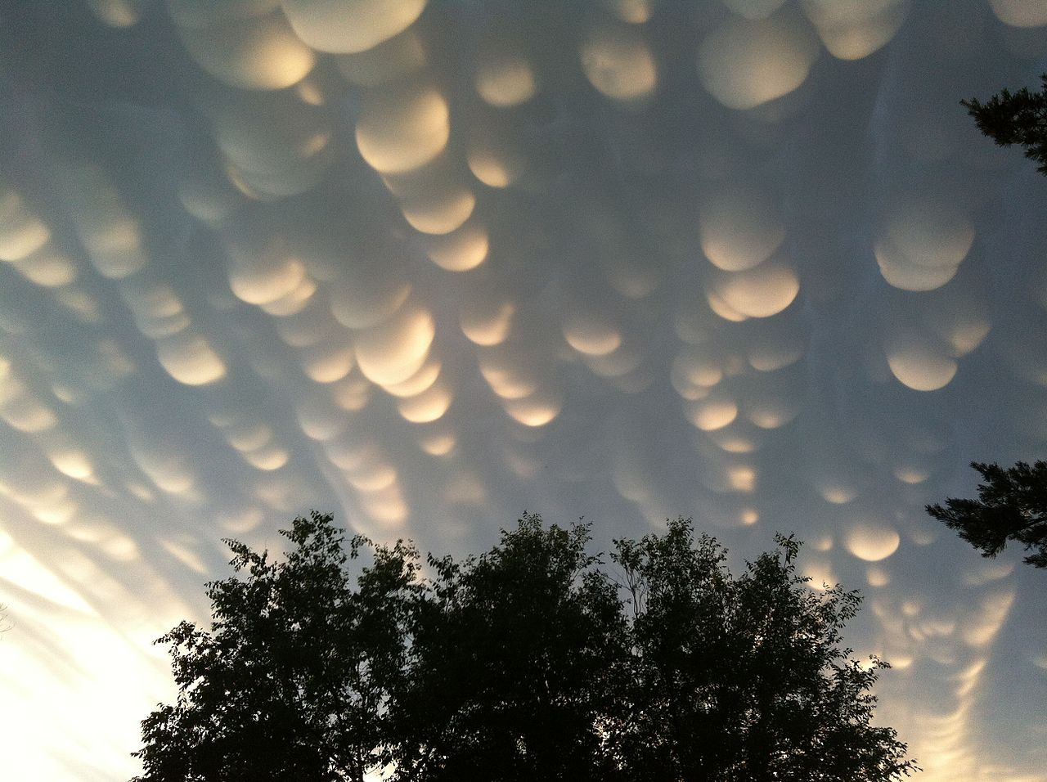

Slide 9
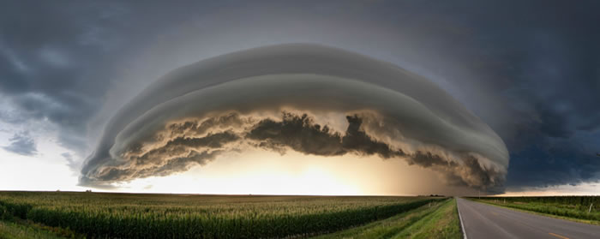

Slide 10
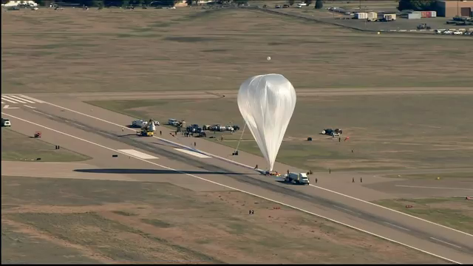

Slide 11
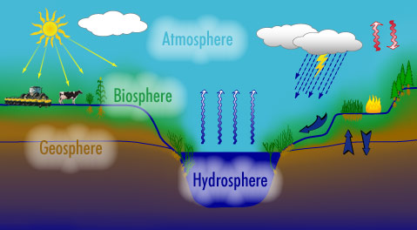
Earth’s Life Support
atmosphere (air)
the hydrosphere (water)
the geosphere (rock, soil, sediment)
the biosphere (living things)

Slide 12
Importance of Atmosphere
Provides O₂ and CO₂
Absorbs solar radiation
Moderates climate
Transports and recycles water and nutrients

Slide 13
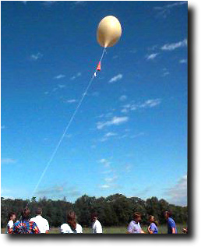
Atmospheric Pressure
We live at the bottom of an “ocean of air”
Just as water pressure is caused by the weight of water...
Atmospheric pressure is caused by the weight of air

Slide 14
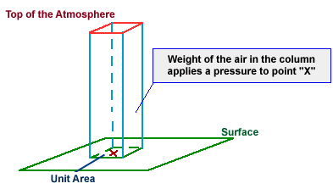
Atmospheric Pressure
pressure = weight/area
column of air from surface to the top of the atmosphere

Slide 15
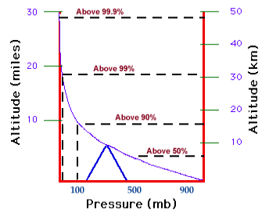
Change with altitude?
as altitude increases, pressure decreases

Slide 16
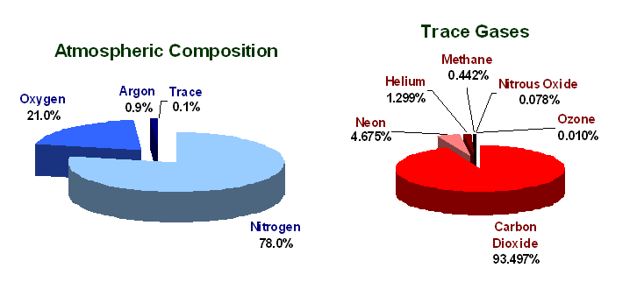
Composition of the Atmosphere
Other permanent gases:
Argon 0.9%
Neon 0.002%
Helium 0.0005%
Krypton 0.0001%
Hydrogen 0.00005%
PERMANENT gases:
Nitrogen 78.1%
Oxygen 20.9%

Slide 17
Variable Gases in the Atmosphere
VARIABLE gases in the atmosphere and typical percentage values are:
Water vapor 0 to 4%
Carbon Dioxide 0.035%
Methane 0.0002%
Ozone 0.000004%

Slide 18
But there are Layers to Earth’s Atmosphere
What parameter do we use to define these layers?

Slide 19
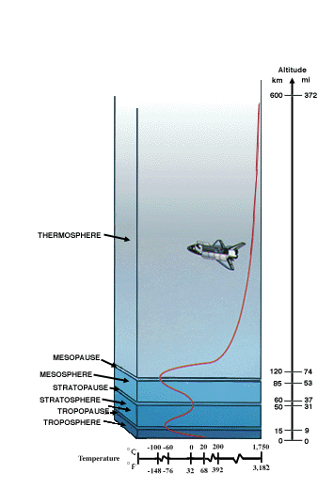
The Layers of the Atmosphere
Are Arranged According to
Temperature
Temperature changes with altitude.
The PAUSES in the layers are the transition zones between temperature changes

Slide 20
Do Activity

Slide 21
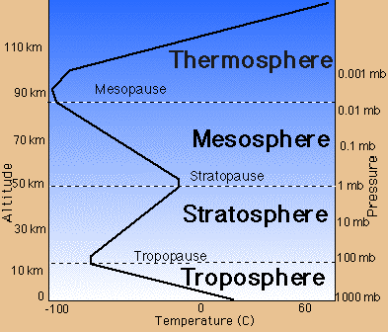

Slide 22
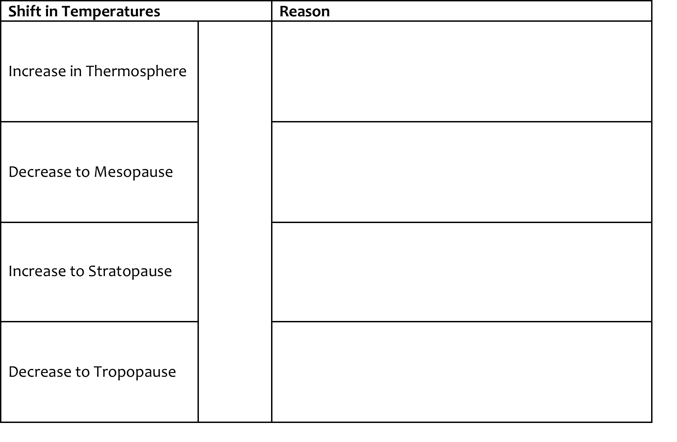
High energy UV and Xray radiation absorbed (closer to sun)
FEELS cold because the molecules are so sparse and far apart
Air becomes thinner again
Formation of ozone layer which traps heat
Air becomes thinner (molecules farther apart)

