Slide 1
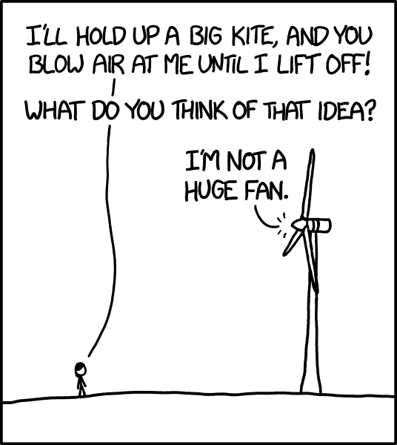
PPT 4.5 Global Wind Patterns

Slide 2
https://youtu.be/edidoiwLGKQ
“Wind” 3:49

Slide 3
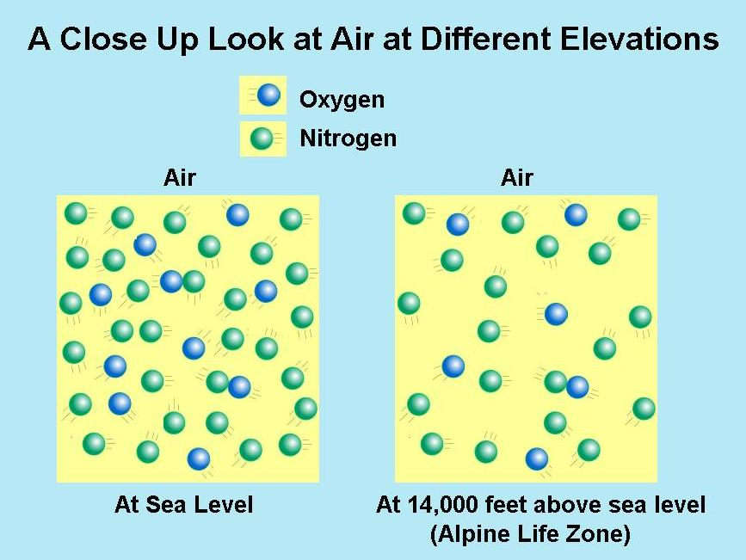
Four properties determine air circulation patterns:
1. Air density: Less dense, warmer air rises

Slide 4
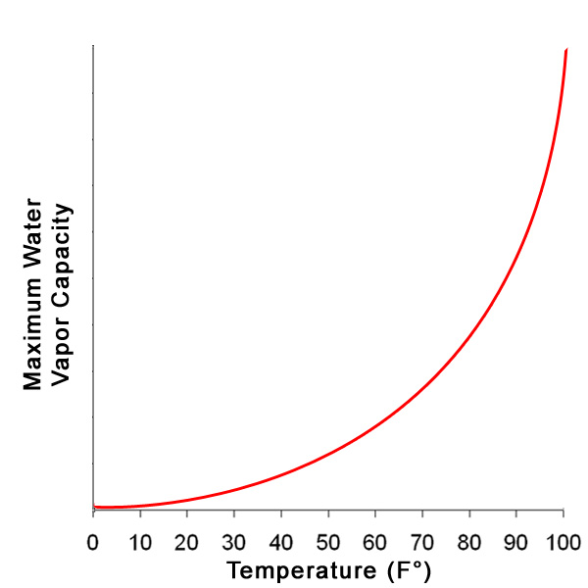
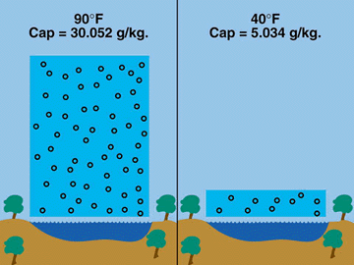
2. Water vapor capacity
Warm air has a higher water vapor capacity (humidity!)
Saturation point

Slide 5
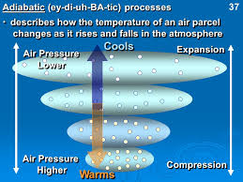
3. Adiabatic heating/cooling
Response to changes in pressure
Air rises🡪lower pressure🡪volume expands🡪cools

Slide 6
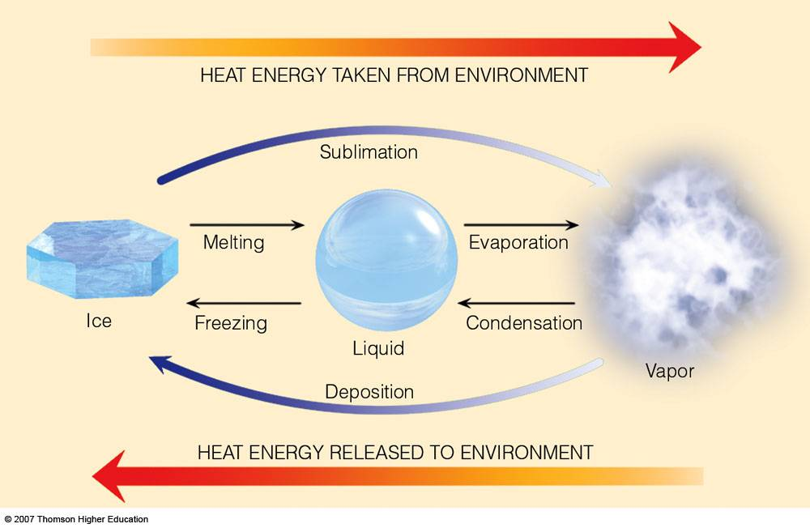
4. Latent heat release
Release of energy as heat when water vapor condenses into precipitation (in clouds)

Slide 7
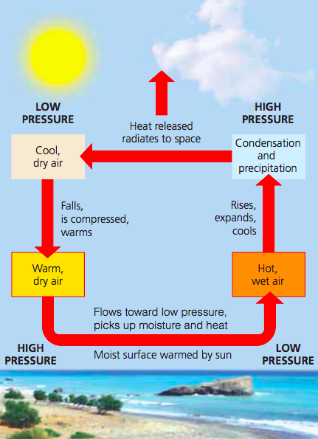

Slide 8
🡪 Video: “Global Atmospheric Circulation” (2:24) https://www.youtube.com/watch?v=Ye45DGkqUkE

Slide 9
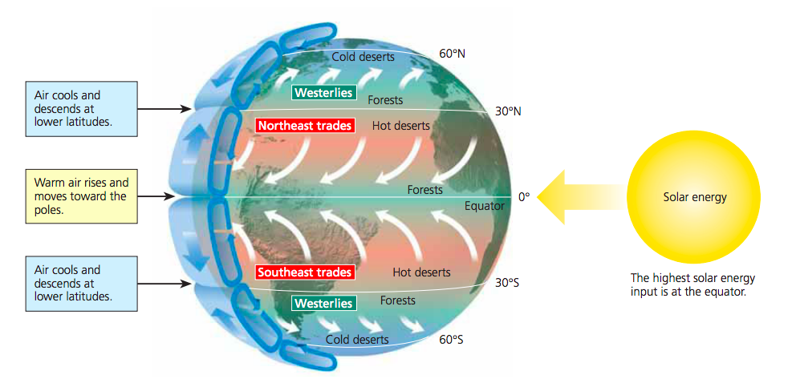

Slide 10
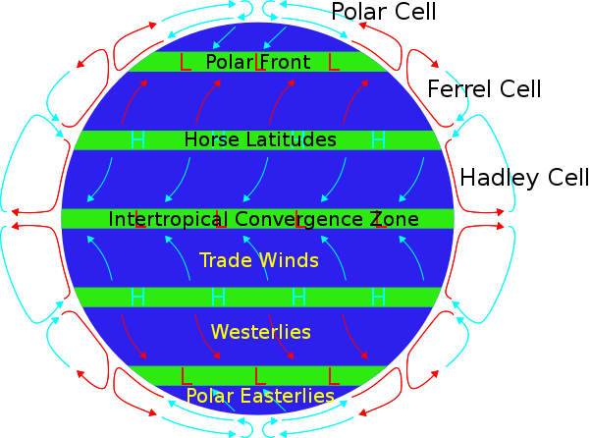
To remember the order: as you move down to the equator, it gets Pretty Frigging Hot. (Polar, Ferrel, Hadley)

Slide 11
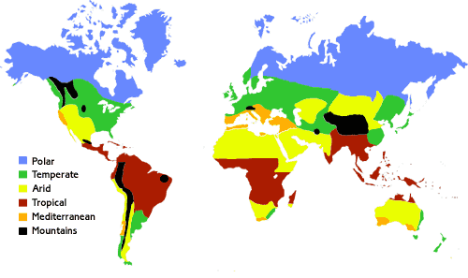

Slide 12
Coriolis Effect: http://video.pbs.org/video/2365036901/
https://www.youtube.com/watch?v=DHrapzHPCSA Global Winds video

Slide 13
