Slide 1
PPT 4.8 Earth’s Geography and Climate

Slide 2
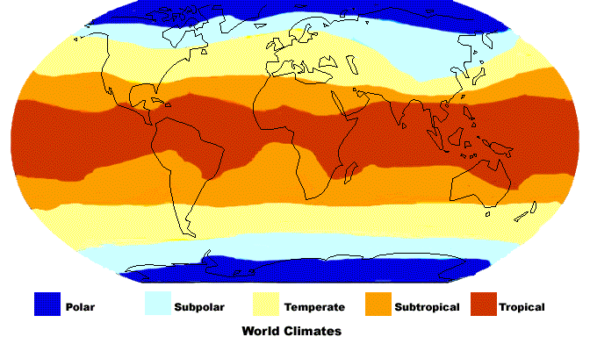

Slide 3
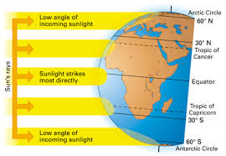
What determines climate patterns?
global air circulation
ocean currents
Angle of sun’s rays (tilt)
🡪heat and precipitation distributed unevenly

Slide 4
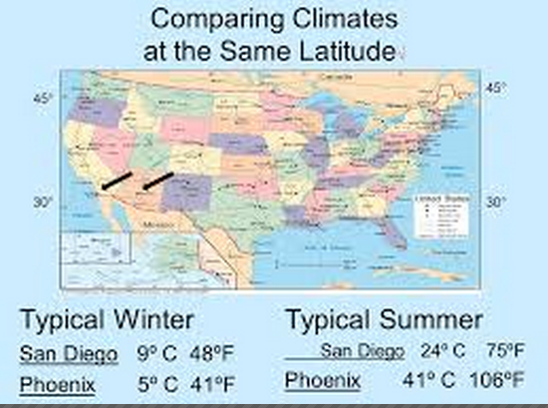
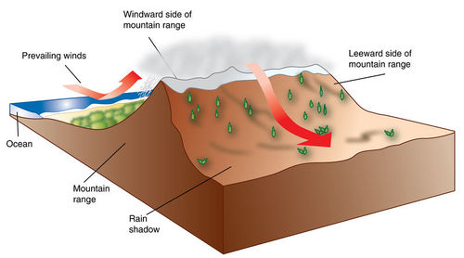
Topographic features
Mountain Ranges
Proximity to water

