Slide 1
PPT 4.9 El Niño and La Niña

Slide 2
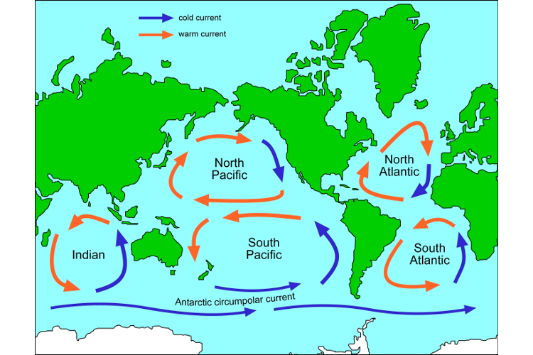
Gyre: Large-scale water circulation that moves clockwise in the Northern Hemisphere and counter-clockwise in the Southern.

Slide 3
Upwelling: upward movement of ocean water
mixes the water, bringing cool and nutrient-rich water from the bottom of the ocean to the surface
it supports large populations of phytoplankton, zooplankton, fish, and fish-eating seabirds.

Slide 4
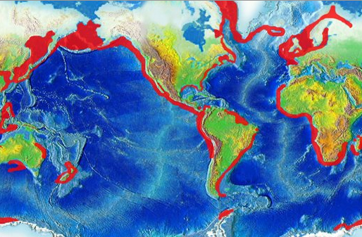

Slide 5
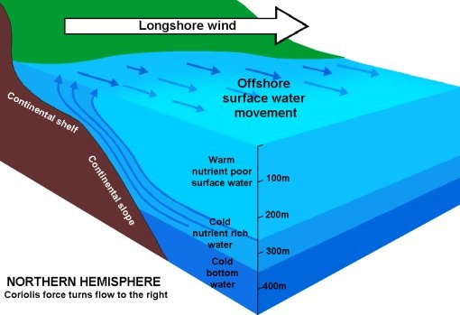
Upwellings occur when:
Far from shore: surface currents move apart and draw water up from deeper layers
Along the steep western coasts of some continents: winds blowing along the coasts push surface water away from land and draw water up

Slide 6
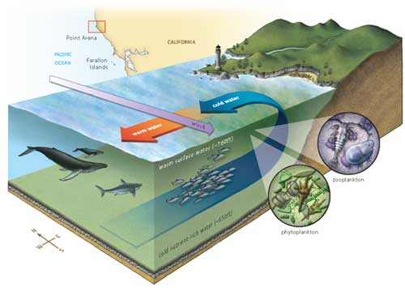

Slide 7
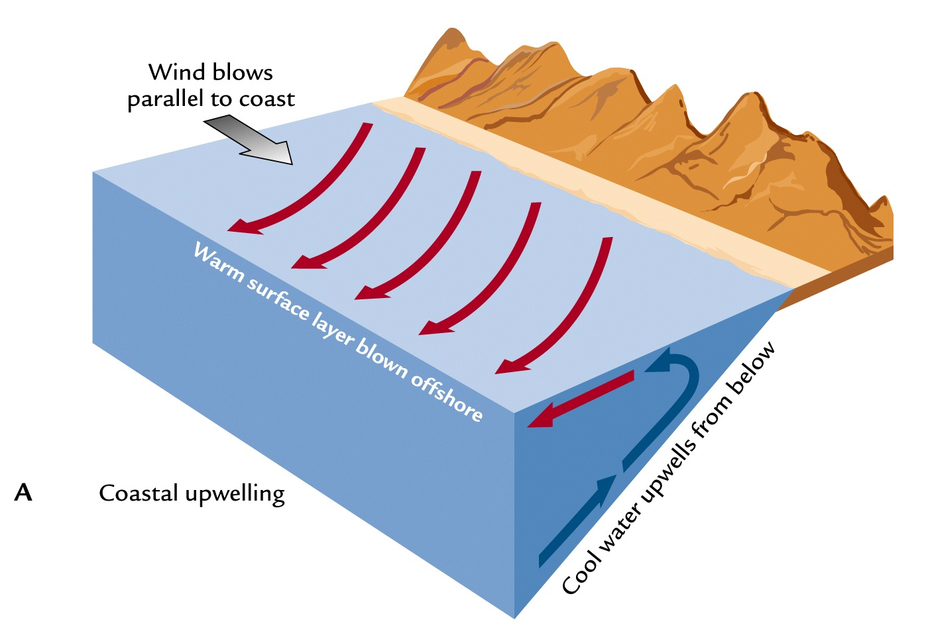

Slide 8
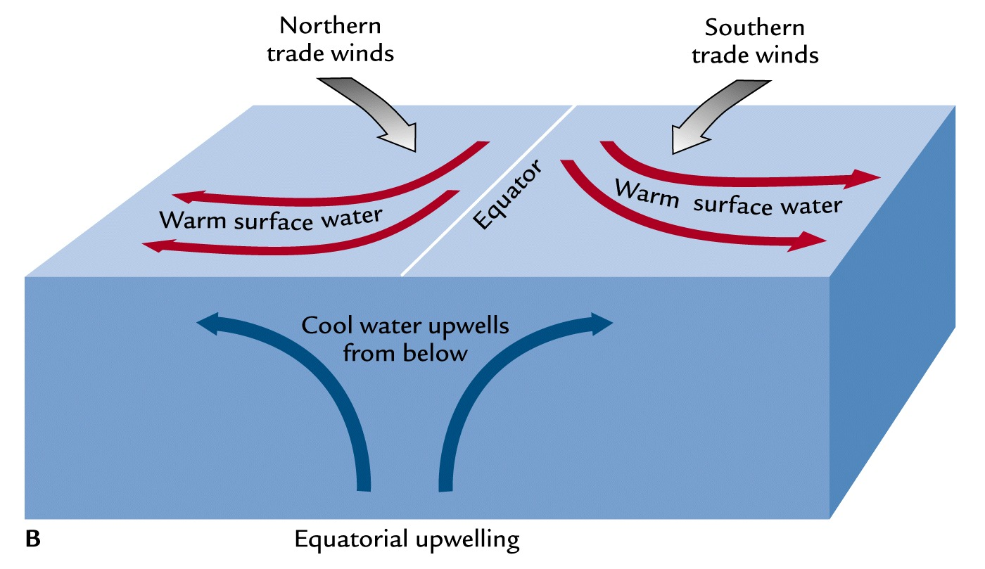

Slide 9
What happens during an El Niño?
Every few years in the Pacific Ocean
normal shore upwellings are affected by changes in weather patterns
prevailing tropical trade winds (E🡪W) weaken or reverse direction
western Pacific warmer waters move toward S.A.
suppress the normal upwellings of cold, nutrient-rich water

Slide 10
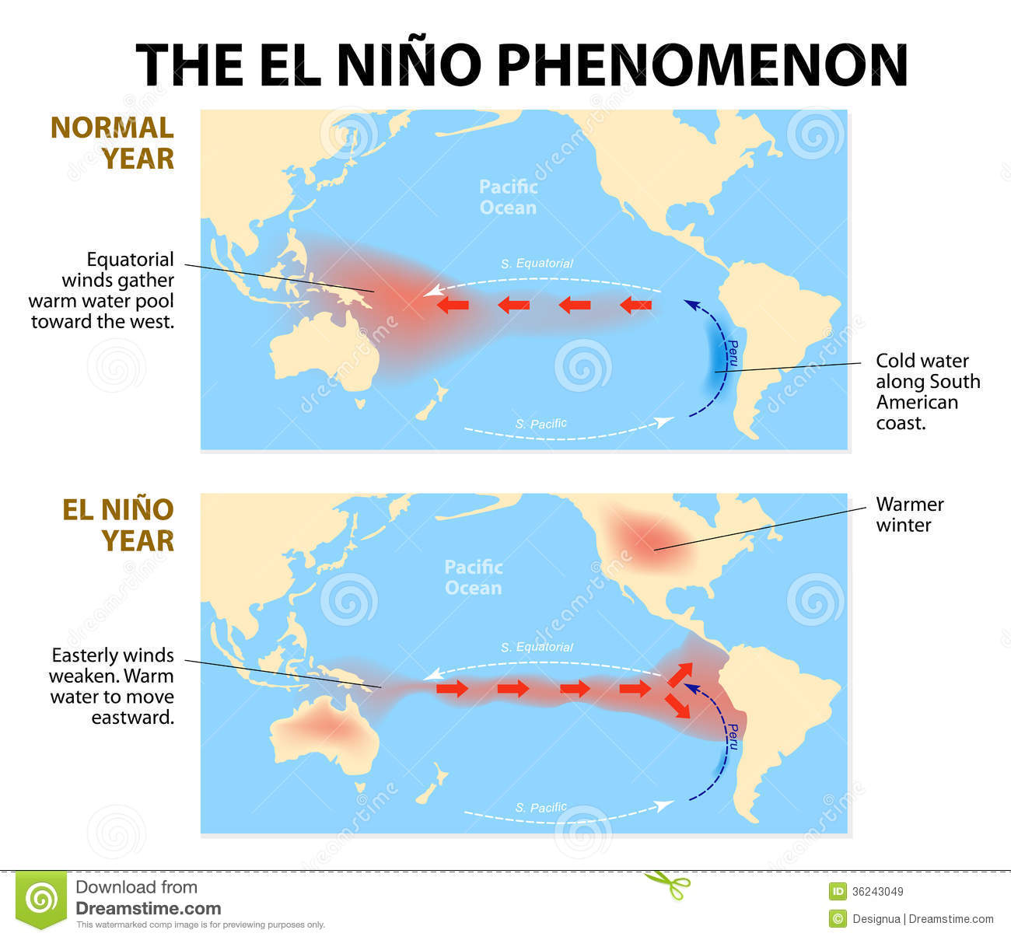

Slide 11
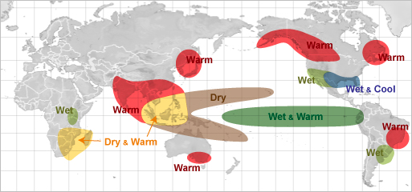
Possible Effects of El Nino
🡪 Decrease in nutrients:
reduces primary productivity
Causes decline in fish populations
🡪 Can alter the weather of at least two-thirds of the globe especially in lands along the Pacific and Indian Oceans

Slide 12
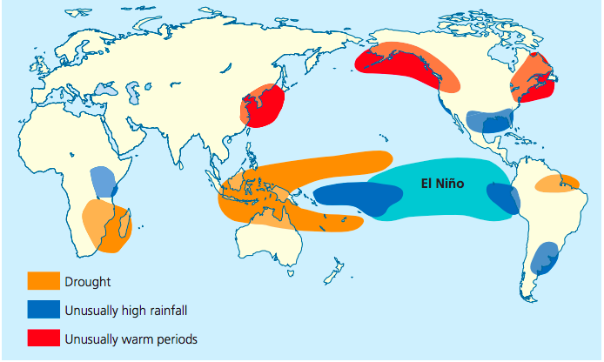

Slide 13
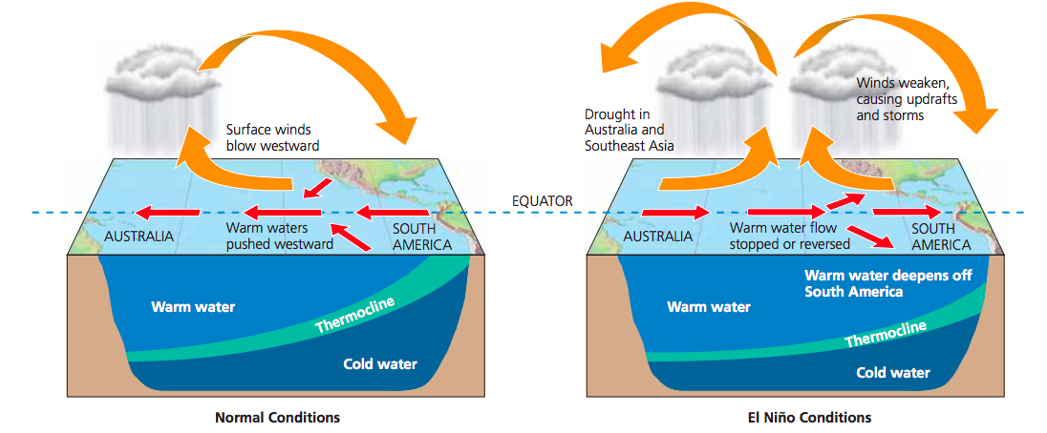

Slide 14
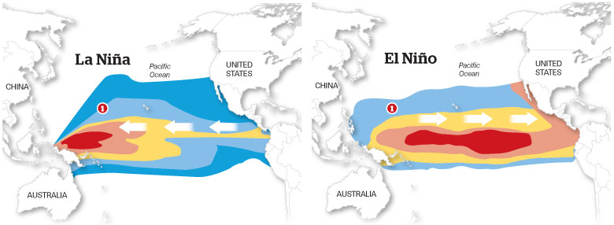
La Niña
cools some coastal surface waters, and brings back upwellings

Slide 15
more Atlantic hurricanes
colder winters in Canada and NE U.S.
Warmer/drier winters in the southeastern and southwestern United States, more wildfires
wetter winters in the Pacific NW
torrential rains in SE Asia
lower wheat yields in Argentina

Slide 16
http://video.nationalgeographic.com/video/el-nino

