Slide 1
PPT 5.14 IPM: Integrated Pest Management
A combination of methods used to effectively control pest species while minimizing the disruption to the environment

Slide 2
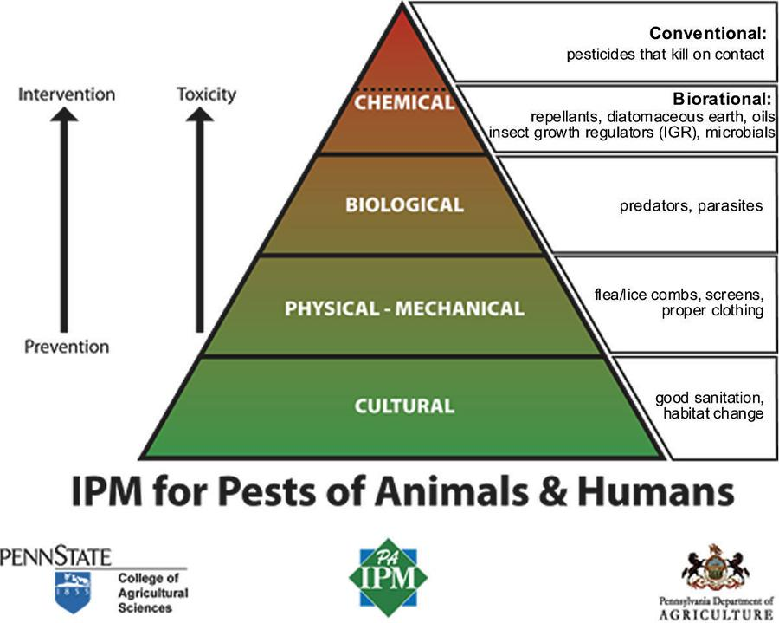

Slide 3
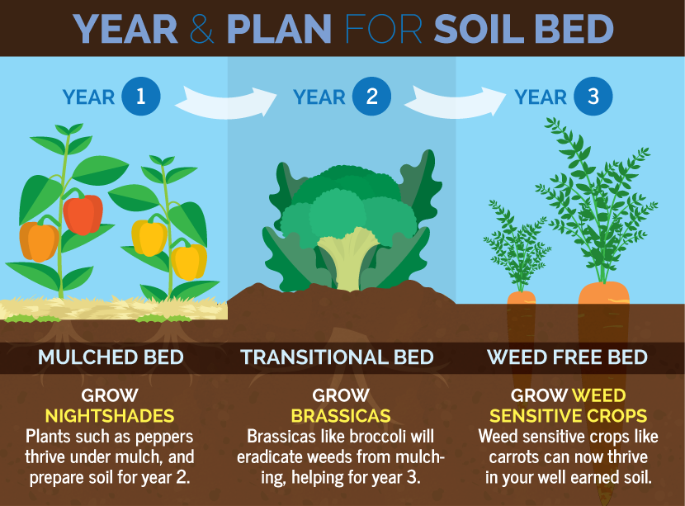
Crop rotation and Intercropping

Slide 4
Use of pest-resistant varieties

Slide 5
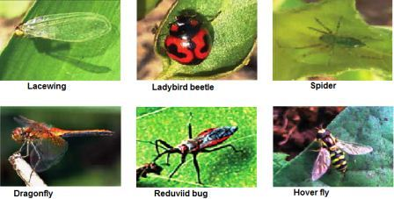
Creation of habitats for predators of pests
Banana protectors!

Slide 6
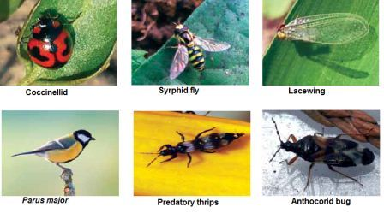
Apple
protectors!

Slide 7
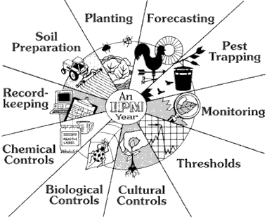
Limited pesticides when necessary
IPM is NOT THE SAME as “Organic”

