Slide 1
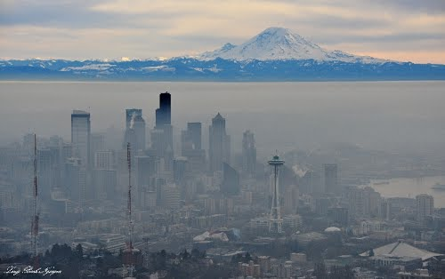
PPT 7.3 Thermal Inversion

Slide 2
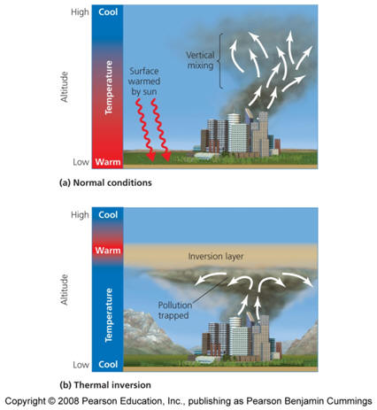
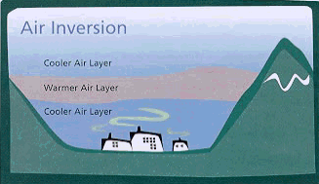
Layer of warm air traps cool air beneath it
Pollutants get trapped
Especially in valleys

Slide 3
Ahlmaty, Kazakhstan
What situations lead to thermal inversions?
Warm fronts/high pressure
Valleys
Areas of oceanic upwelling (Cali)
When radiation from the earth exceeds radiation received from the sun (when does that happen?)
At poles during winter, nearly always present (over land)
Only on land in general, as the ocean retains heat
Night and winter
Notes:
In the night and winter

Slide 4
https://www.youtube.com/watch?v=L7i7N-je-aM 2:58 The Inversion
https://www.youtube.com/watch?v=T_U3TXHBt-0 2:24 Temperature Inversions

