Slide 1
Now we’ll watch a video
With your partner, write down topics from the video

Slide 2
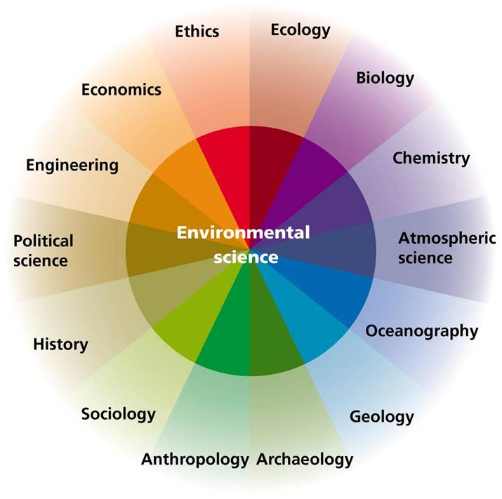
Environmental Science is Interdisciplinary

Slide 3
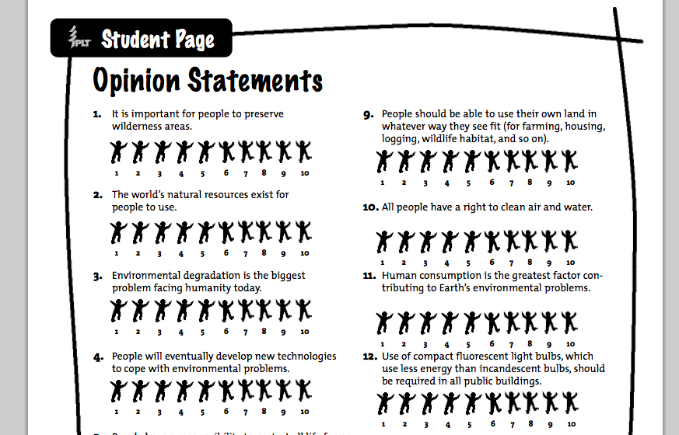
Fill out Opinions Page 1=Strongly disagree to 10=Strongly agree

Slide 4
Opinions page— share answers in group
Agree on 3 of the statements to discuss
Take a minute without talking to note a few of your own points
Discuss the statements and note some of the points of the others in your group you find interesting/different from yours

Slide 5
Fishing for the Future
Please go to your assigned table to complete the lab activity!

Slide 6
Homework
Upcoming:
Fishing for the future lab questions
Read Ch. 1/Take notes

