Slide 1
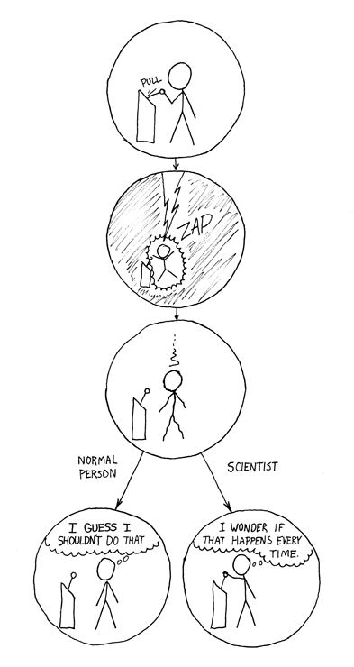
The Scientific Method

Slide 2
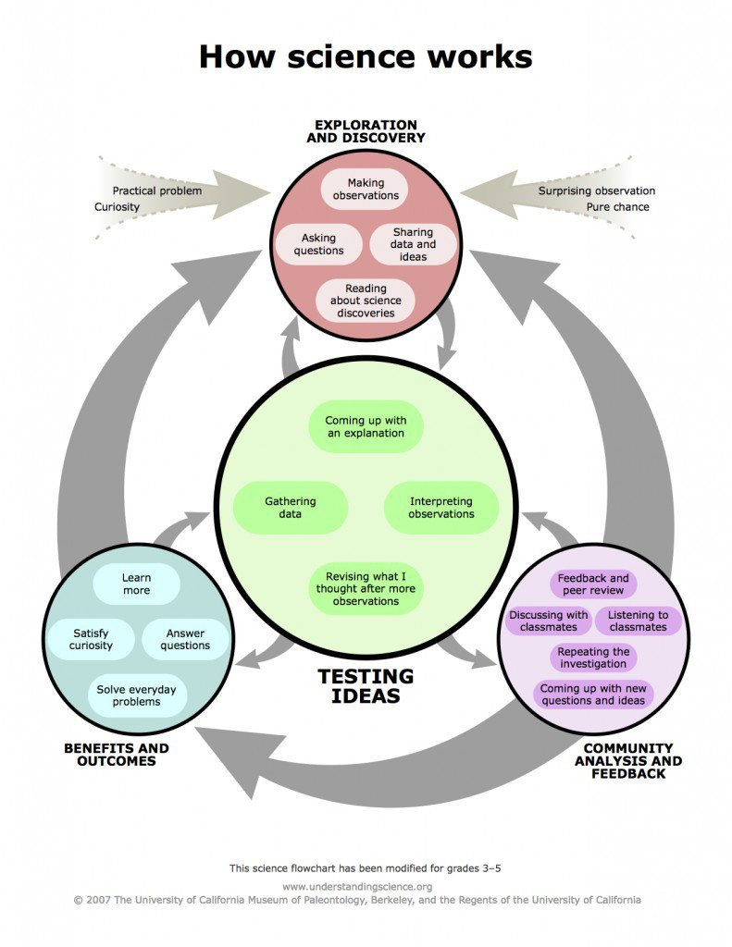

Slide 3
1. Make Observations
Use your senses to take in information about the world
Objective facts; no inferences

Slide 4
There was an axe next to the bloody dead body.
The axe was the murder weapon.
The axe at the crime scene was found 10 meters to the left of the body.
The killer was left-handed and threw the axe to the left.

Slide 5
F
I
K
J
E
B
C
D
A
G
H

Slide 6
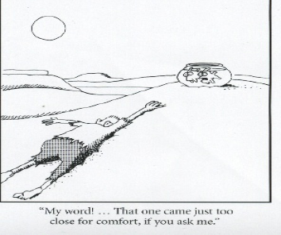

Slide 7
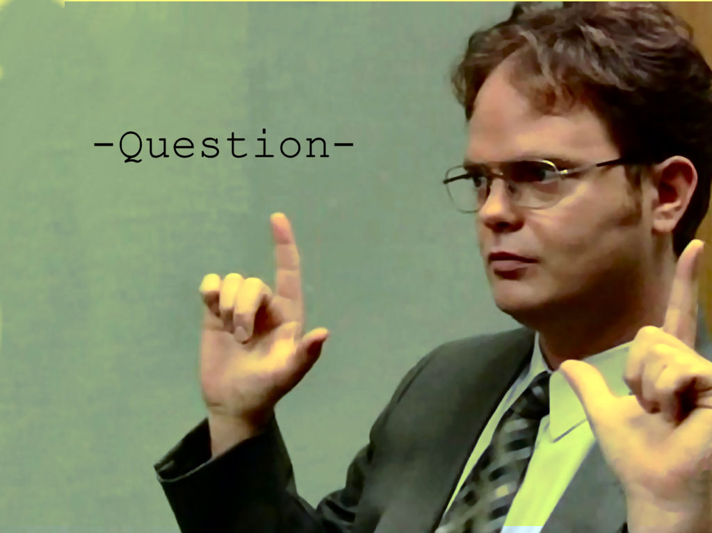
2. Background Research/ Ask a Question
What is previously known about the topic?
Build on that: What is it that still needs to be known (or confirmed)?

Slide 8
3. Form a Hypothesis
A testable statement
Often contains a PREDICTION

Slide 9
What’s wrong with these?
Chocolate may or may not cause pimples.
I think salt in soil causes plants to grow slowly.
There are ghosts in my closet.
Is plant growth affected by the color of the light?
Bacterial growth might be affected by temperature.
Sparrows are happier birds than eagles.

Slide 10
RULES:
A hypothesis is written as a statement, not a question.
“I think/I predict” is not found in a hypothesis.
A hypothesis is testable.
For a hypothesis to be properly supported through evidence or rejected, it must take a specific stand one way or the other. (Not wishy-washy!)

Slide 11
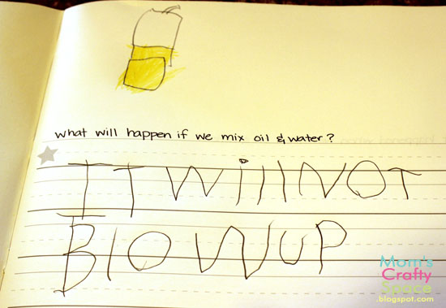
Is this a well-written hypothesis?

Slide 12
What is a null hypothesis?
Predicts NO RELATIONSHIP between two phenomena, no difference among groups
“devil’s advocate” hypothesis (since usually you’re interested in showing some sort of relationship—but not always! Tobacco scientists)

Slide 13
4. Design an Experiment
Most experiments require a Control Group
The baseline or standard situation with no variables changed
This is the basis for comparison
One or more Experimental Groups

Slide 14
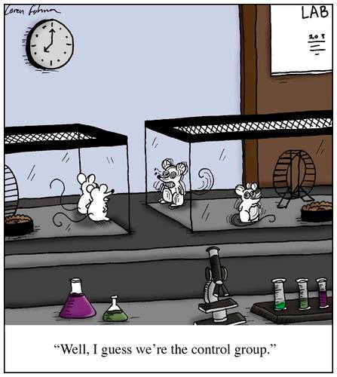

Slide 15
Independent Variable: What will be changed?
Dependent Variable: What will be measured?
Controlled Variables/Constants: What must remain the same?

Slide 16
MIX/DRY!
Manipulated
Independent
X-axis
Only one—but levels
Dependent
Responsive
Y-axis
May be more than one—Qual & Quant

Slide 17
Common Issues with Experimental Design
Sample size too small
No repeated trials
Uncontrolled variables
No control group
More than one IV

Slide 18
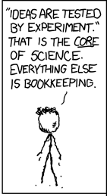

Slide 19
Lois wants to find out whether feeding babies mashed carrots improves their vision. She borrows 50 babies from her son Stewie’s daycare. 25 of them are given a normal diet. 25 are given mashed carrots as their evening meal every night. She then gives them a vision test.
IV?
DV?
Control Group?
Experimental Group?
Constants? (at least 3)
Diet of babies (Carrots/no carrots)
Vision of babies (score on vision test)
Diet with no carrots
Diet has carrots
Rest of diet, age/sex of babies, baseline vision, amount of sleep, same test given, etc.)

Slide 20
5. Gather/Present Data
Collect information from the experiment (tables)
Qualitative: Descriptive words
Color, smell, texture, presence of smoke, sounds
Quantitative: Numerical data
Number of bubbles, length, weight, amount remaining

Slide 21
Present information in understandable format (graphs)
→How to Select a Graph Type
Identify the two sets of data to be graphed. (These will be the IV and DV)
Which will be on the X-axis? (That’s the IV—remember MIX and DRY)
Is that data categories or continuous?
What’s that mean?

Slide 22
Categories
Different groups or categories; no “in-between”
Genders, colors, ranks (1st, 2nd, 3rd) species of animal, brands of products, grades (A, B, C), types of batteries

Slide 23
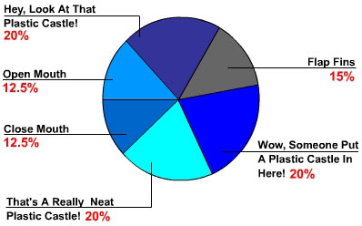
PIE CHART
Parts of a whole, percentages, fractions?
A Day in the Life of a Goldfish

Slide 24
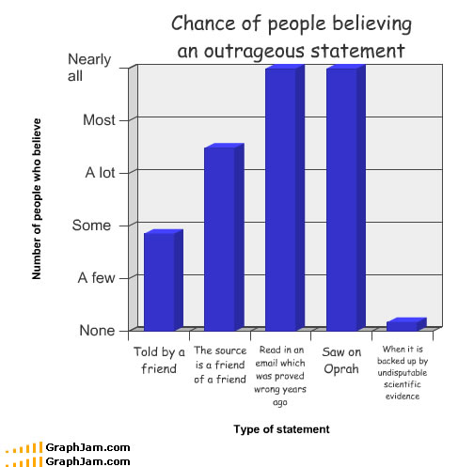
Comparing different categories?
Bar graph

Slide 25
Continuous
Standard measurements or ranges
Continuous data
Length, amounts, weight, time, temperature

Slide 26
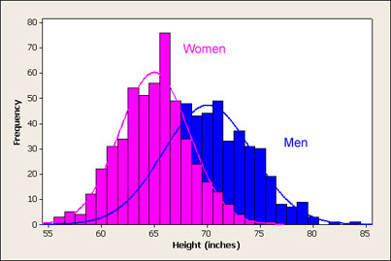
Compare data by dividing into intervals (a frequency distribution)?
Histogram

Slide 27
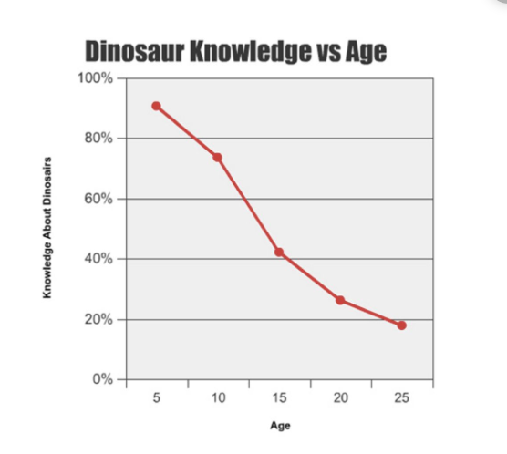
Determine cause and effect—trend between data points?
Line graph

Slide 28
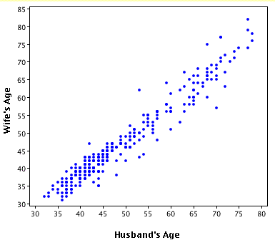
Determine correlation between variables—trend among all data points?
Scatterplot

Slide 29
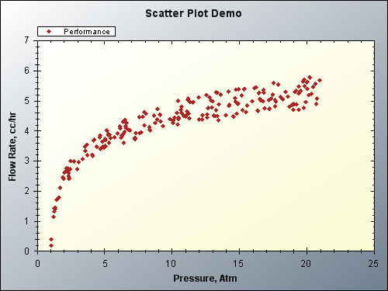

Slide 30
6. Analyze Data/ Draw Conclusions
Interpret your results and see what you learned from the experiment. Do your results support your hypothesis?

Slide 31
Writing a Conclusion
Restate the problem question which explains the reason for doing the lab.
Was hypothesis supported, not supported or inconclusive based on the data? Why?
What did the data say? What was the control group, IV, and DV? Describe the graph and any trends that are visible.

Slide 32
Possible causes of error (there is no experiment that will ever have none of these).
What are some “real world” applications of this experiment?
What are new questions that have come up as a result of this experiment? What are suggestions for further research?
Final summary statement: Answer the original question.

Slide 33
NEVER USE I, we, us, me, my, our, etc. –any pronouns—anywhere in a lab report.
Example: “We conducted this experiment over 4 days.” Should be: “This experiment was conducted over 4 days.”

Slide 34
7. Submit for Peer Review

Slide 35
Scientific Theory
A widely accepted explanation for something
Only formed if the experiment is repeated many times by many people, and the results are always consistent

