Slide 1
Systems

Slide 2
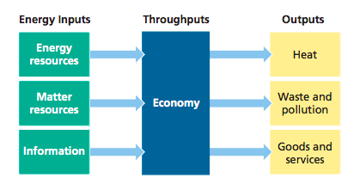
System: a set of components that function and interact in some regular way. (Ex: human body, a river, an economy…)
3 Key Components:
inputs from the environment
flows or throughputs of matter and energy within the system at certain rates
outputs to the environment

Slide 3
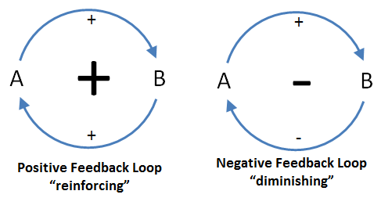
Feedback Loops: any process that increases (positive feedback) or decreases (negative feedback) a change to a system

Slide 4
Ted Ed Video Feedback Loops: How Nature Gets Its Rhythms
http://ed.ted.com/lessons/feedback-loops-how-nature-gets-its-rhythms-anje-margriet-neutel

