Slide 1
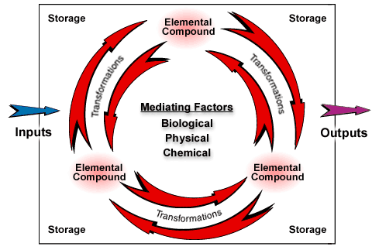
The elements and compounds that make up nutrients move continually through air, water, soil, rock, and living organisms in ecosystems and in the biosphere in cycles called biogeochemical cycles

Slide 2
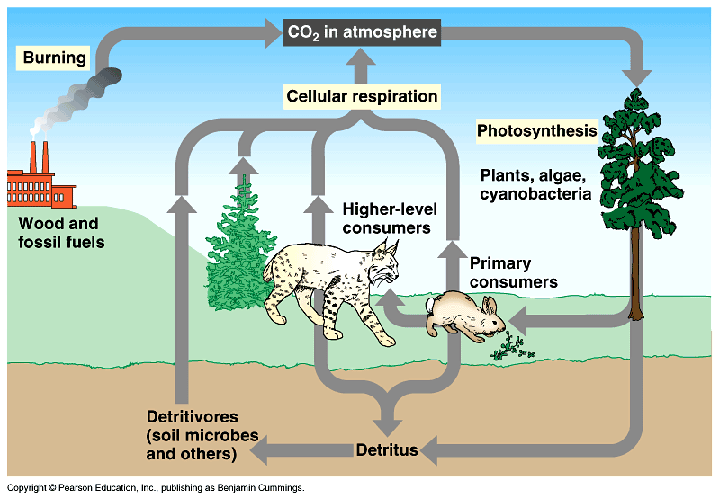
The Carbon Cycle

Slide 3
Carbon is the element of life
The concentration of carbon in living matter (18%) is 100 times greater than in the earth (0.19%)
For life to continue, carbon must be recycled

Slide 4
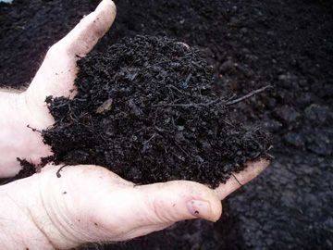
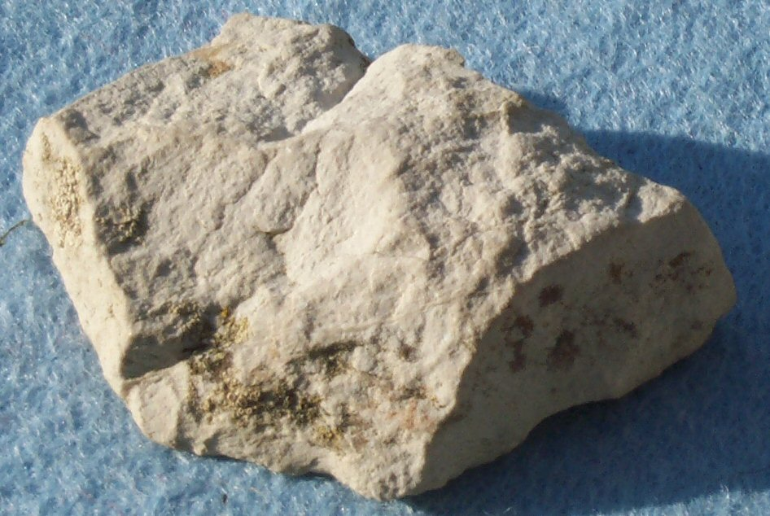
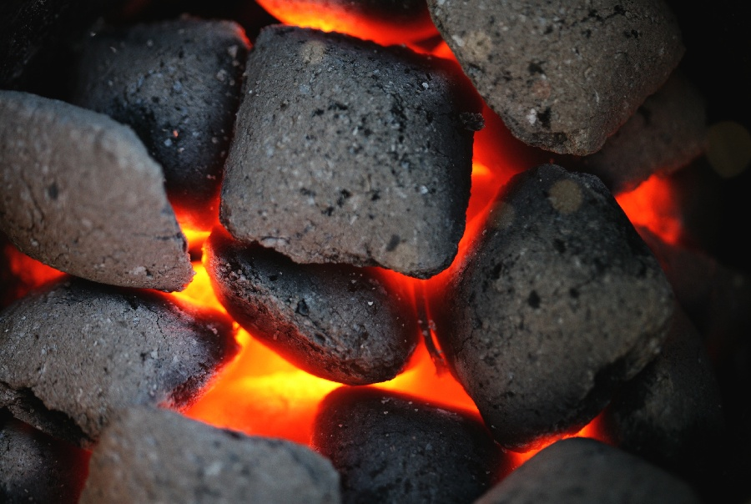
Carbon in the abiotic environment
Carbon dioxide (CO₂) in atmosphere
CO₂ dissolved in water—HCO₃⁻
Calcium carbonate rocks (limestone and coral)—CaCO₃
Deposits of coal, petroleum, and natural gas from fossilized organisms
Dead organic matter (humus)

Slide 5
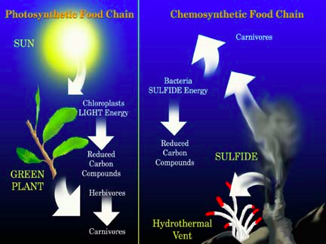
Carbon enters the biotic world through…
Photosynthesis (plants/algae/cyanobacteria)
CO₂ + H₂O → C₆H₁₂O₆ + O₂
Chemosynthesis (archaebacteria)
<1% of the carbon

Slide 6
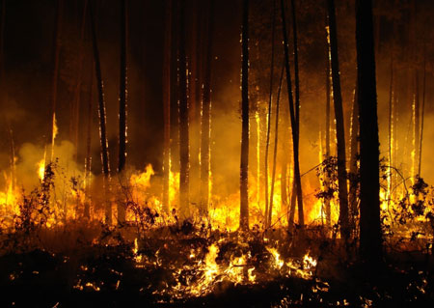
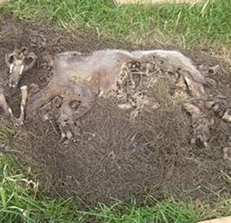
Carbon returns to the atmosphere and water by…
Cellular respiration (reverse of photosynthesis)
Burning
Decay
produces CO₂ if oxygen is present
Produces methane (CH₄) if oxygen is not present

Slide 7
Uptake and Return of CO2 are not in balance
Carbon dioxide concentration (ppm)
Seasonal fluctuations; 2012 = 397 ppm
No change in Greenland glacial ice until 300 years ago (Industrial Revolution)

