Slide 1
primary productivity
Rate at which autotrophs synthesize new biomass
In other words, how fast are the producers (plants and algae) photosynthesizing? How much is being produced and how fast?
http://graphics.stanford.edu/courses/cs448c-00-fall/plants.jpg

Slide 2
gross primary productivity (GPP)
Total amount of organic material (glucose) fixed by autotrophs during photosynthesis (or chemosynthesis)

Slide 3
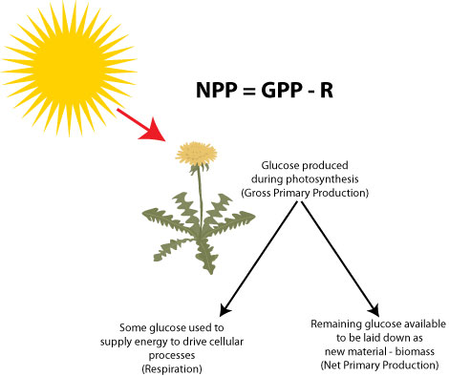
net primary productivity (NPP)
Rate of production of biomass potentially available to consumers (herbivores)
Not all of the GPP goes into making biomass (growth and reproduction)
Some productivity is used in the autotroph’s own life processes (respiration) and this energy is ultimately lost as heat
So, NPP = GPP - R

Slide 4
You might see it expressed as:
Energy per unit area per unit time ex: J/m²/yr
Biomass added per unit area per unit time ex: g/m²/yr
Remember, if time is involved, you are talking about rates

Slide 5
Factors that Affect Primary Productivity
Solar radiation: quality/quantity of light
2. Temperature:
­In general, warmer temps correlate to higher productivity
However, high temperatures can denature enzymes;
Also, there may be high productivity in cold ocean waters due to upwelling of nutrients
3. CO₂
4. H₂O

Slide 6
More Factors
Nutrients: ­any food, chemical element or compound required by an organism to live, grow and reproduce, e.g. iron, magnesium, calcium, nitrate, phosphate, silicate
--Algal blooms are often caused by an oversupply of a limiting nutrient, like phosphates from detergents in our lakes and rivers
6. Herbivory: grazing of autotrophs by herbivores can ⇓ productivity (e.g. sea urchins ⇓ ing productivity of kelp forest habitat)

Slide 7
Therefore…
The least productive ecosystems are those with limited heat and light energy, limited water and limited nutrients
The most productive ecosystems are those with high temperatures, lots of water, light and nutrients

Slide 8
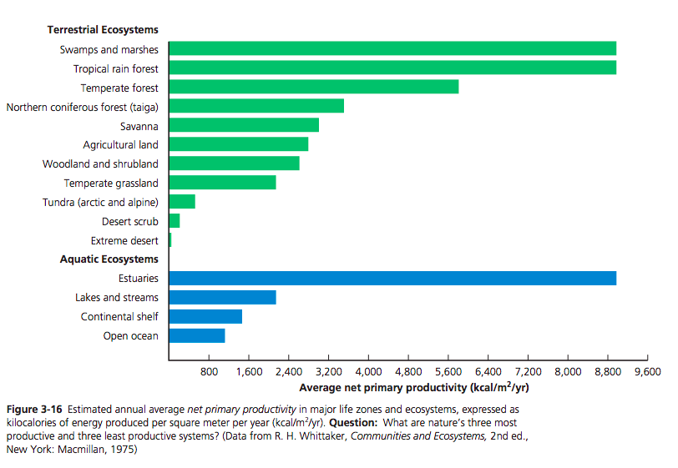

Slide 9
Humans use, waste, or destroy 20-30% of the earth’s NPP We make up <1% of the biomass of the earth’s consumers.

Slide 10
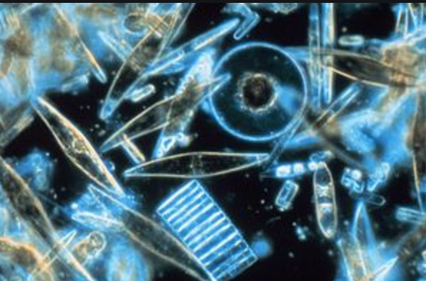
Marine producers
Algae
Macroalgae (seaweed/kelp)
Phytoplankton (diatoms, dinoflagellates, etc)
→ 40% of Earth’s O2! Thank you, phytoplanktons!
Plants
The only true marine plants are seagrasses (may count mangroves)
Bacteria
Cyanobacteria (blue-green algae)
Chemosynthesizers (no light needed)

Slide 11
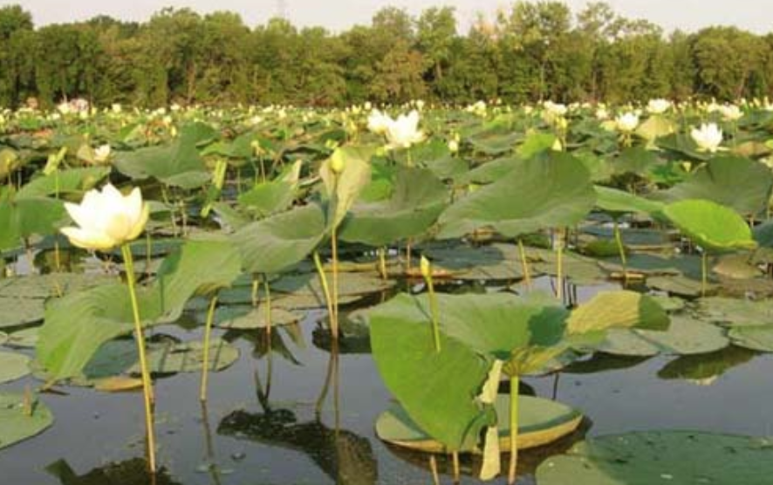
Freshwater producers
Algae—macro and phyto
Aquatic Plants
Water lilies, cattails, duckweed, etc
Bacteria
Cyanobacteria (blue-green algae)

